Slide 1



Slide 2


We would like to begin this presentation by acknowledging we are on the lands of the Treaty 7 First Nations.
We acknowledge the many First Nations peoples whose footsteps have marked these lands for generations and pay respect to the land that we all live, work, and play.

Slide 3
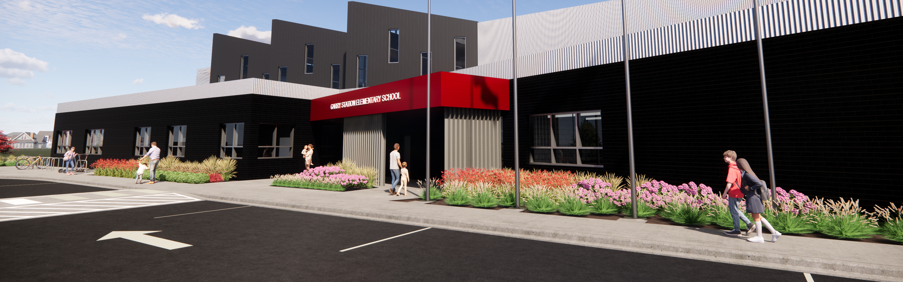
Requirement for a Capital Plan
School Divisions are required to submit a Three-Year Capital Plan by April 1st each year.
The Capital Plan is reviewed by Alberta Education to assess needs for:
New Schools to address enrolment pressures
Modernization Projects to modernize learning environments for functionality and programming, improve building conditions, enrolment pressures, and address health and safety concerns.
School Divisions are required to rank their projects by priority.

Slide 4
Our Facilities
13 Elementary Facilities
4 Middle Schools
4 High Schools
Does not include 3 Christian School Facilities that are owned by their societies

Slide 5
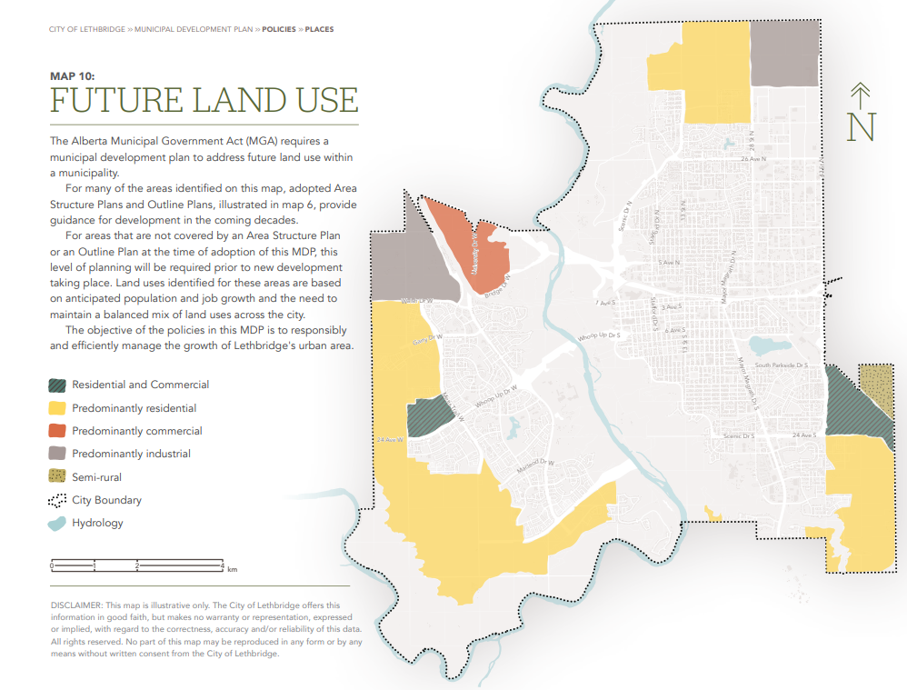
Drivers for New Schools
One of the most significant drivers for a new school is the pace of development within the city.
This development influences enrolment growth in the city.
Although there is development in all areas of the city, west Lethbridge has seen significant growth in the last several years.
As the Future Land Use Map as provided by the City of Lethbridge illustrates, west Lethbridge has the most significant area for future growth into the future.

Slide 6
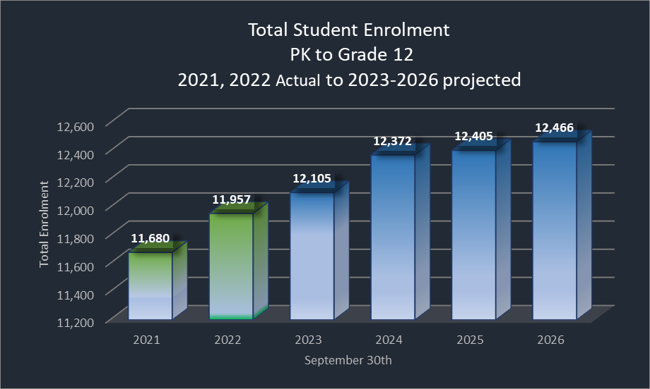
Demographics
The enrolment projections are on the conservative side due to unknown impacts of migration and housing developments given the current economic climate. However as per Statistics Canada, Canadian Municipal Area (CMA) population counts as of July 2022, reported that the CMA for the Lethbridge region is 133,064 which is an increase of 2976 or 2.3% from the prior year. With the economic development that has been occurring in Lethbridge and the latest CMA population growth data, it is anticipated that the potential enrolment growth could be greater than what is projected in this capital plan.

Slide 7
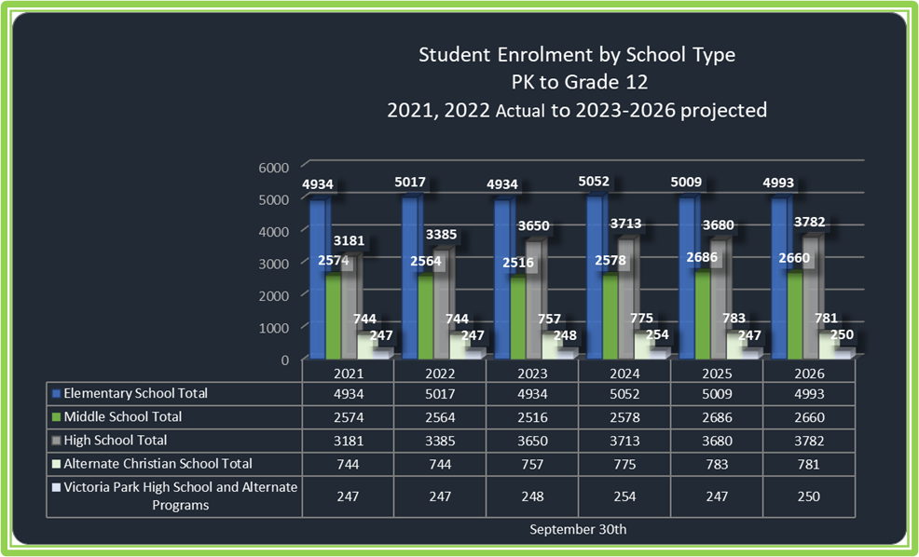

Demographics

Slide 8
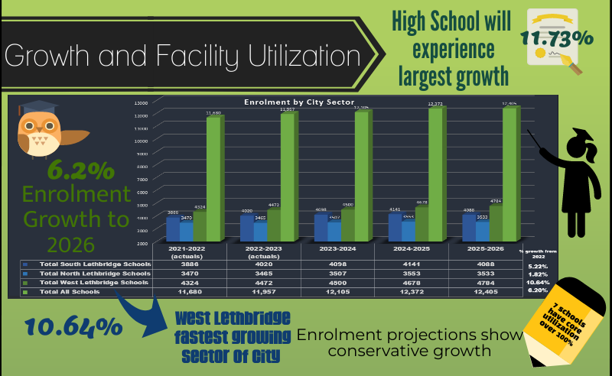

Slide 9

Recent New School Builds
School | First Year Requested in Capital Plan | Year Approved | Opening Capacity | Opened
Coalbanks Elementary | 2006 | 2014 | 500 students | August 2017
Senator Joyce Fairbairn Middle School | 2008 | 2015 | 799 students | August 2018
Dr. Robert Plaxton Elementary School | 2008 | 2017 -Planning 2018-Construction | 600 students | August 2021
West Lethbridge Elementary School in Garry Station | 2008 | 2021 | 610 with approval for 12 modulars to 900 students | Scheduled for Sept 2025
This Photo by Unknown Author is licensed under CC BY-NC-ND

Slide 10
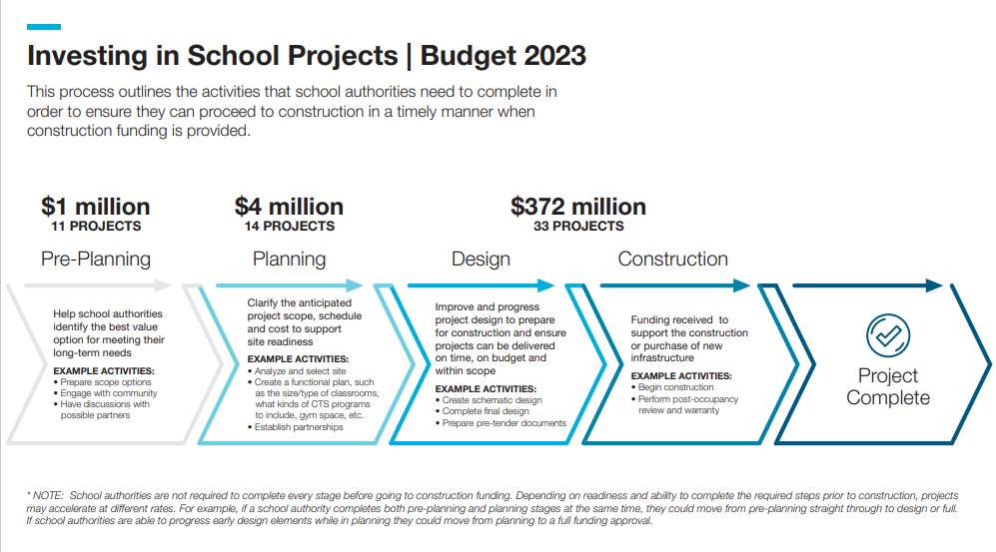
The Path to Project Funding
Galbraith Modernization received preplanning funds in 2021
Galbraith Modernization Planning Funding announced, February 2023
Source Alberta Education, 2023

Slide 11
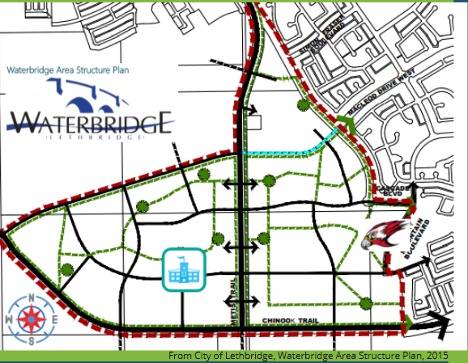
New K-5 Elementary School Request
Enrolment Pressures are the greatest drivers for the construction of new schools.
In the south end of west Lethbridge, as illustrated in the Future Land Use Map, future growth will be the greatest.
Coalbanks Elementary School and Dr. Probe School are the nearest to future development.
Coalbanks has capacity of 107% and Dr. Probe at 73%. Both schools will continue to see enrolment pressures as the south end of west Lethbridge continues to grow. Both schools have 13 modular classrooms each and already experience pressure on core spaces.
The school would likely go in the future growth area of Waterbridge, not far from Senator Joyce Fairbairn. Development of this area is still years away. Therefore, although this is our number one new school priority it is not the number one priority in the Capital Plan.
This school has been in the capital plan request since 2008.

Slide 12

Planning Funds Request
Continued enrolment growth in west Lethbridge (elementary and high school biggest challenges)
Currently 3 out of 4 elementary schools require modernization
1625 elementary student spaces are in modular classrooms (3, 600 student schools)
Explore opportunities for future space, partnerships
To study west Lethbridge as it is a complicated puzzle

Slide 13
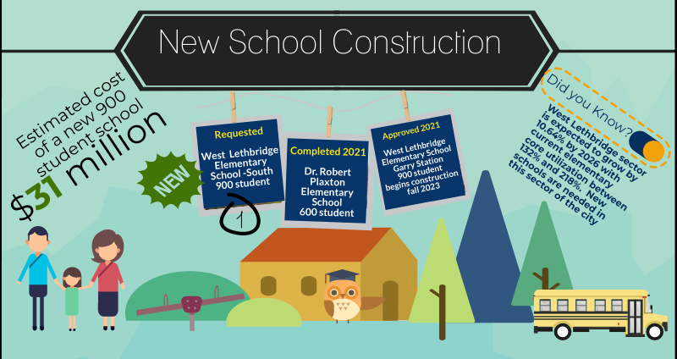

Slide 14
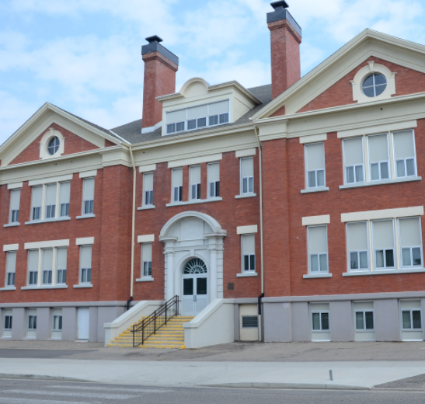
School Modernization
There are 9 schools requested for modernization.
Drivers for consideration for modernization include:
Health and Safety
Building Condition
Program Delivery
Utilization
Infrastructure Performance
Galbraith is 111 years old and the oldest school in the Division. Modernization of Galbraith is the #1 priority for a major modernization. Alberta Education provided planning funds for assessing high level needs for a modernization. A visioning session was held with Galbraith staff and parent community on May 11th and 12th 2022. The report was provided to Alberta Education to supplement the Three-Year Capital Plan. In February 2023, School Planning Funds have been announced to further plan for a modernization of Galbraith.

Slide 15
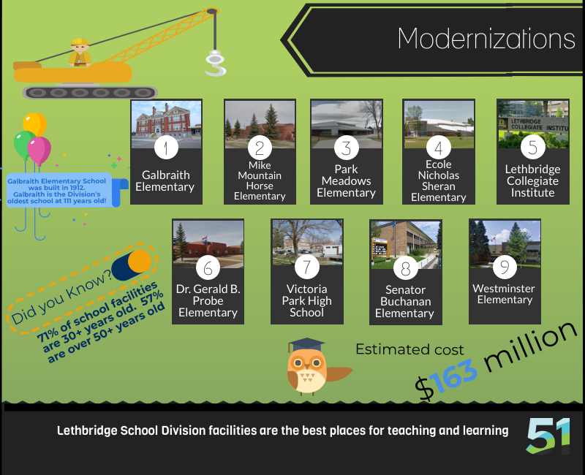
Galbraith and LCI are major modernizations due to the nature and significant scope of work required.
The other schools are considered minor modernizations as upgrades have been performed over the last few years through IMR and CMR initiatives

Slide 16

School Planning Funds announced in February 2023 for Galbraith Elementary School Modernization

Slide 17
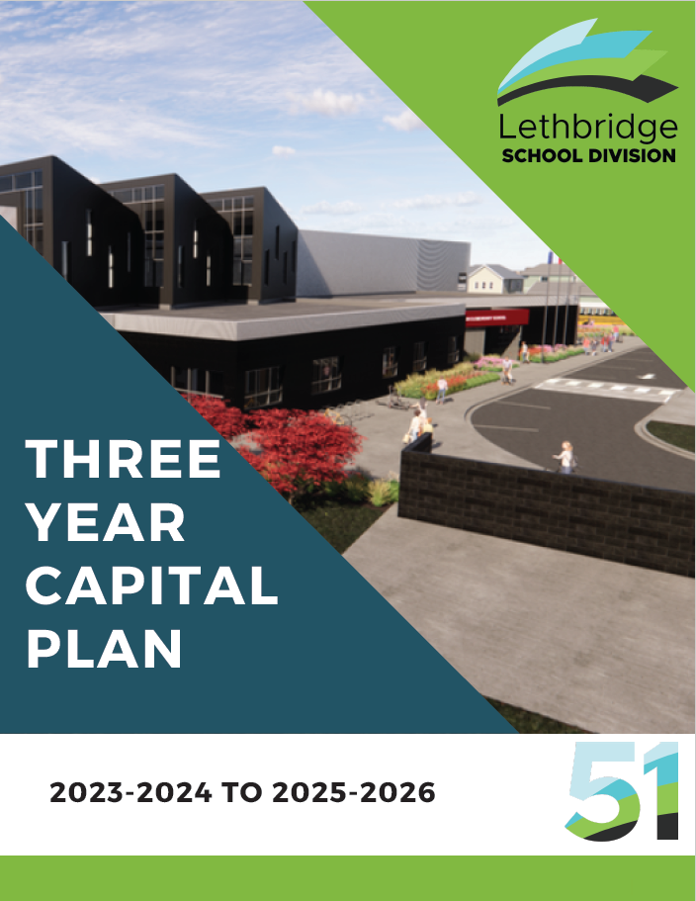
For more information
See the 134-page Three Year Capital Plan on the Division website.
This document includes detailed information related to division demographics, growth, and school enrolment and community profiles.
Further details about the requested projects in the plan begin on page 40.

