Slide 1
Study in Lethbridge 来我们莱桥学习
Succeed with us!
与我们一起走向成功

Slide 2
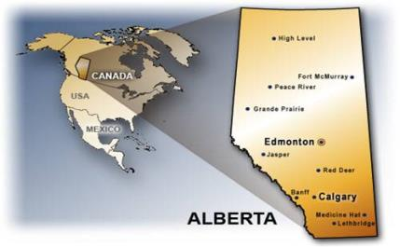
Where are we? 我们在哪里？
Alberta is in the western part of Canada, just east of the Rocky Mountains.
亚伯达位于加拿大的西部，落基山脉的东边
Lethbridge is in the southern part of Alberta
莱桥位于亚伯达南部
Notes:
Second province from the Pacific Ocean
Western border is the Rocky Mountains
1 hour to Rocky Mountains to the West
1 hour to US border to the South

Slide 3
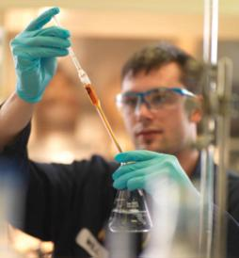
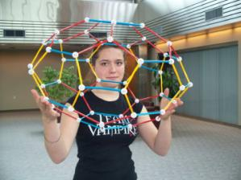
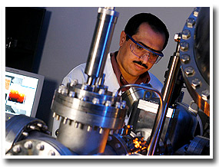
Why study in alberta? 为什么要来亚伯达学习
One of the strongest economies in North America
北美经济最强之一
Highest per capita family income in Canada – high quality of life
加拿大家庭人均收入最高-生活质量高
Lowest unemployment rate in Canada
在加拿大，失业率最低
Government invests heavily in education
政府大力投资教育
No provincial sales tax – less expensive to live in Alberta.亚伯达， 没有省的销售税，生活费用低
Notes:
In Canada, education is the responsibility of each province.
Province of Alberta puts a great deal of money into education – low teacher/student ratio, up-to-date school buildings and technology
Sales tax in BC = 7%, in Ontario = 8%
Much less expensive to purchase clothing, eat out in a restaurant in Alberta
Less expensive to educate a student, so we can pass that saving on to our students’ families.

Slide 4
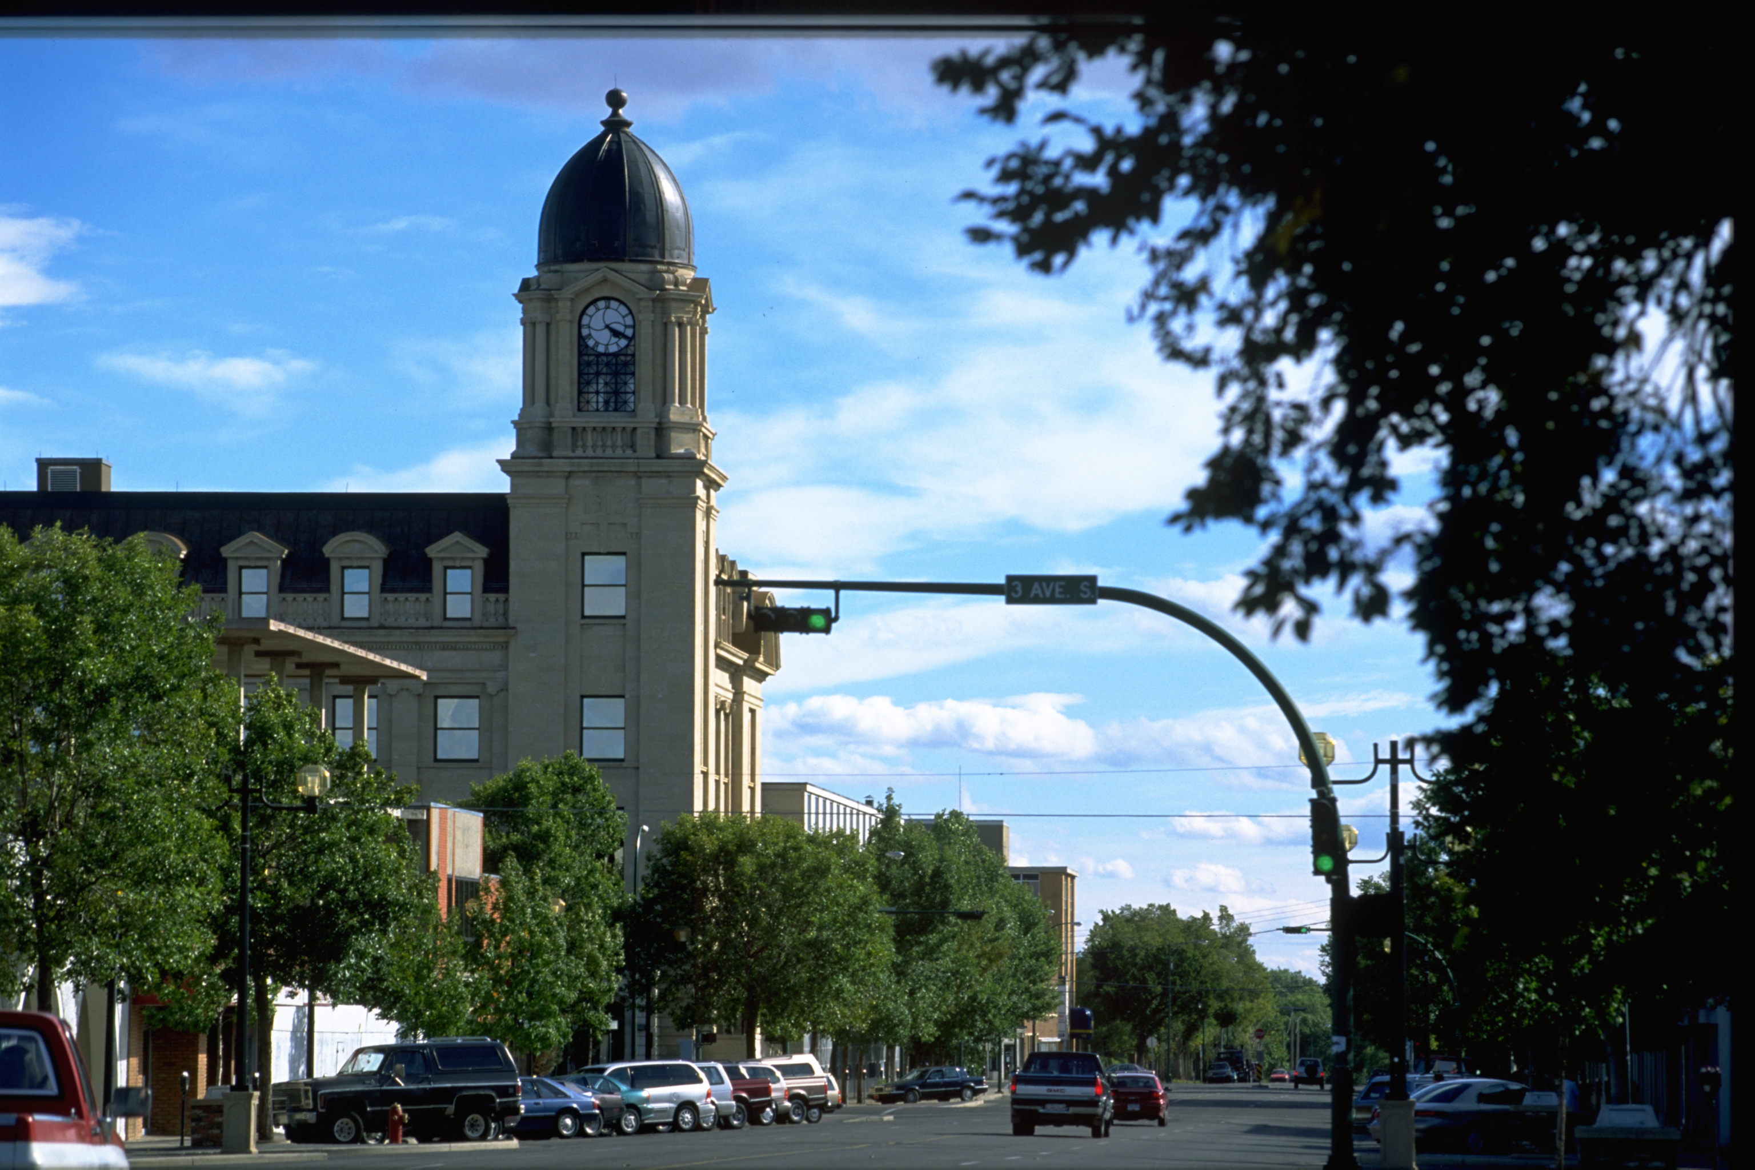
Lethbridge, Alberta 亚伯达，莱桥
Southern Alberta – farming, education, research, industry, oil, natural gas
亚伯达南部，-农业，教育，研究，工业，石油，天然气
Weather – Chinooks
气候，-季风
Excellent educational programs for international students – high school, college, university
高中，学院，大学，给国际学生提供极佳教育课程
Notes:
Very rich agricultural land with irrigation – grow grains, corn, canola, potatoes for McCain.
Well-educated citizens – College and University, 2 research stations: Animal Diseases Research Institute and Agricultural Research and Development Centre
Industry – McCain French fries, Pratt and Whitney airplane engines

Slide 5
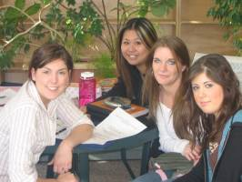
High quality of life 生活质量高
Between 90 000 - 100 000 residents: safe, accessible
人口在9万至10万之间。
Many parks and recreation facilities
很多公园和休息场数
Shopping malls, art galleries, museums, restaurants
商城，艺术馆，博物馆，餐馆
Notes:
Small city, but has everything that larger centres have.
Public transit makes it easy for students to get around the city.
Many cultural activities throughout the year, strong arts scene

Slide 6
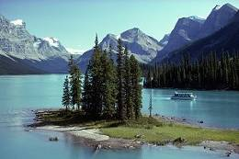
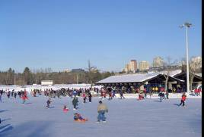
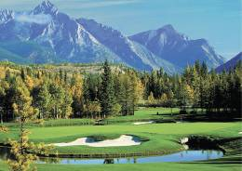
High quality of life 生活质量高
Close to the Rocky Mountains
靠近落基山脉
Clean air and water
清洁的水和空气
A climate with four seasons
四季分明
Notes:
Families often go to the mountains on the weekend – Waterton Lakes (75 minutes from Lethbridge) is a World Heritage site.
Blue skies 320 days/year – no pollution, no need to wear a mask
Fresh, clean water – can drink from the tap

Slide 7
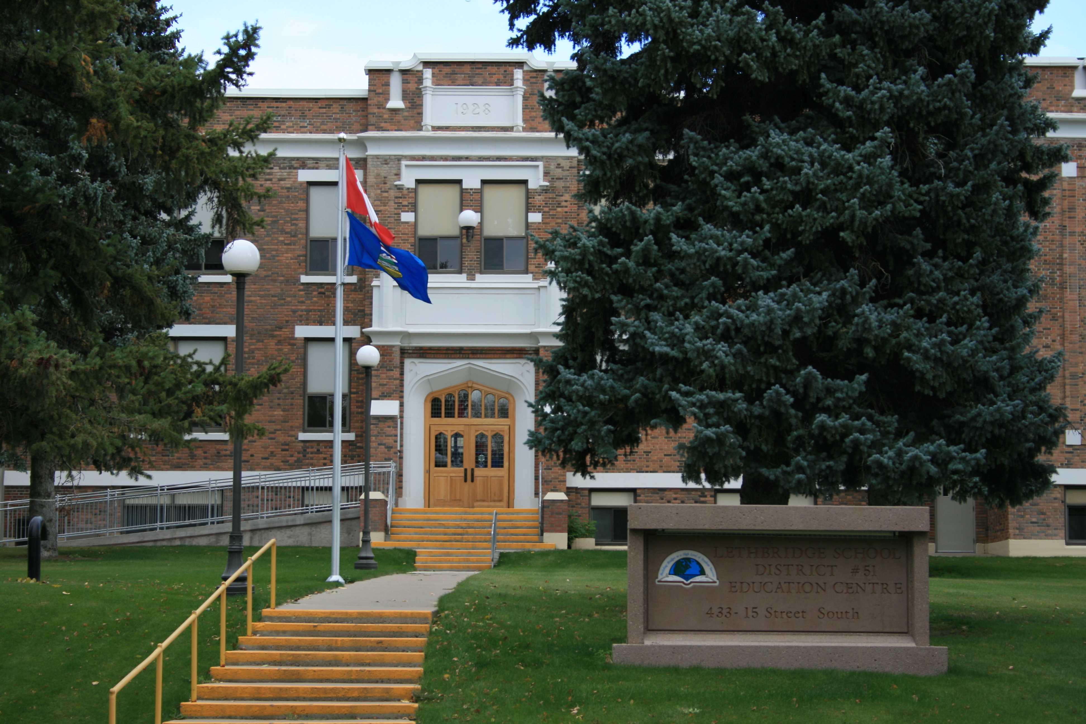
Lethbridge School District 莱桥学区
Four high schools
四所高中
High speed WIFI
无线网络
Excellent academic and co-curricular programs
优秀的学术和课外计划
Safe, clean community
社区安全，清洁
Notes:
This photo is my office building.
Four high schools which take international students– 3 regular, 1 protestant faith-based
WIFI with some blocks
All schools have excellent programs for academics and clubs and sports
We employ our own custodians who take great pride in keeping our buildings clean and in good repair.

Slide 8
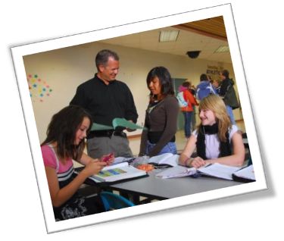
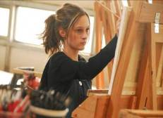
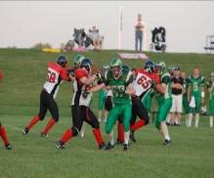
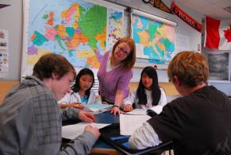
Focus on students 注重学生
Government-certified, enthusiastic teachers who challenge their students
政府认证的，热情挑战学生的老师们
Support systems in place – International Services Office, Vice Principal in each school, Advisor
协助系统健全，-国际服务办公室，每个学校有付校长及顾问，
Notes:
The University of Lethbridge is renown across Canada as being the best place to study education – we hire many of their graduates.
U of L also has a graduate program in education – most of our teachers have 5 years of university, many also have a masters degree.
All teachers in Alberta must be government-certified.
Students have a great deal of support in our schools – my office, VP in each school, every student has an advisor to check with every day.

Slide 9
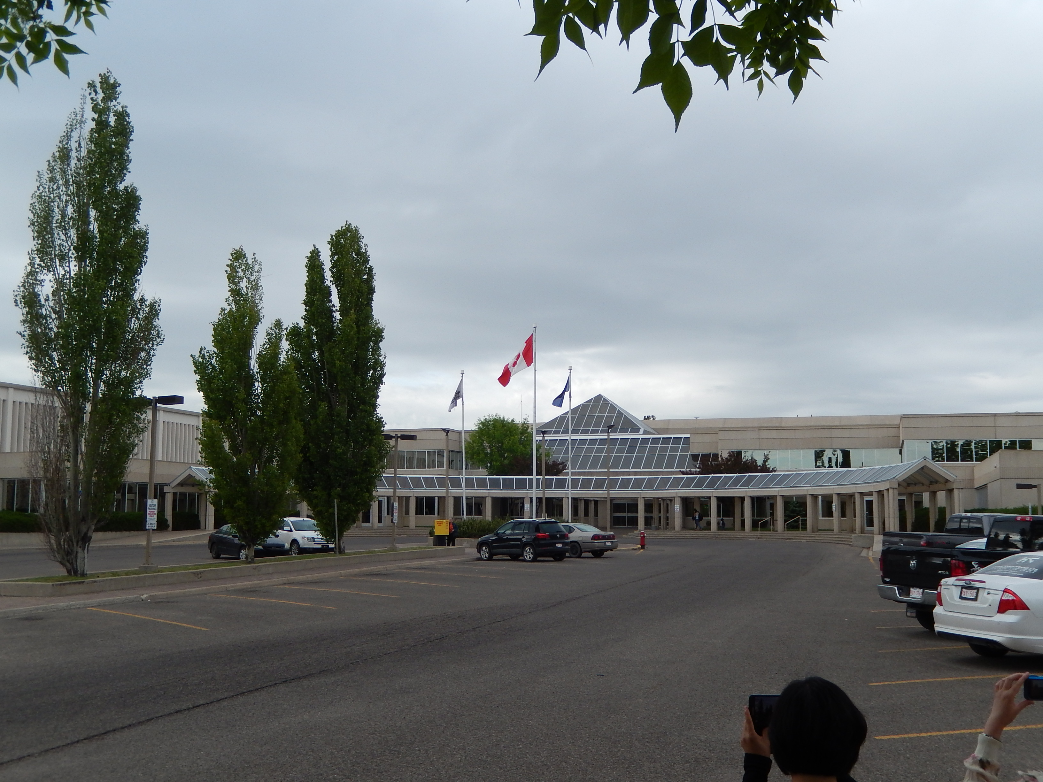
After graduation 毕业之后
学
An Alberta high school diploma is accepted in colleges and universities world-wide.
全球的学院，大学，都接受亚伯达高中毕业证书
offers many programs for international students:
为国际学生提供很多课程
agriculture, automotives, criminal justice, criminal justice, early childhood education, fashion design, health care aide, interior design, massage therapy, multimedia production…
农业，汽车修理，刑事司法，幼儿教育，时尚设计，医疗保健，室内设计，按摩疗法，多媒体等等
Lethbridge College
莱桥学院
Notes:
High school graduates can go on to college or university in Lethbridge.
Unusual for a city of our size to have both a university and a college.
College for vocational training mostly.
Can also do first 2 years of business and nursing, then transfer to the university.

Slide 10
After graduation 毕业之后
学
An Alberta high school diploma is accepted in colleges and universities world-wide.
全球的学院，大学，都接受亚伯达高中毕业证书
Offers transfer programs to the university in
Nursing and Business Administration
护士和工商管理，学分转入大学
Requires 100 high school credits, including English 30-2 for admission 护士和工商管理需要高中一百个学分，包括英语30-2，就可以入学
Lethbridge College
莱桥学院
Notes:
High school graduates can go on to college or university in Lethbridge.
Unusual for a city of our size to have both a university and a college.
College for vocational training mostly.
Can also do first 2 years of business and nursing, then transfer to the university.

Slide 11
After graduation 毕业之后
The University of Lethbridge
莱桥大学
Offers undergraduate degrees in Humanities, Sciences, Social Sciences, Education (teaching), Fine Arts, Health Sciences, and Management
提供人文，社会科学，教育（教学），美术，健康科学，及管理的本科学位
Requires 100 high school credits and English and Math 30-1 for admission.入学要求高中一百个学分，和英语，数学30-1
Notes:
World-renown for work in neuroscience, and best in Canada for Education.
Offers undergraduate, masters, and PhD programs.

Slide 12
After graduation 毕业之后
The University of Lethbridge
莱桥大学
Offers PhD programs in Sciences and Education.
科学教育的博士课程
Offers preparation programs to transfer for medicine, pharmacy, dentistry, engineering
提供医学，药学，口腔，工程预备课程
Offers graduate (Masters) programs in Arts, Counselling, Education, Fine Arts, Music, Nursing, Science, and Management
提供美术，咨询，教育，音乐，护士，科学管理硕士课程
Notes:
World-renown for work in neuroscience, and best in Canada for Education.
Offers undergraduate, masters, and PhD programs.

Slide 13
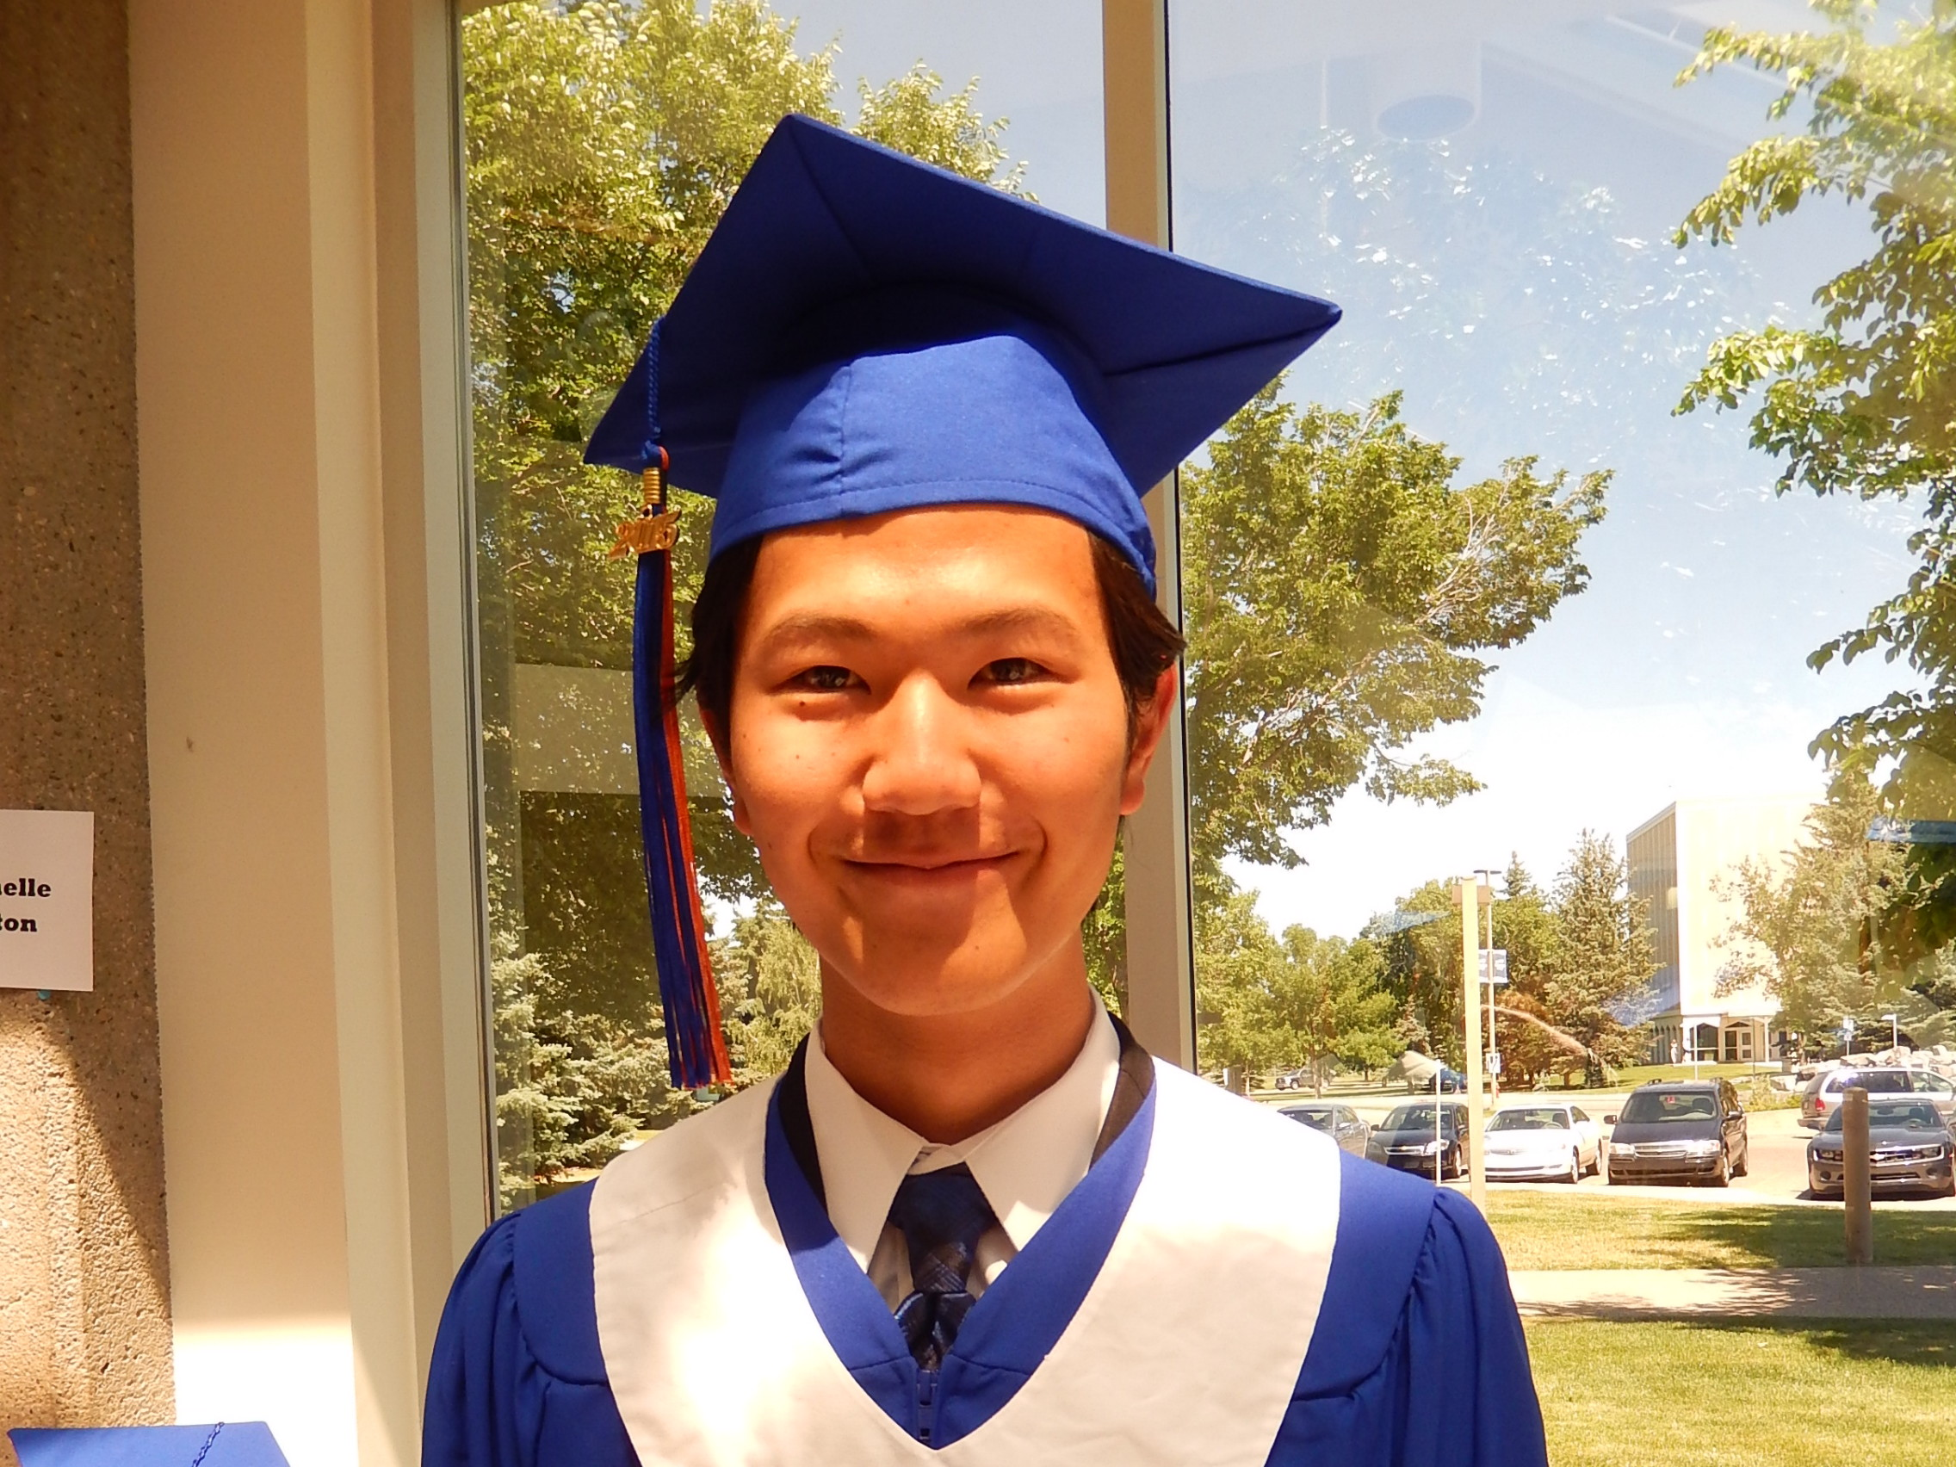
WHERE ARE OUR STUDENTS NOW? 现在的学生在哪里？
In the past 3 years, every international student who has come to Lethbridge to study, with the intention to graduate, has successfully graduated with a high school diploma from Alberta. We have a 100% success rate which we attribute to excellent teaching, good support, and personal service.
过去三年中，来我们莱桥学习的每一位国际学生，都拿到了我们亚伯达省的高中毕业证书。鉴于我们优秀的教育，团队支持，个人服务，我们的成功率百分之百。
Last year, we had five graduates. They are all currently enrolled in colleges or universities in Canada, the United States, or Japan.
去年，我们有5位毕业生，都成功录取于加拿大，美国，日本的大学
Yohane was accepted into the Sophia University in Japan – the third best private university in Japan! 育晗娜就是被成功录取于日本苏菲亚大学，日本名列前三名的顶尖大学。
Notes:
Excellent graduation rate.
Our graduates go on to study in North America and back home.

Slide 14
Chinook high school 季风高中
Our newest high school
我们最新的高中
State of the art media centre for presentations and theatre productions
演讲和舞台服务艺术媒体中心
Many young staff members who love to travel and meet new people.
许多爱旅行的年轻员工，结识新人
University preparation program
大学的预备课程
Notes:
About 5 years old.
In a new development in West Lethbridge.
New houses and businesses opening up nearby.

Slide 15
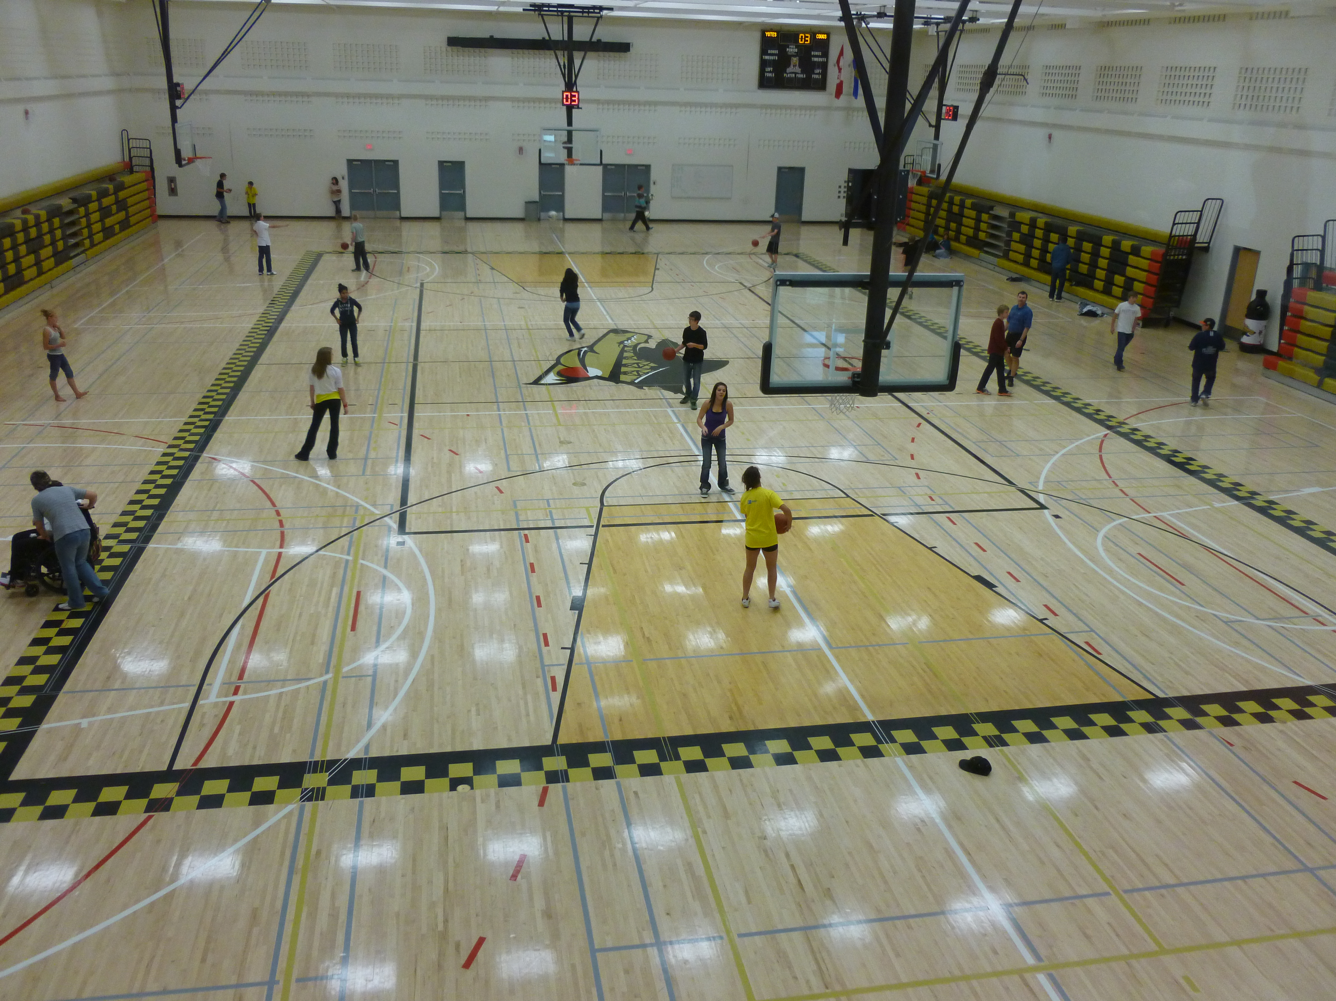
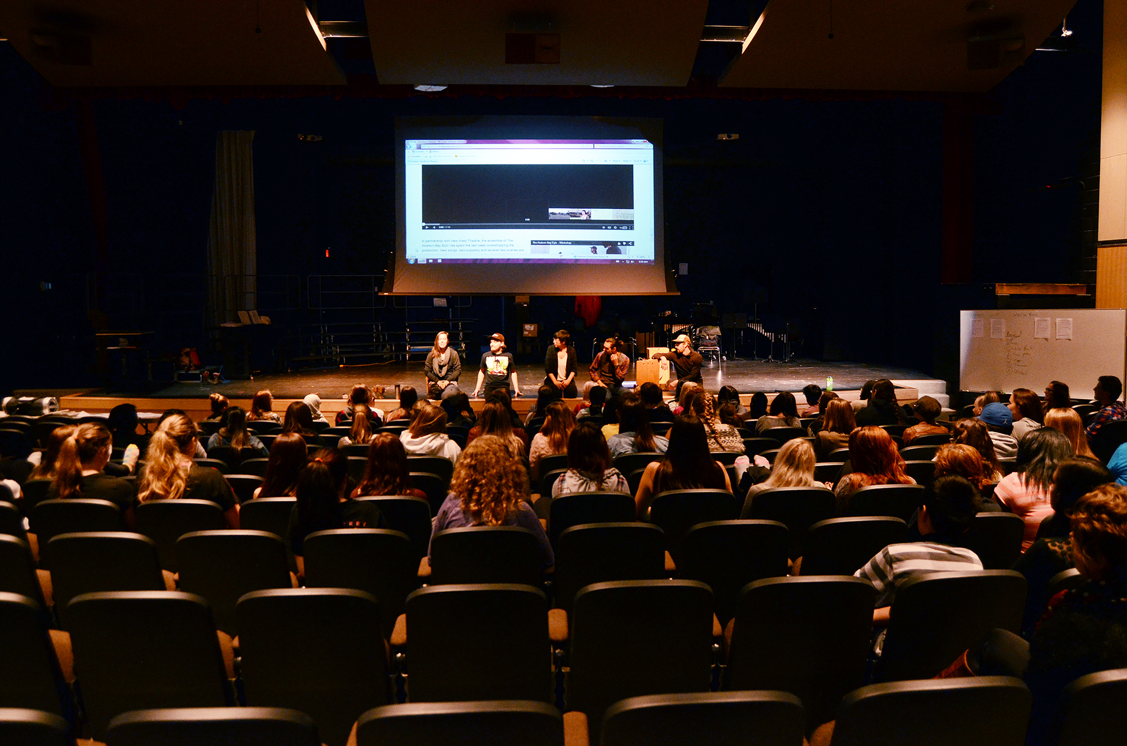
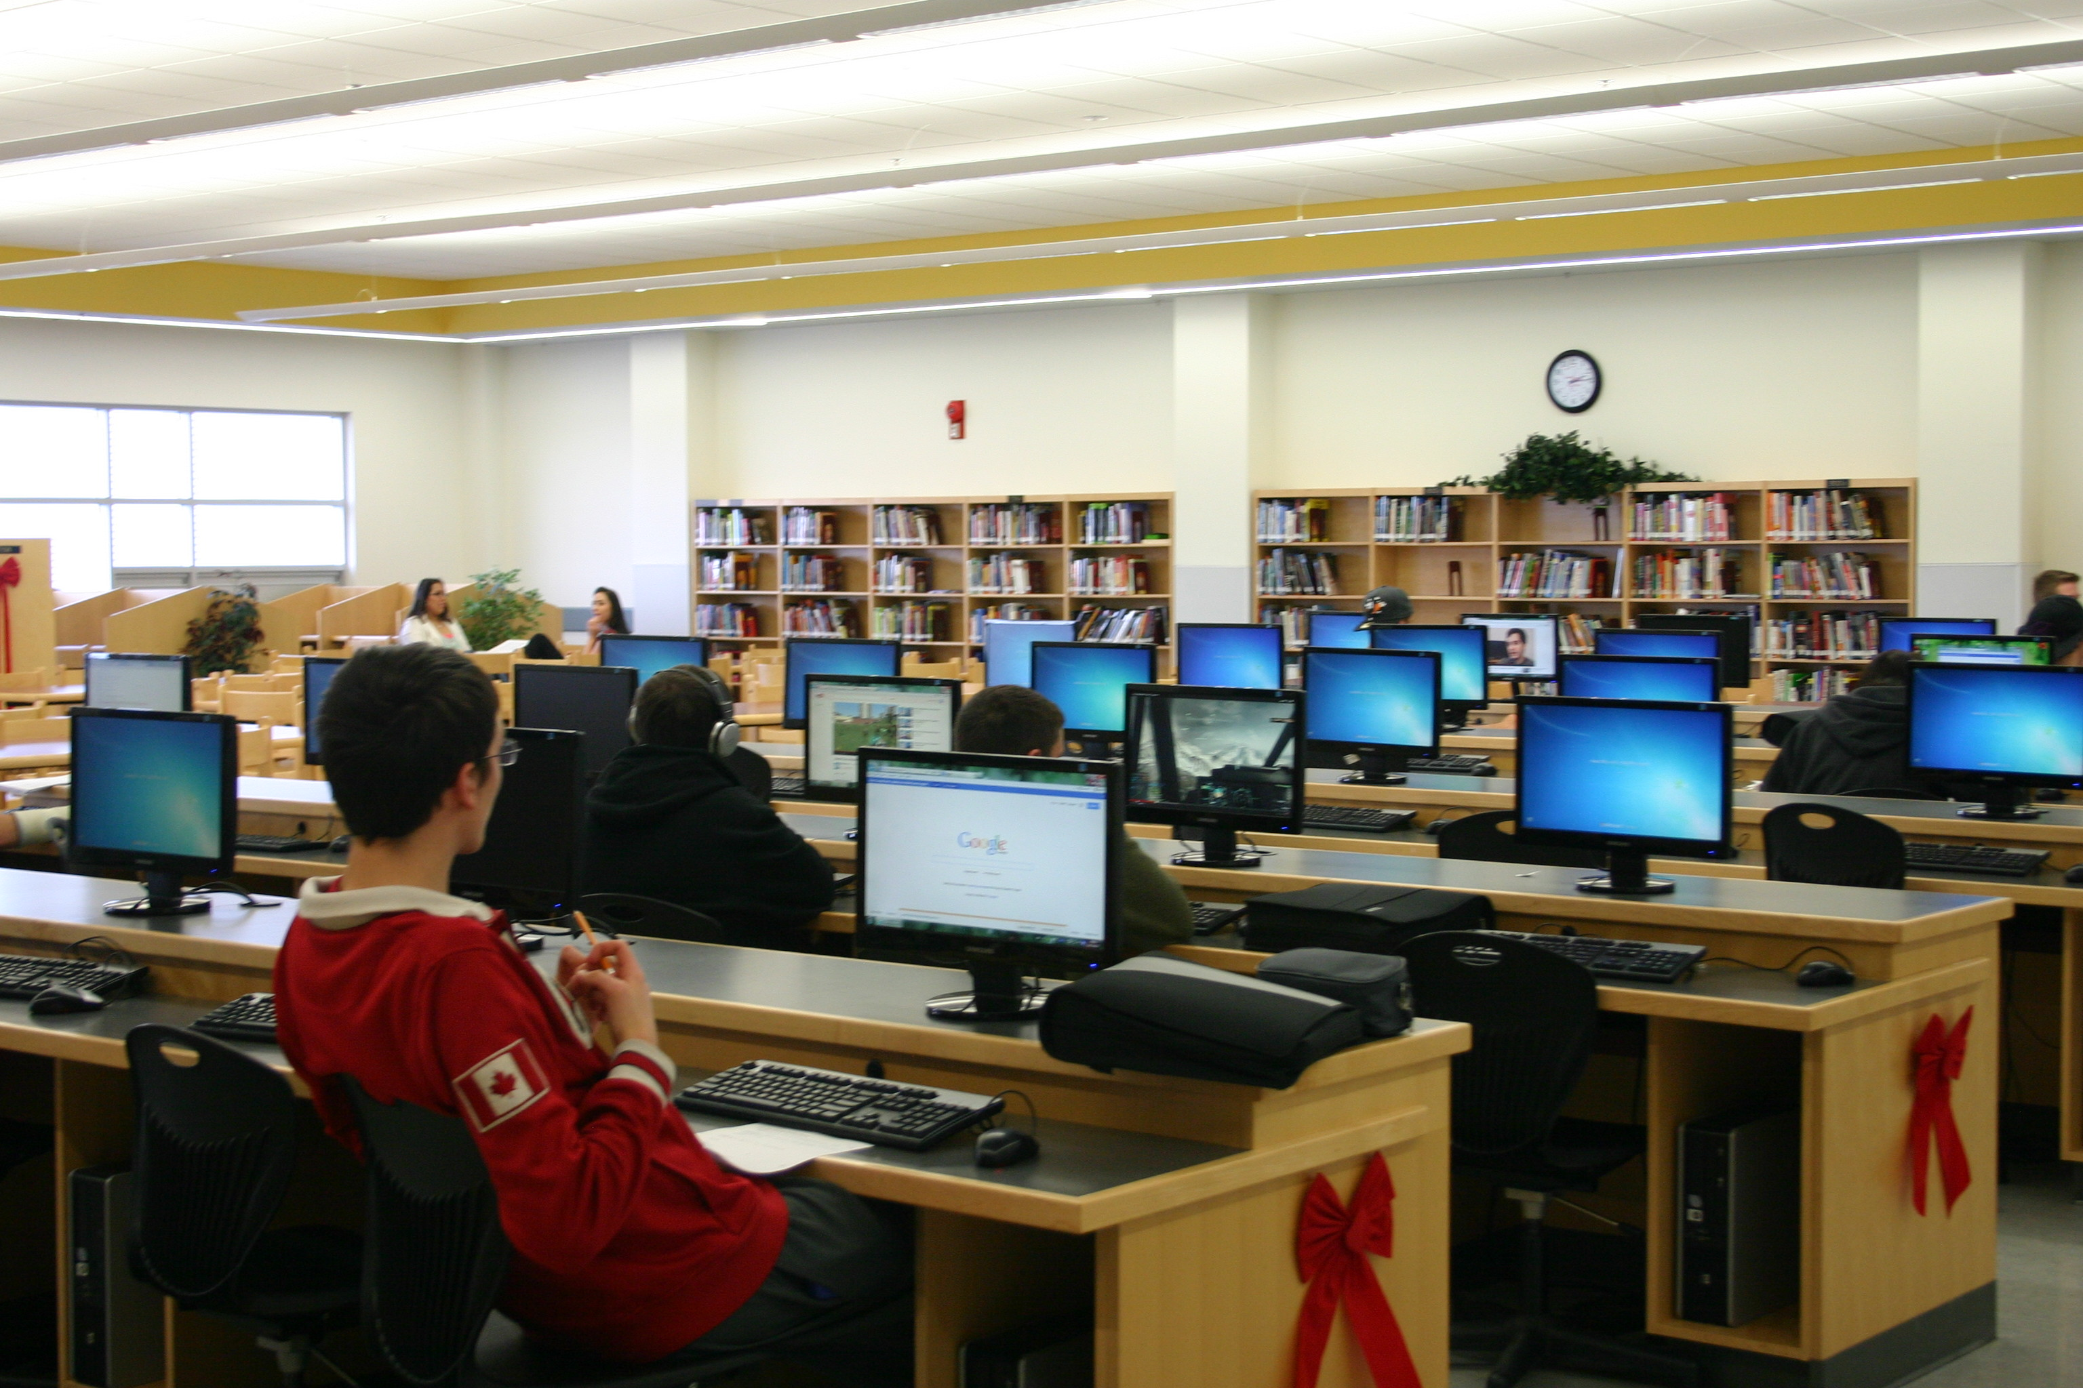
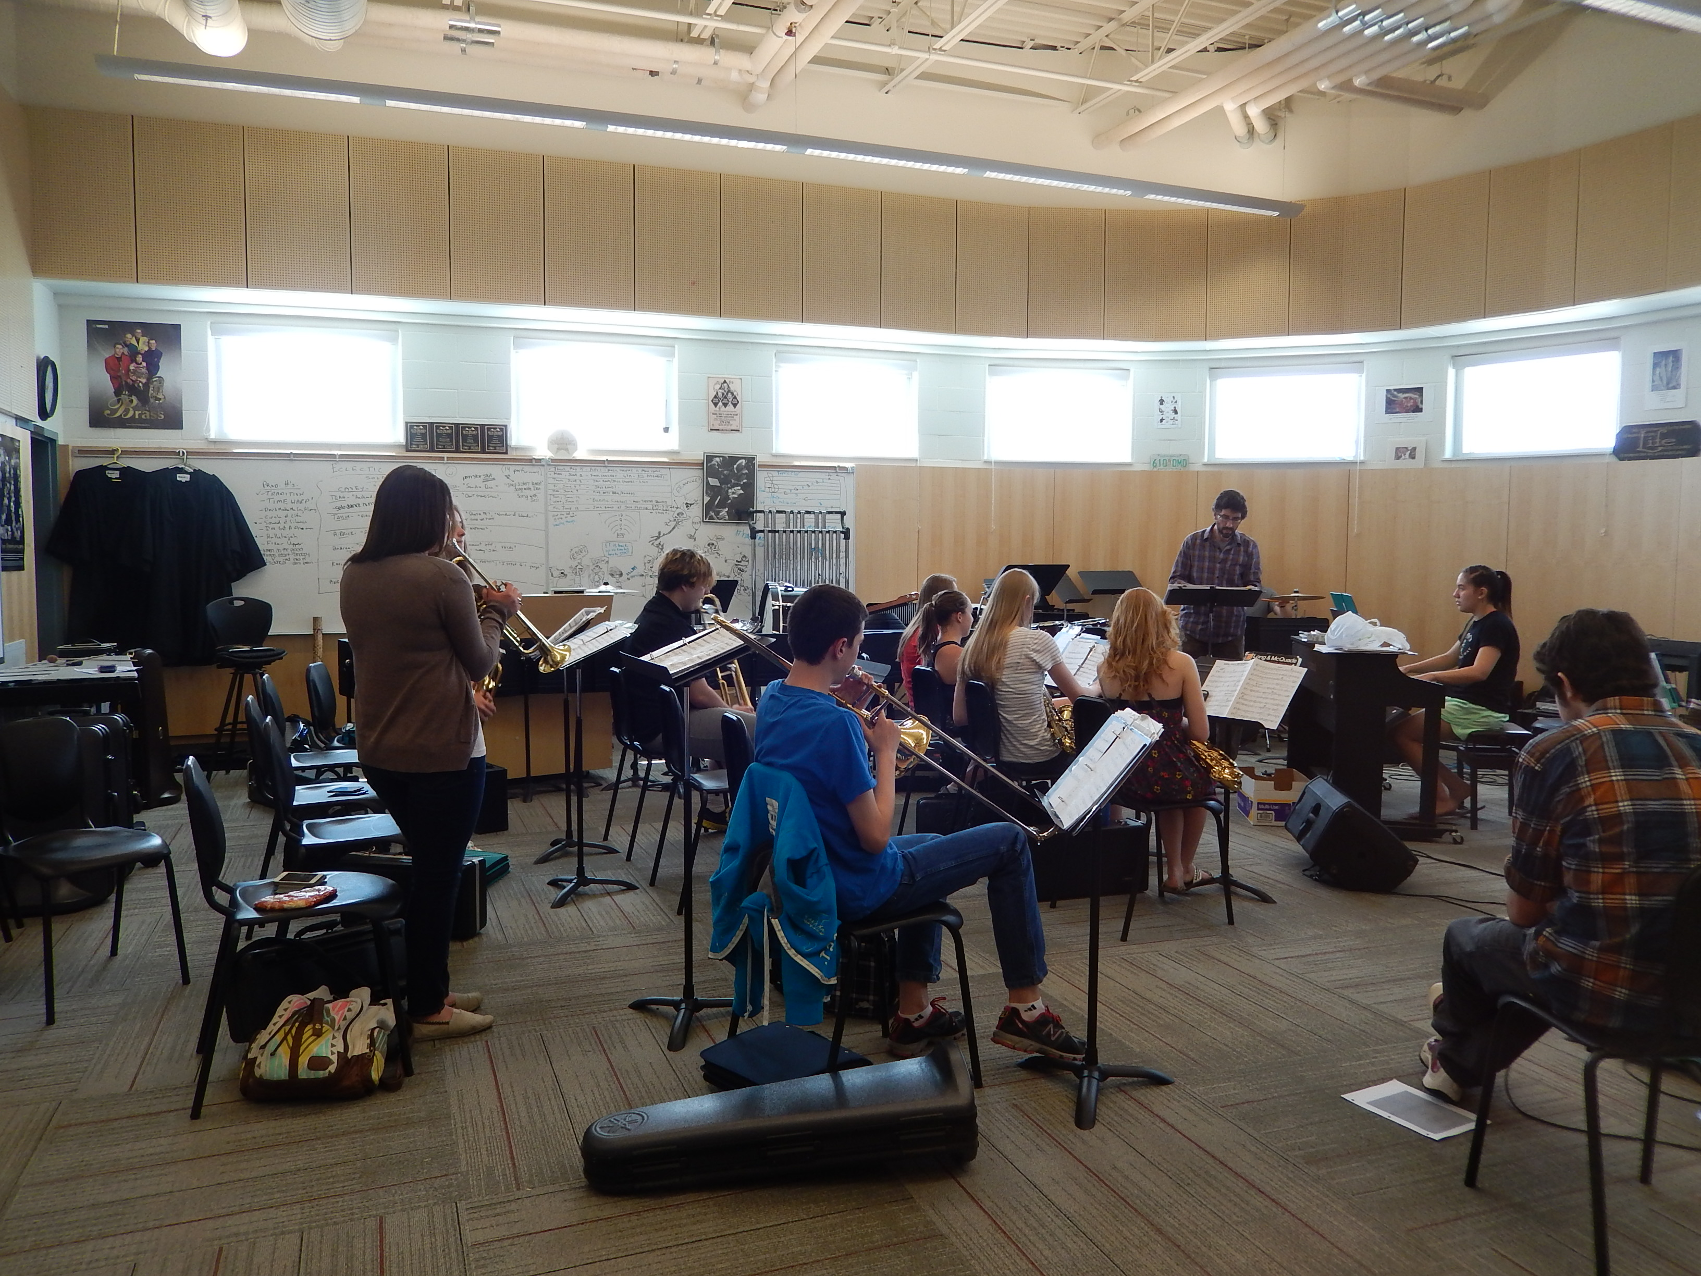
Chinook high school 季风高中
Notes:
Largest gymnasium south of Calgary.
Theatre for performing arts events and assemblies.

Slide 16
Lethbridge Collegiate institute 莱桥LCI 高中
Our longest established high school – history of success
历史最悠久的高中
Two gymnasiums, state of the art computer labs
两个体育馆，先进的计算机实验室
Strong language programs – ELL, German, Spanish, French Immersion, Japanese
健全的语言课程-ELL,德语，西班牙语，纯法语，日语
Notes:
Our largest high school until Chinook was built, so now has lots of room and excellent facilities, but less students.
Excellent facilities – 2 gymnasiums, many computer labs, automotives (only offered here)

Slide 17
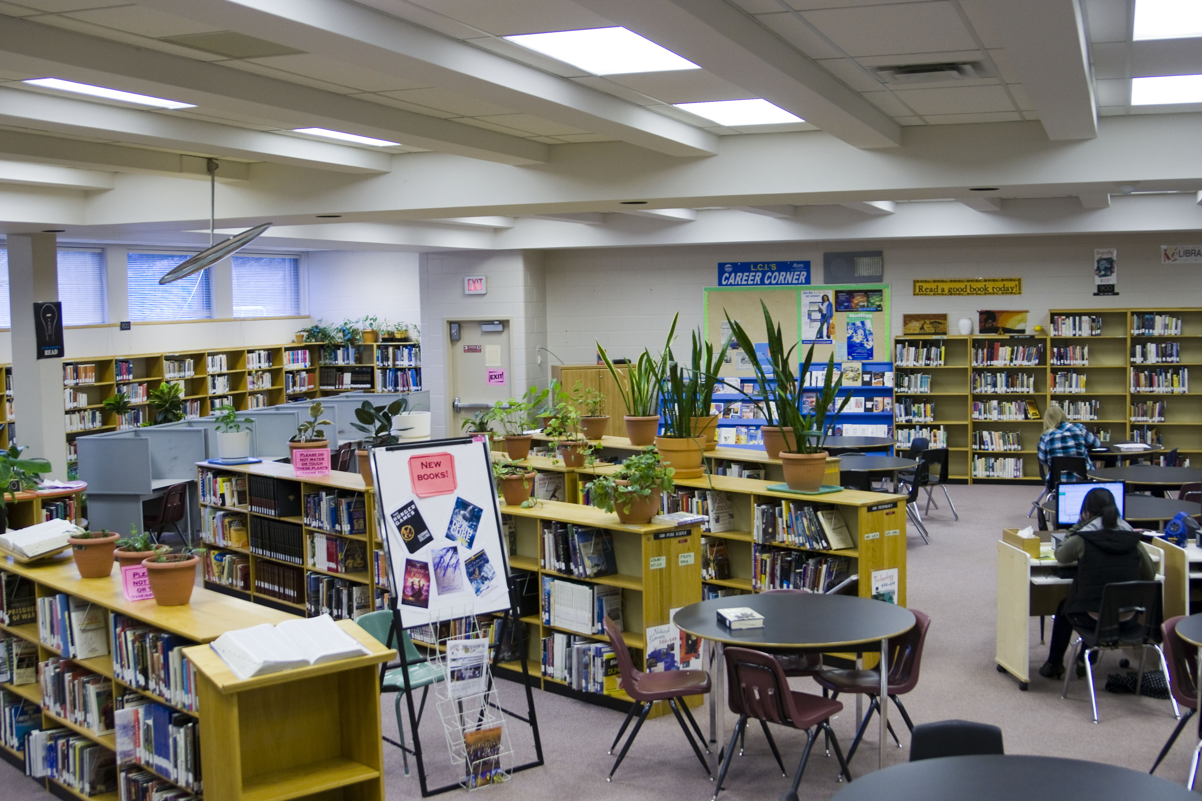
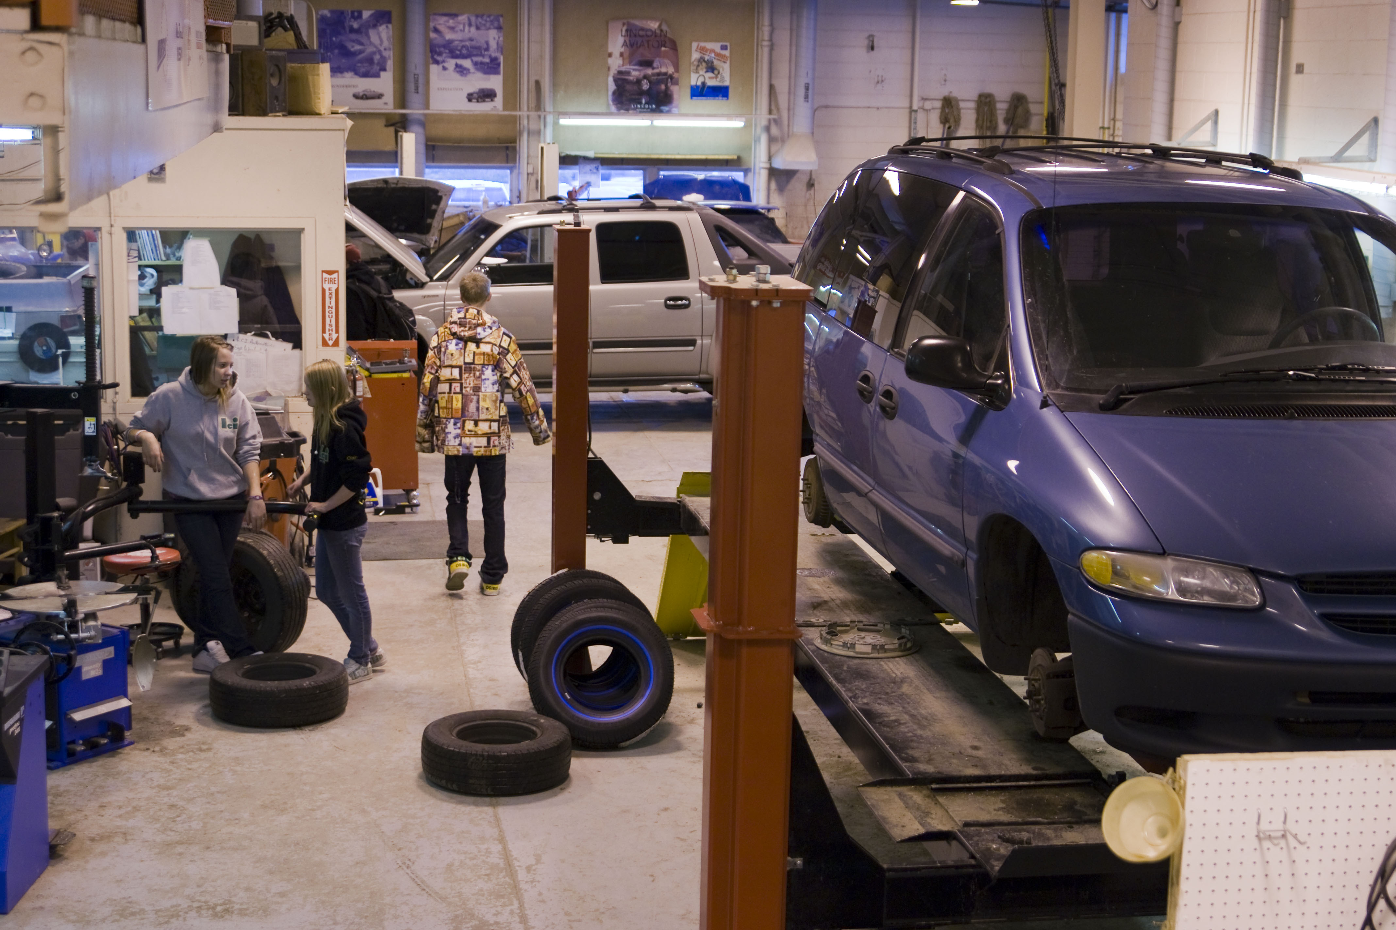
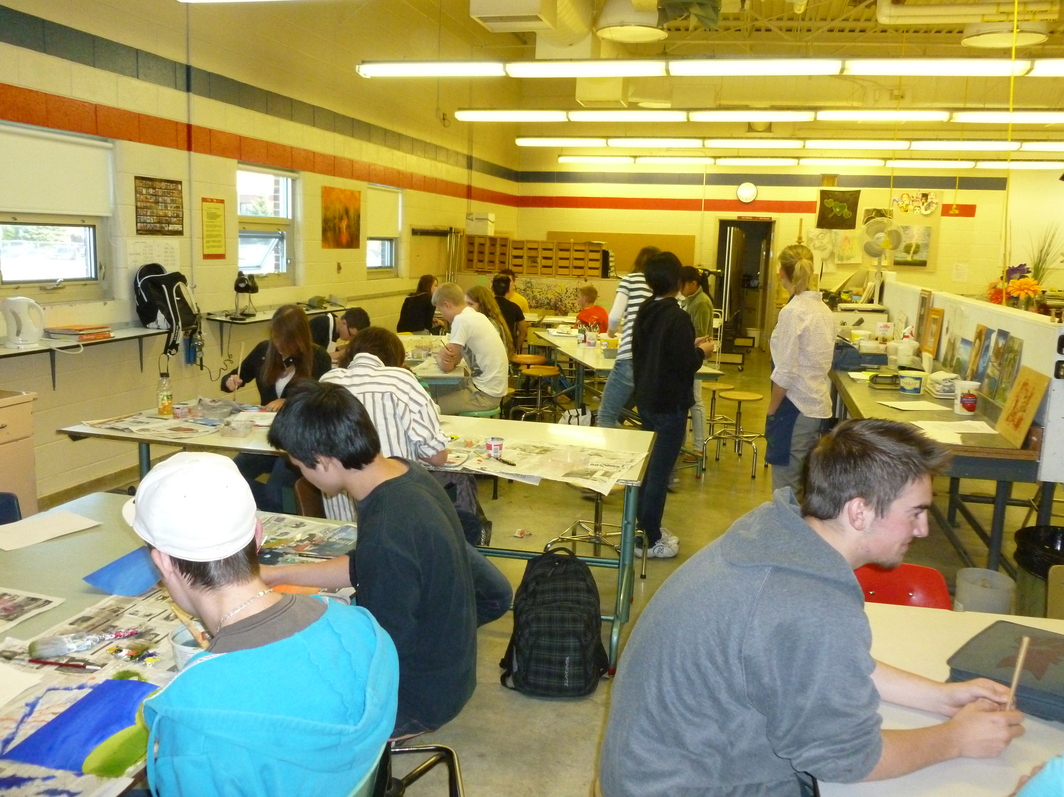
Lethbridge Collegiate institute 莱桥LCI高中
Notes:
You can see their excellent facilities.
I am partial to LCI because I graduated from there many years ago.

Slide 18
Winston Churchill high 温斯顿丘吉尔高中
Excellent academic and co-curricular programs – International Baccalaureate
优秀学术和课外课程，国际文凭
Very diverse population of students from many cultures不同文化背景的学员
Excel in sports programs and teams
很棒的体育团队课程
Notes:
Located in the north end of Lethbridge.
Probably our most diverse ethnic population.
Staff members provide great support to students for whom English is not their first language.

Slide 19
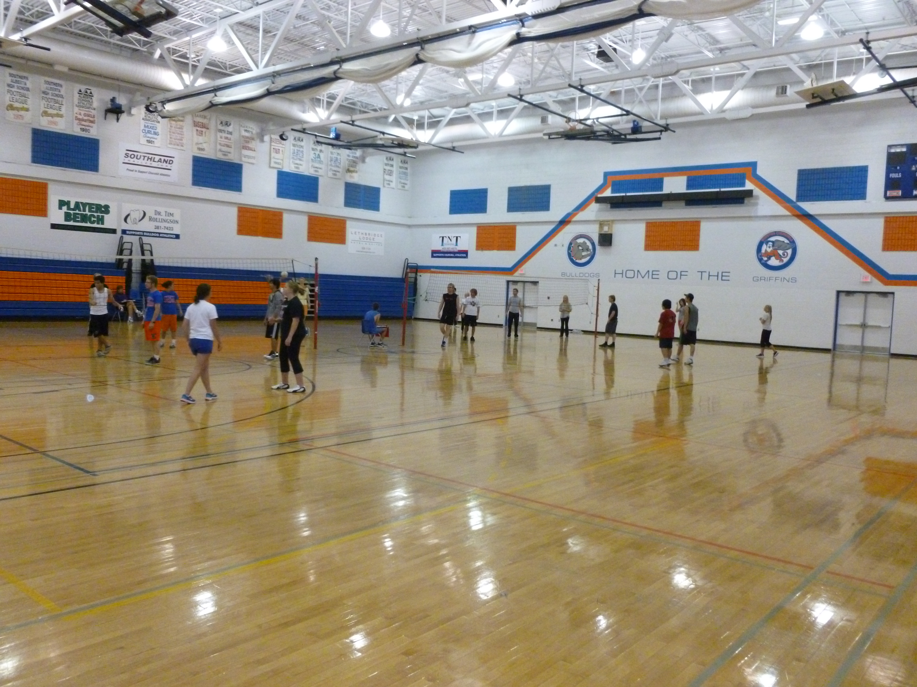
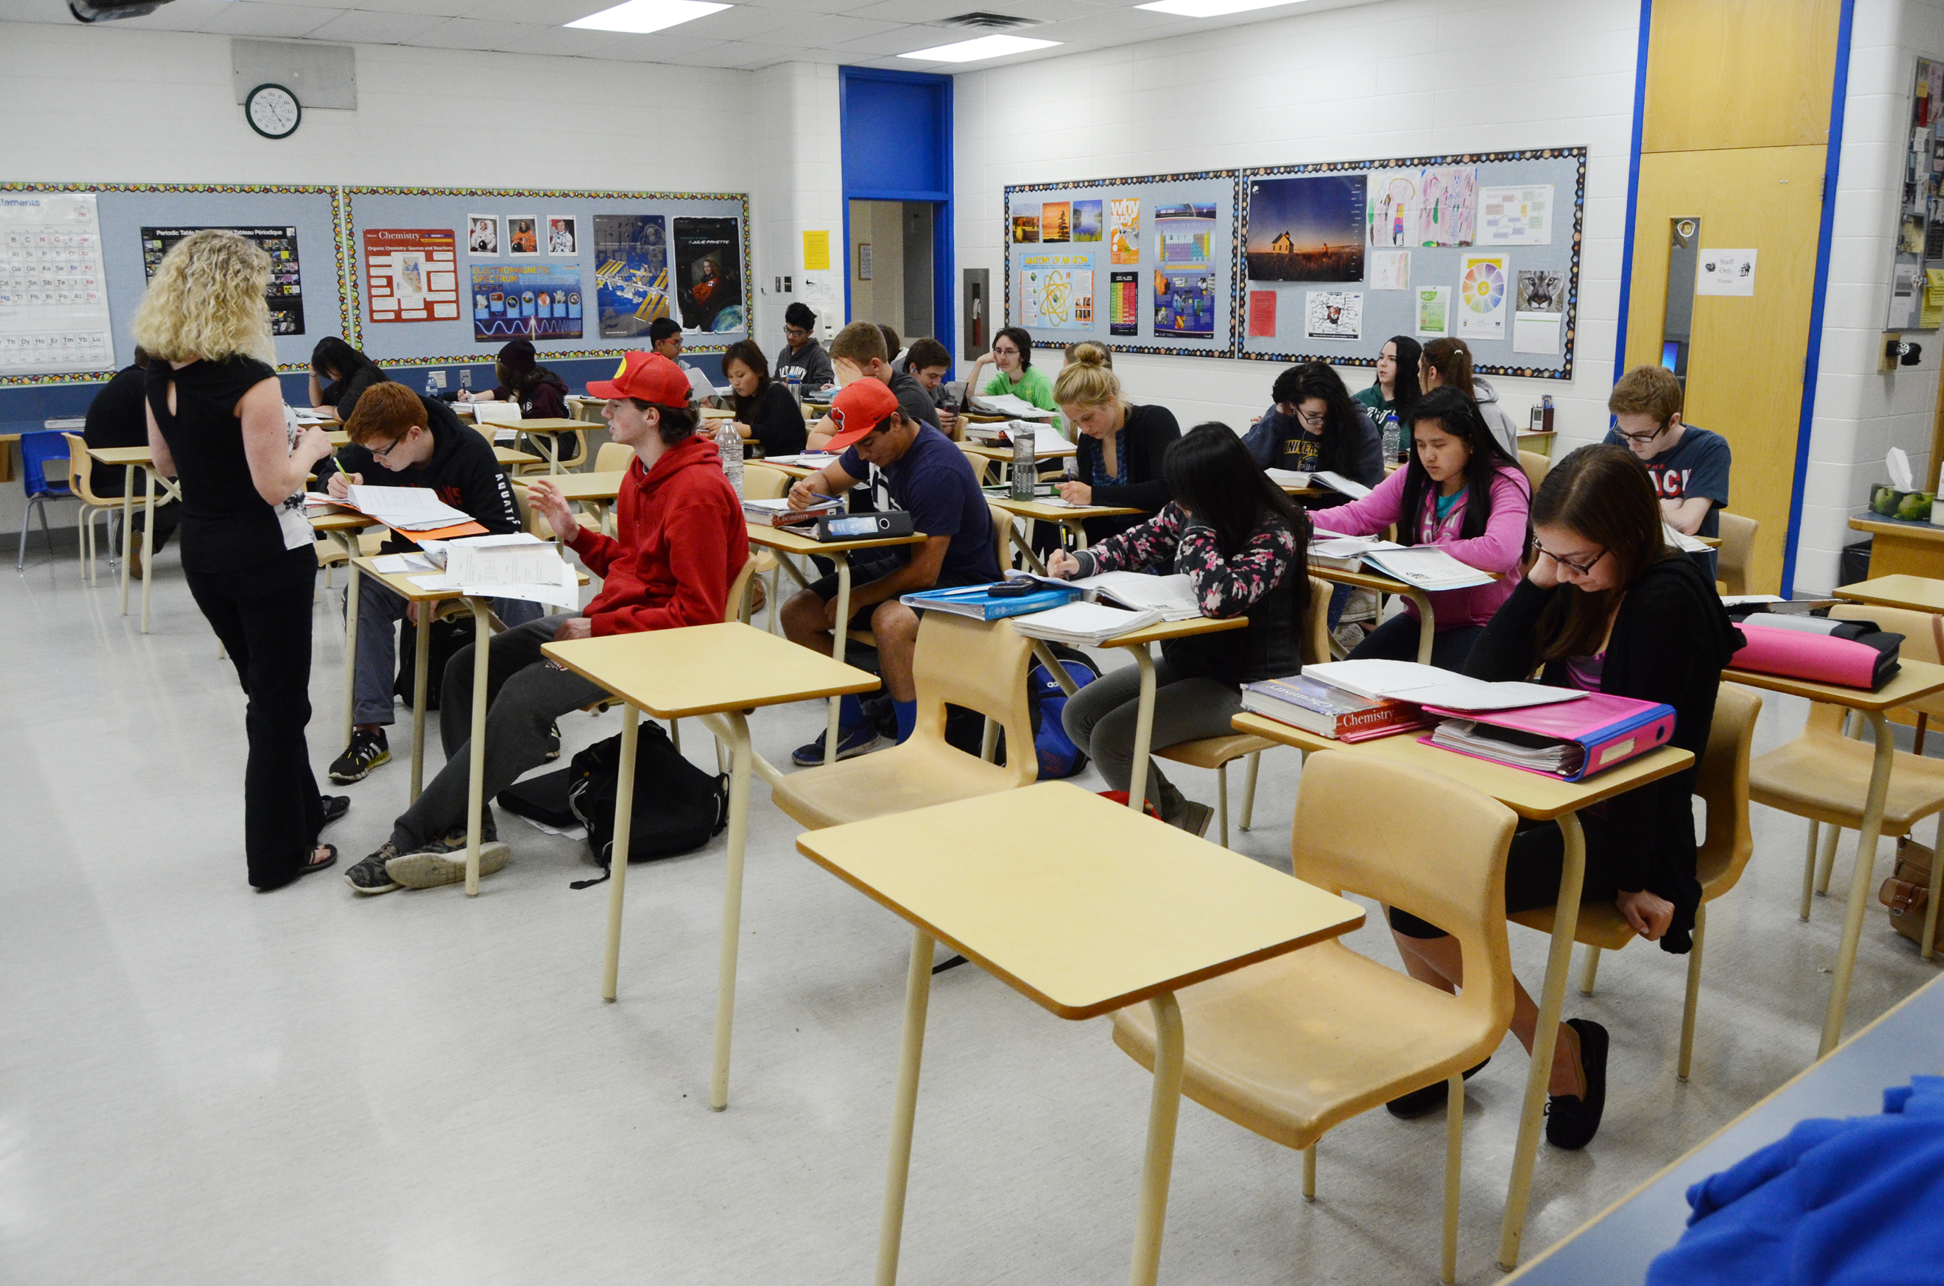
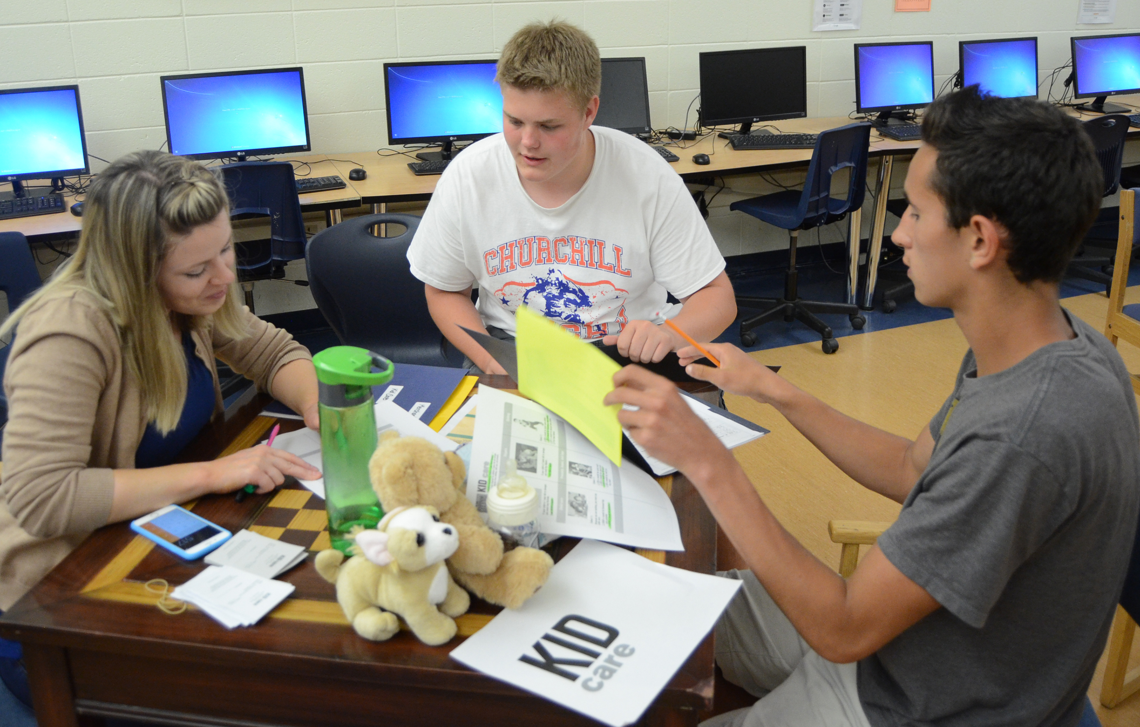
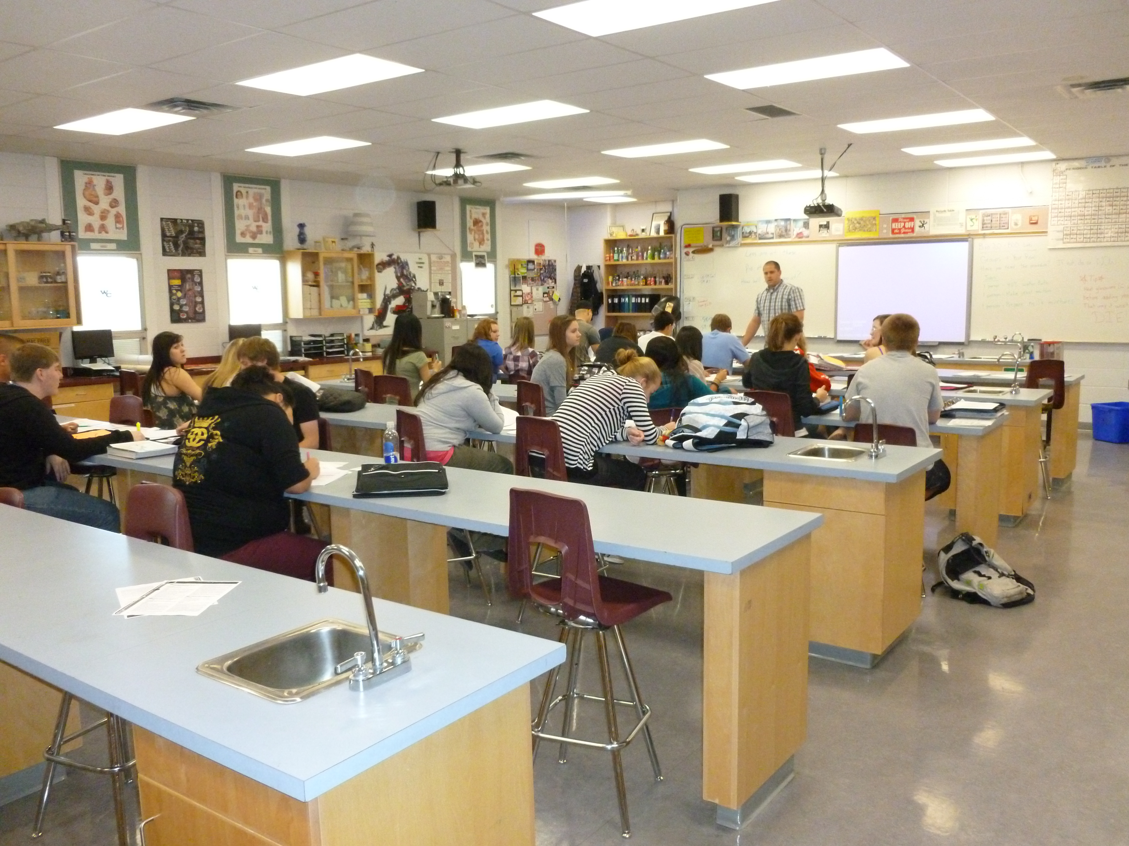
Winston Churchill high 温斯顿丘吉尔高中
Notes:
Once again, you can see the cleanliness and maintenance of our buildings.

Slide 20
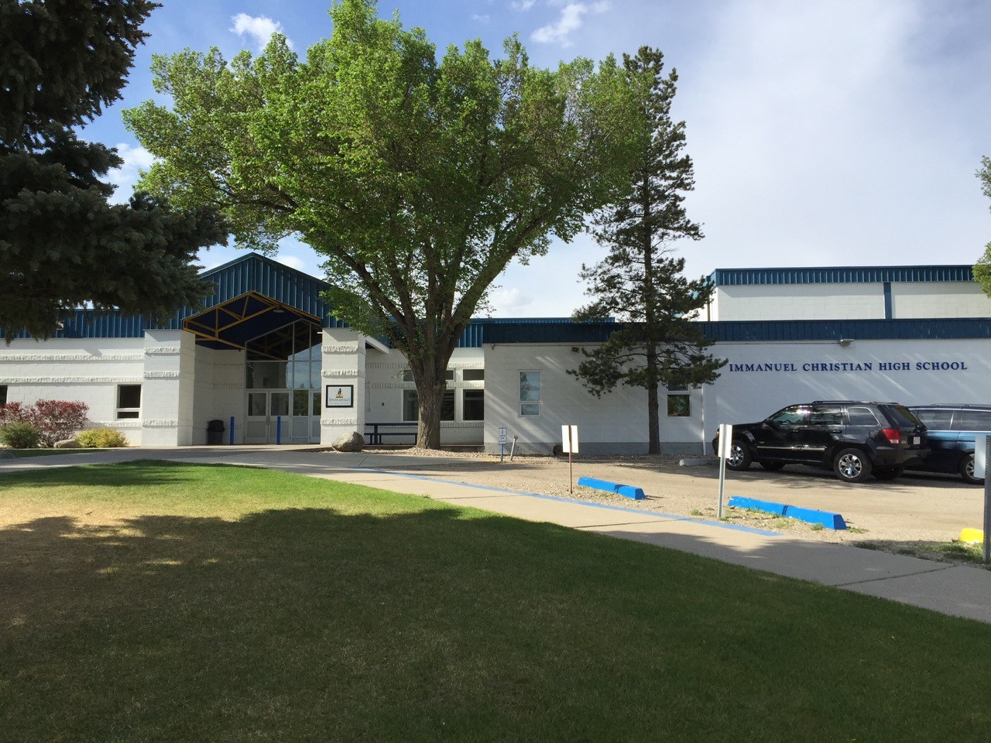
Immanuel Christian high 易曼纽尔基督高中
Excellent academic and co-curricular programs
优秀的学术和课外课程
Teach Alberta curriculum from the Christian perspective.
传授基督有关的亚伯达课程
Small school population with a strong community spirit.
学员不多，具有强大的社区精神，
Notes:
ICHS has been a school for over 50 years, and was adopted into our district just over a year ago.
Is an alternative faith-based program. Only put students here by parent request.
Many students come from farms and small towns around Lethbridge.

Slide 21
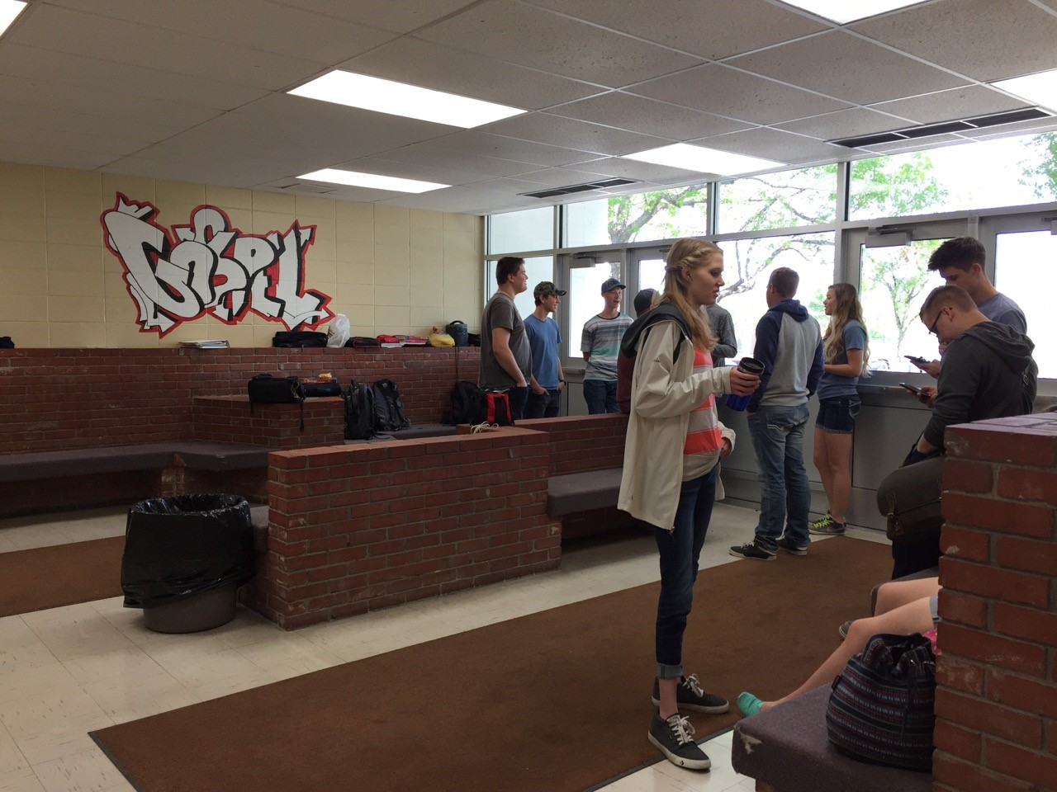
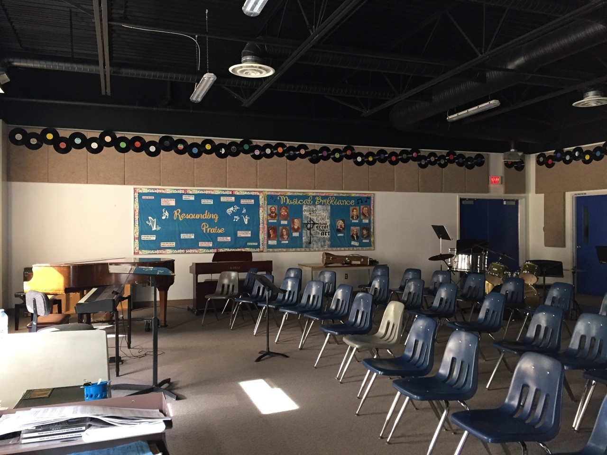
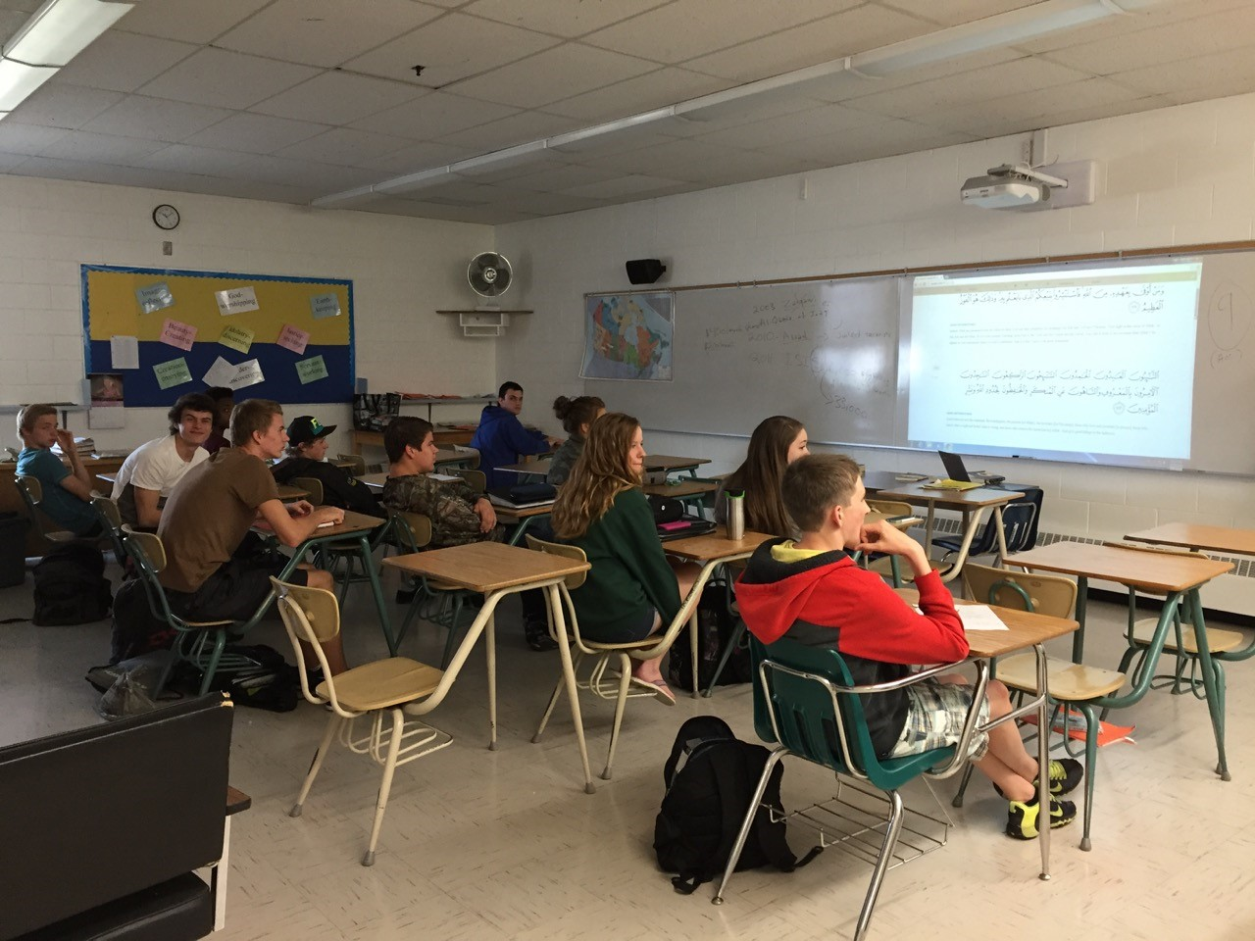
Immanuel Christian high 伊曼纽尔基督高中

Slide 22
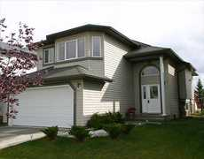
Where will my child live?我们的孩子住哪里？
Carefully chosen homestay family – English-speaking family which enjoys teaching others about Canadian culture and enjoys learning about other cultures.
精心挑选的，讲英语的寄宿家庭，乐意传授加拿大文化和学习了解其他文化的家庭
Within walking distance or bus ride to school.
离学校或校车只有步行的距离
a
Notes:
High standards for our homestays.
Families come in all types and sizes and are guaranteed to be different from your family at home.

Slide 23
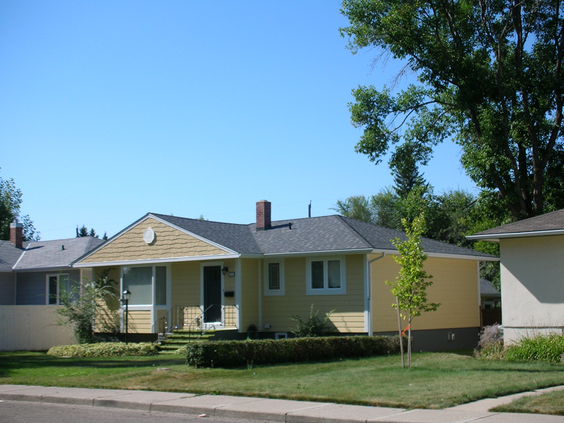
Where will my child live? 我的孩子住哪里？
Single-family house with outdoor space.
独立家庭，有室外空间
Student will have his or her own bedroom and share the house with the family
学生有他或她自己的房间，合用房子
Equipped with WIFI for email and Skype
有无线网络，邮箱和视频设备
Notes:
Always single-family dwellings in family-oriented neighborhoods.
Encourage our students to become a part of the family.

Slide 24
WHAT SUPPORTS ARE THERE FOR STUDENTS IN HOMESTAY? 学生住寄宿家庭有哪些支持
The Canada Homestay Network’s relationship manager also works in our International Services office
加拿大家庭寄宿网络经理也就职于我们国际服务办公室
24/7 support through CHN 24/7
通过加拿大家庭寄宿网络得到服务
100% matching success rate to date (we’ve never needed to move anyone)
目前为止，匹配的成功率为百分之百，（我们不需要调动人员）
Notes:
Best of both worlds – support of Canada-wide homestay network, but work side-by-side with homestay relationship manager in Lethbridge – very personalized service.

Slide 25
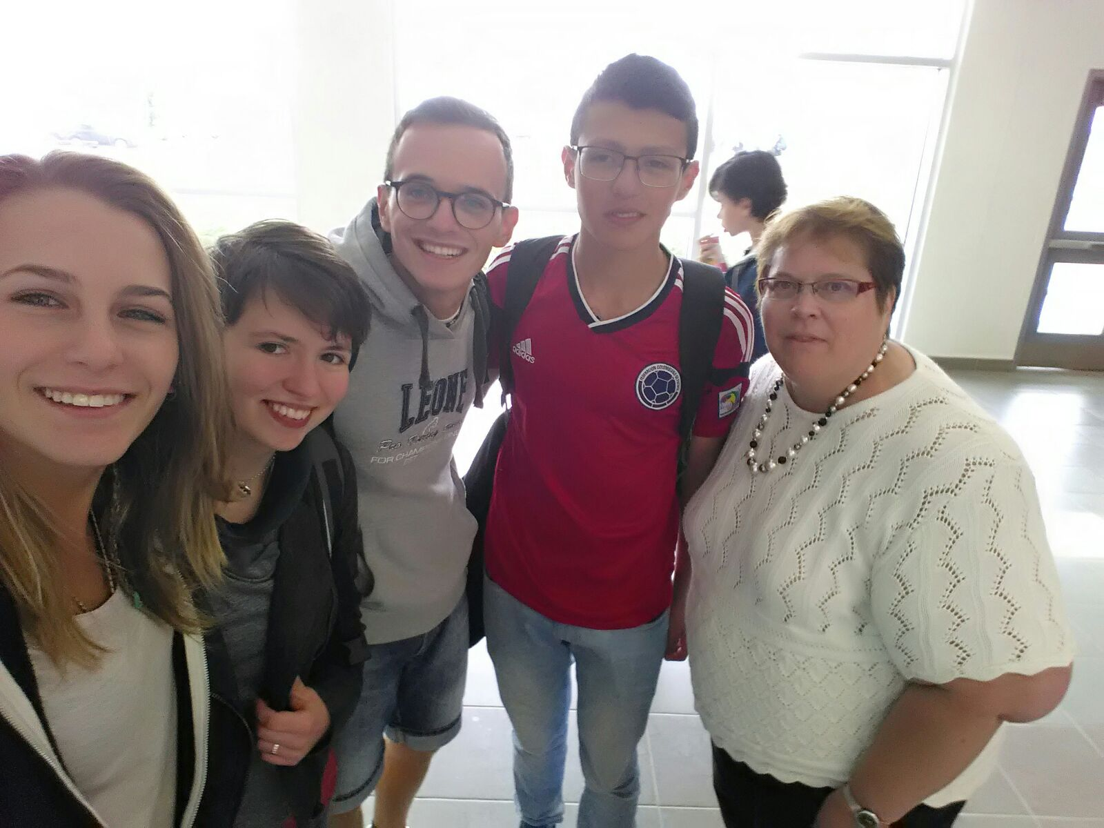
OPTIONS IN Lethbridge school district 莱桥学区选项
Graduate from high school in Lethbridge:
从莱桥学区毕业:
1 + 2 (if English proficiency is high enough)
1 + 2 （如果英语水平足够好）
3 full years in Lethbridge (no ESL entrance exam for University)
在莱桥学区学完3年整（进大学不需英语为第二语言的考试）
Notes:
Choices – students can also choose options to take when they are here for a longer term
Summer camp is an excellent way to become familiar with Lethbridge and area and make friends from around the world.

Slide 26
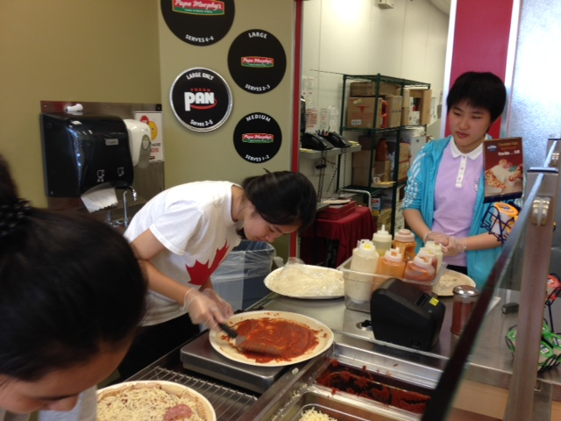
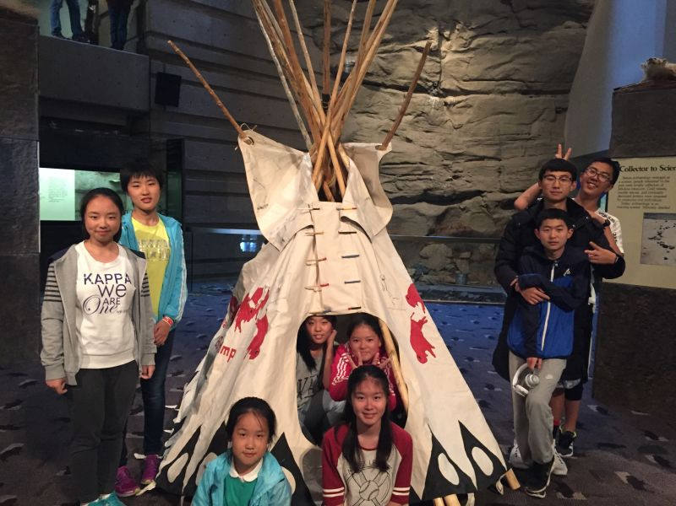
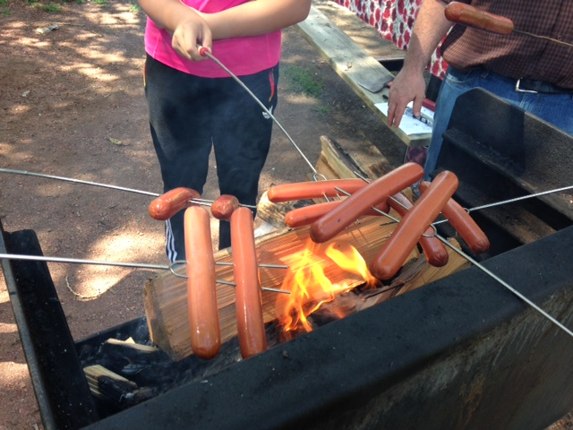
OPTIONS IN Lethbridge school district 莱桥学区选项
Join us for summer camp for 1 – 4 weeks in July/August.
7/8月，参加我们一到四周的夏令营
Notes:
Choices – students can also choose options to take when they are here for a longer term
Summer camp is an excellent way to become familiar with Lethbridge and area and make friends from around the world.

Slide 27
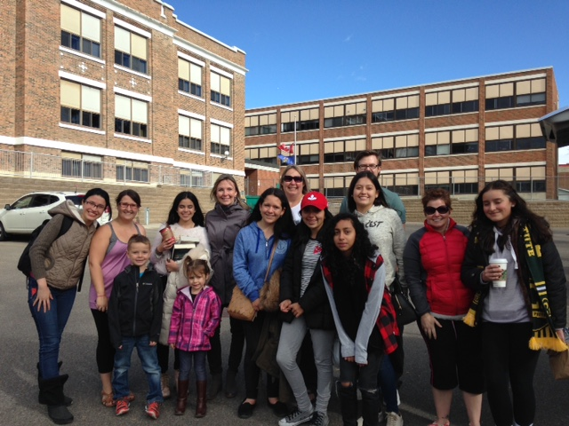
OPTIONS IN Lethbridge school district 莱桥学区选项
Join a short-term group from your school to attend in Lethbridge for 2-3 months.
加入您校的短期组,
来莱桥学习2-3个月。
Notes:
Choices – students can also choose options to take when they are here for a longer term
Summer camp is an excellent way to become familiar with Lethbridge and area and make friends from around the world.

Slide 28
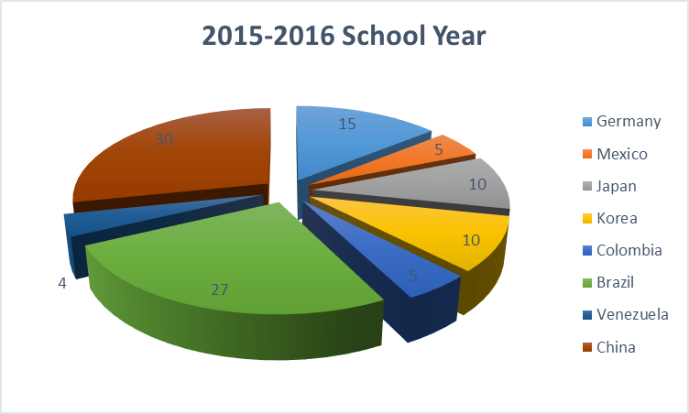
WHERE DO OUR STUDENTS COME FROM? 我们的学生来自何方？
We have students from four different continents!
我们的学生来自各个地区，
These statistics reflect full time equivalents of various nationalities.
Notes:
This year, so far, we have only one full-time student from China (expecting another for Semester II).
We spread out our students from the same country between our schools so that they have more opportunity to use their English and make Canadian friends.

Slide 29
Affordable quality education 负担得起的高质量教育
For One School Year of Study in Lethbridge:
莱桥一年学校费用
Compare with other Districts:
与其他地区比较
Calgary卡尔加里 - $22 345
Vancouver 温哥华 - $24 800
Toronto 多伦多 - $27 025
Application Fee 申请费 |  |  |  | $250.00
Homestay Placement/Custodian Fees 寄宿家庭安置/托管费家庭服务费 |  |  |  | $950.00
Medical Insurance 医疗保险费 |  |  |  | $500.00
Tuition 学费 |  |  |  | $11 000.00
Homestay 寄宿费 |  |  |  | $8 000.00
Airport transfers 机场接送费 |  |  |  | $400.00
Total | 总共 |  |  | $21 100.00
Notes:
Although Lethbridge offers an excellent program of academics and fabulous homestays, we can offer it at a lower price due to lower costs in a smaller centre and less sales tax – studying in Lethbridge is financially desireable.

Slide 30
Alberta, Canada *

Slide 31
Study in Lethbridge 到莱桥来学习
Succeed with us!
与我们一起走向成功

