Slide 1



Study in Lethbridge
Succeed with us!

Slide 2
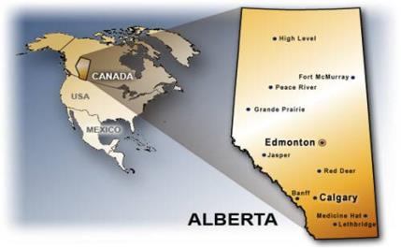
Where are we?
Alberta is in the western part of Canada, just east of the Rocky Mountains.
Lethbridge is in the southern part of Alberta.

Slide 3
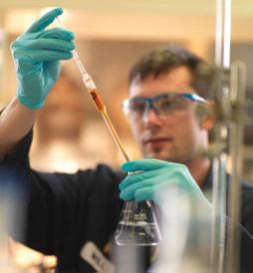
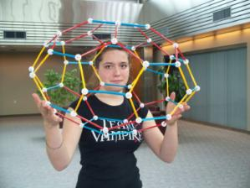
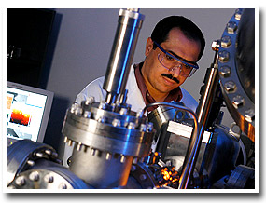
Why study in alberta?
One of the strongest economies in North America
Highest per capita family income in Canada – high quality of life
Lowest unemployment rate in Canada
Government invests heavily in education
No provincial sales tax – less expensive to live in Alberta.

Slide 4
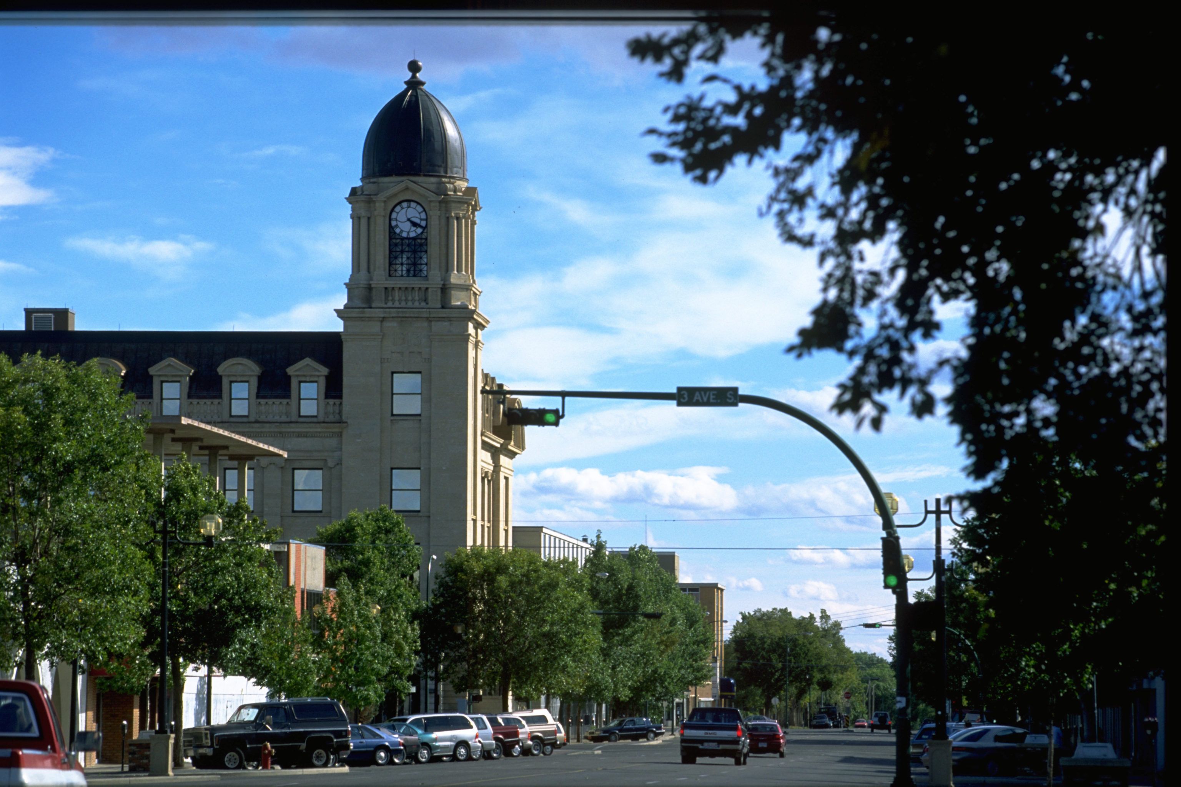
Lethbridge, Alberta
Southern Alberta – farming, education, research, industry, oil, natural gas
Weather – Chinooks
Excellent educational programs for international students – high school, college, university

Slide 5
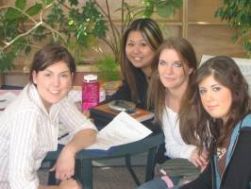

High quality of life
Between 90 000 - 100 000 residents: safe, accessible
Many parks and recreation facilities
Shopping malls, art galleries, museums, restaurants

Slide 6
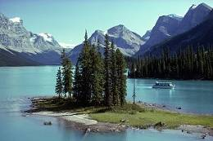
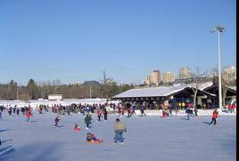

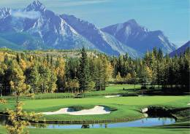
High quality of life
Close to the Rocky Mountains
Clean air and water
A climate with four seasons

Slide 7
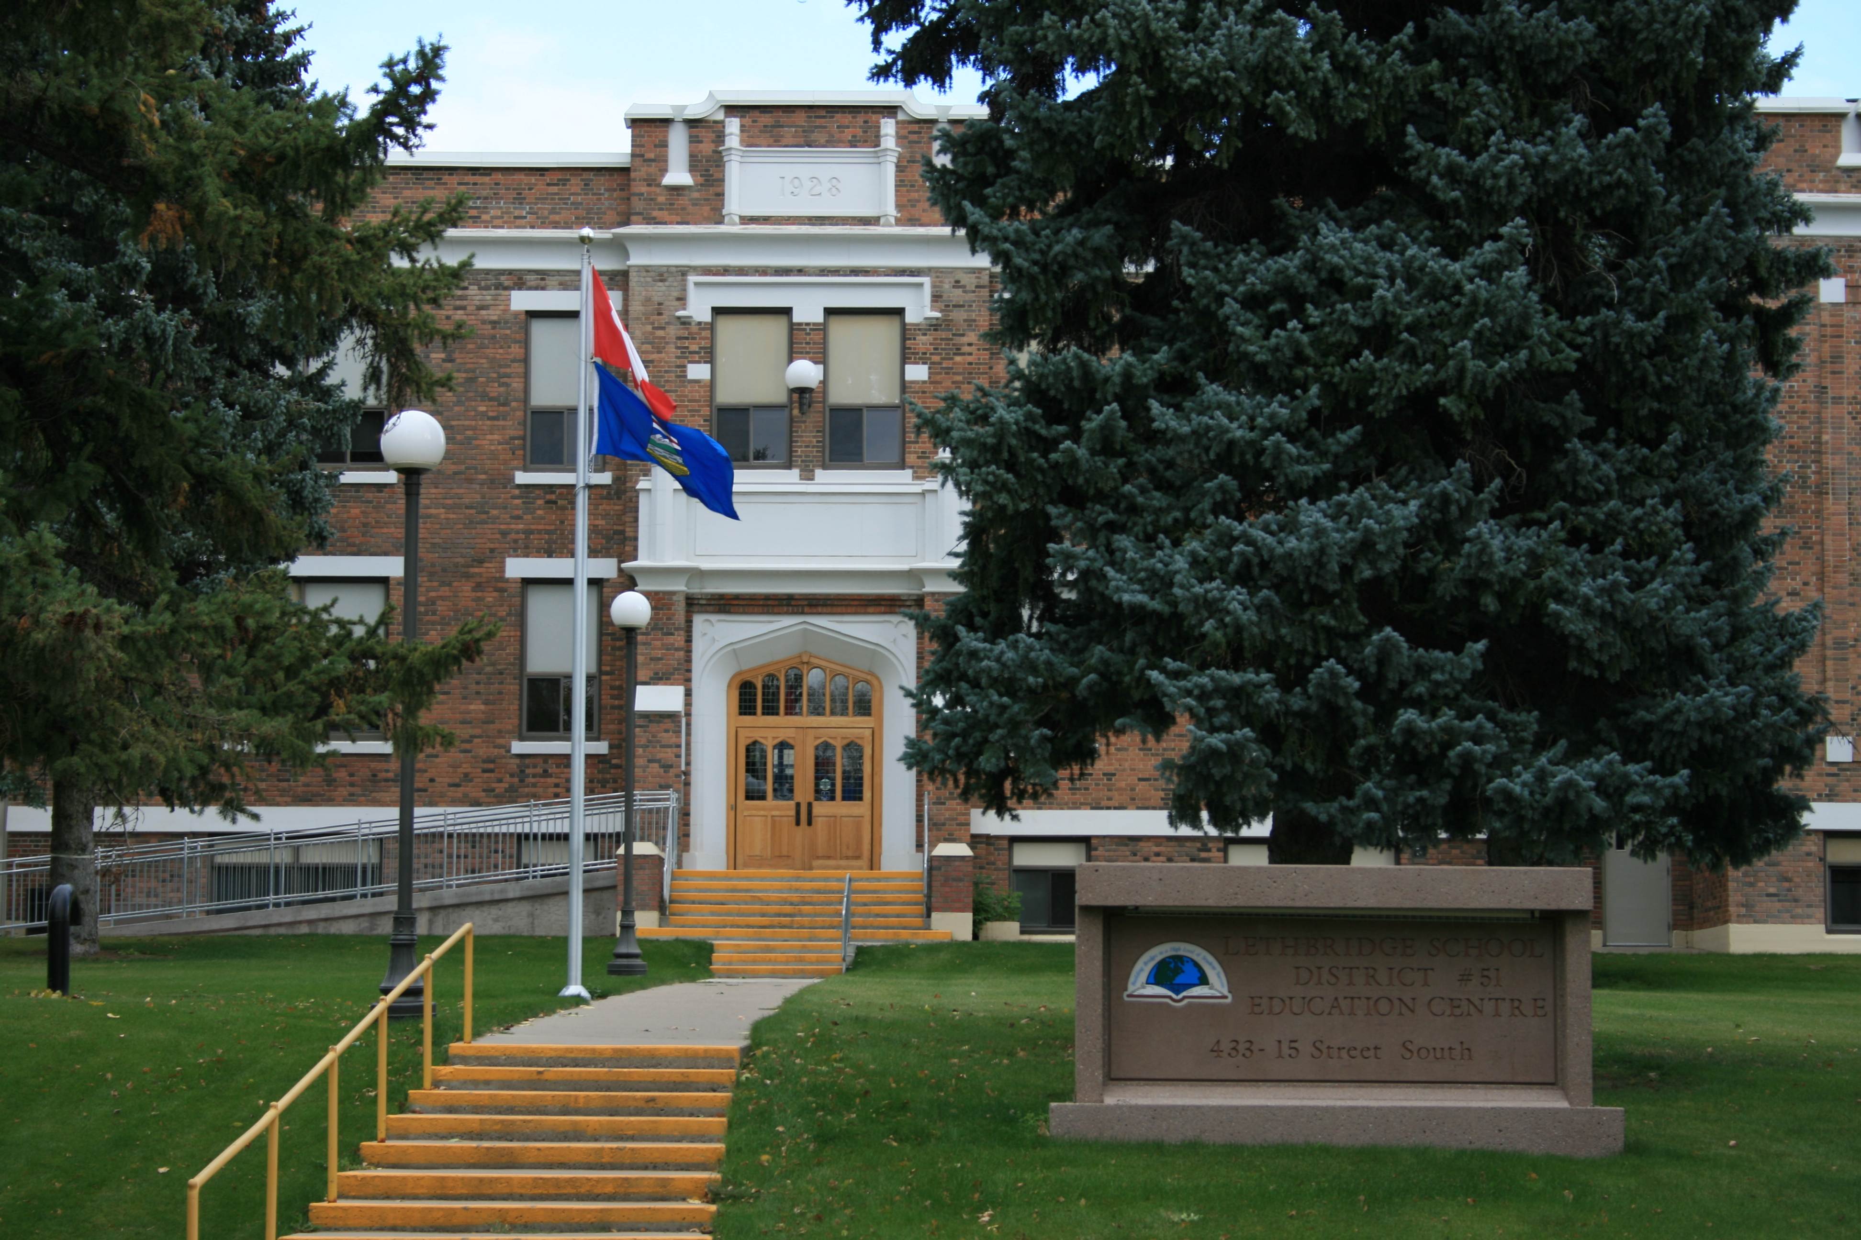
Lethbridge School District
Four high schools
High speed WIFI
Excellent academic and co-curricular programs
Safe, clean community

Slide 8




Focus on students
Government-certified, enthusiastic teachers who challenge their students
Support systems in place – International Services Office, Vice Principal in each school, Advisor

Slide 9
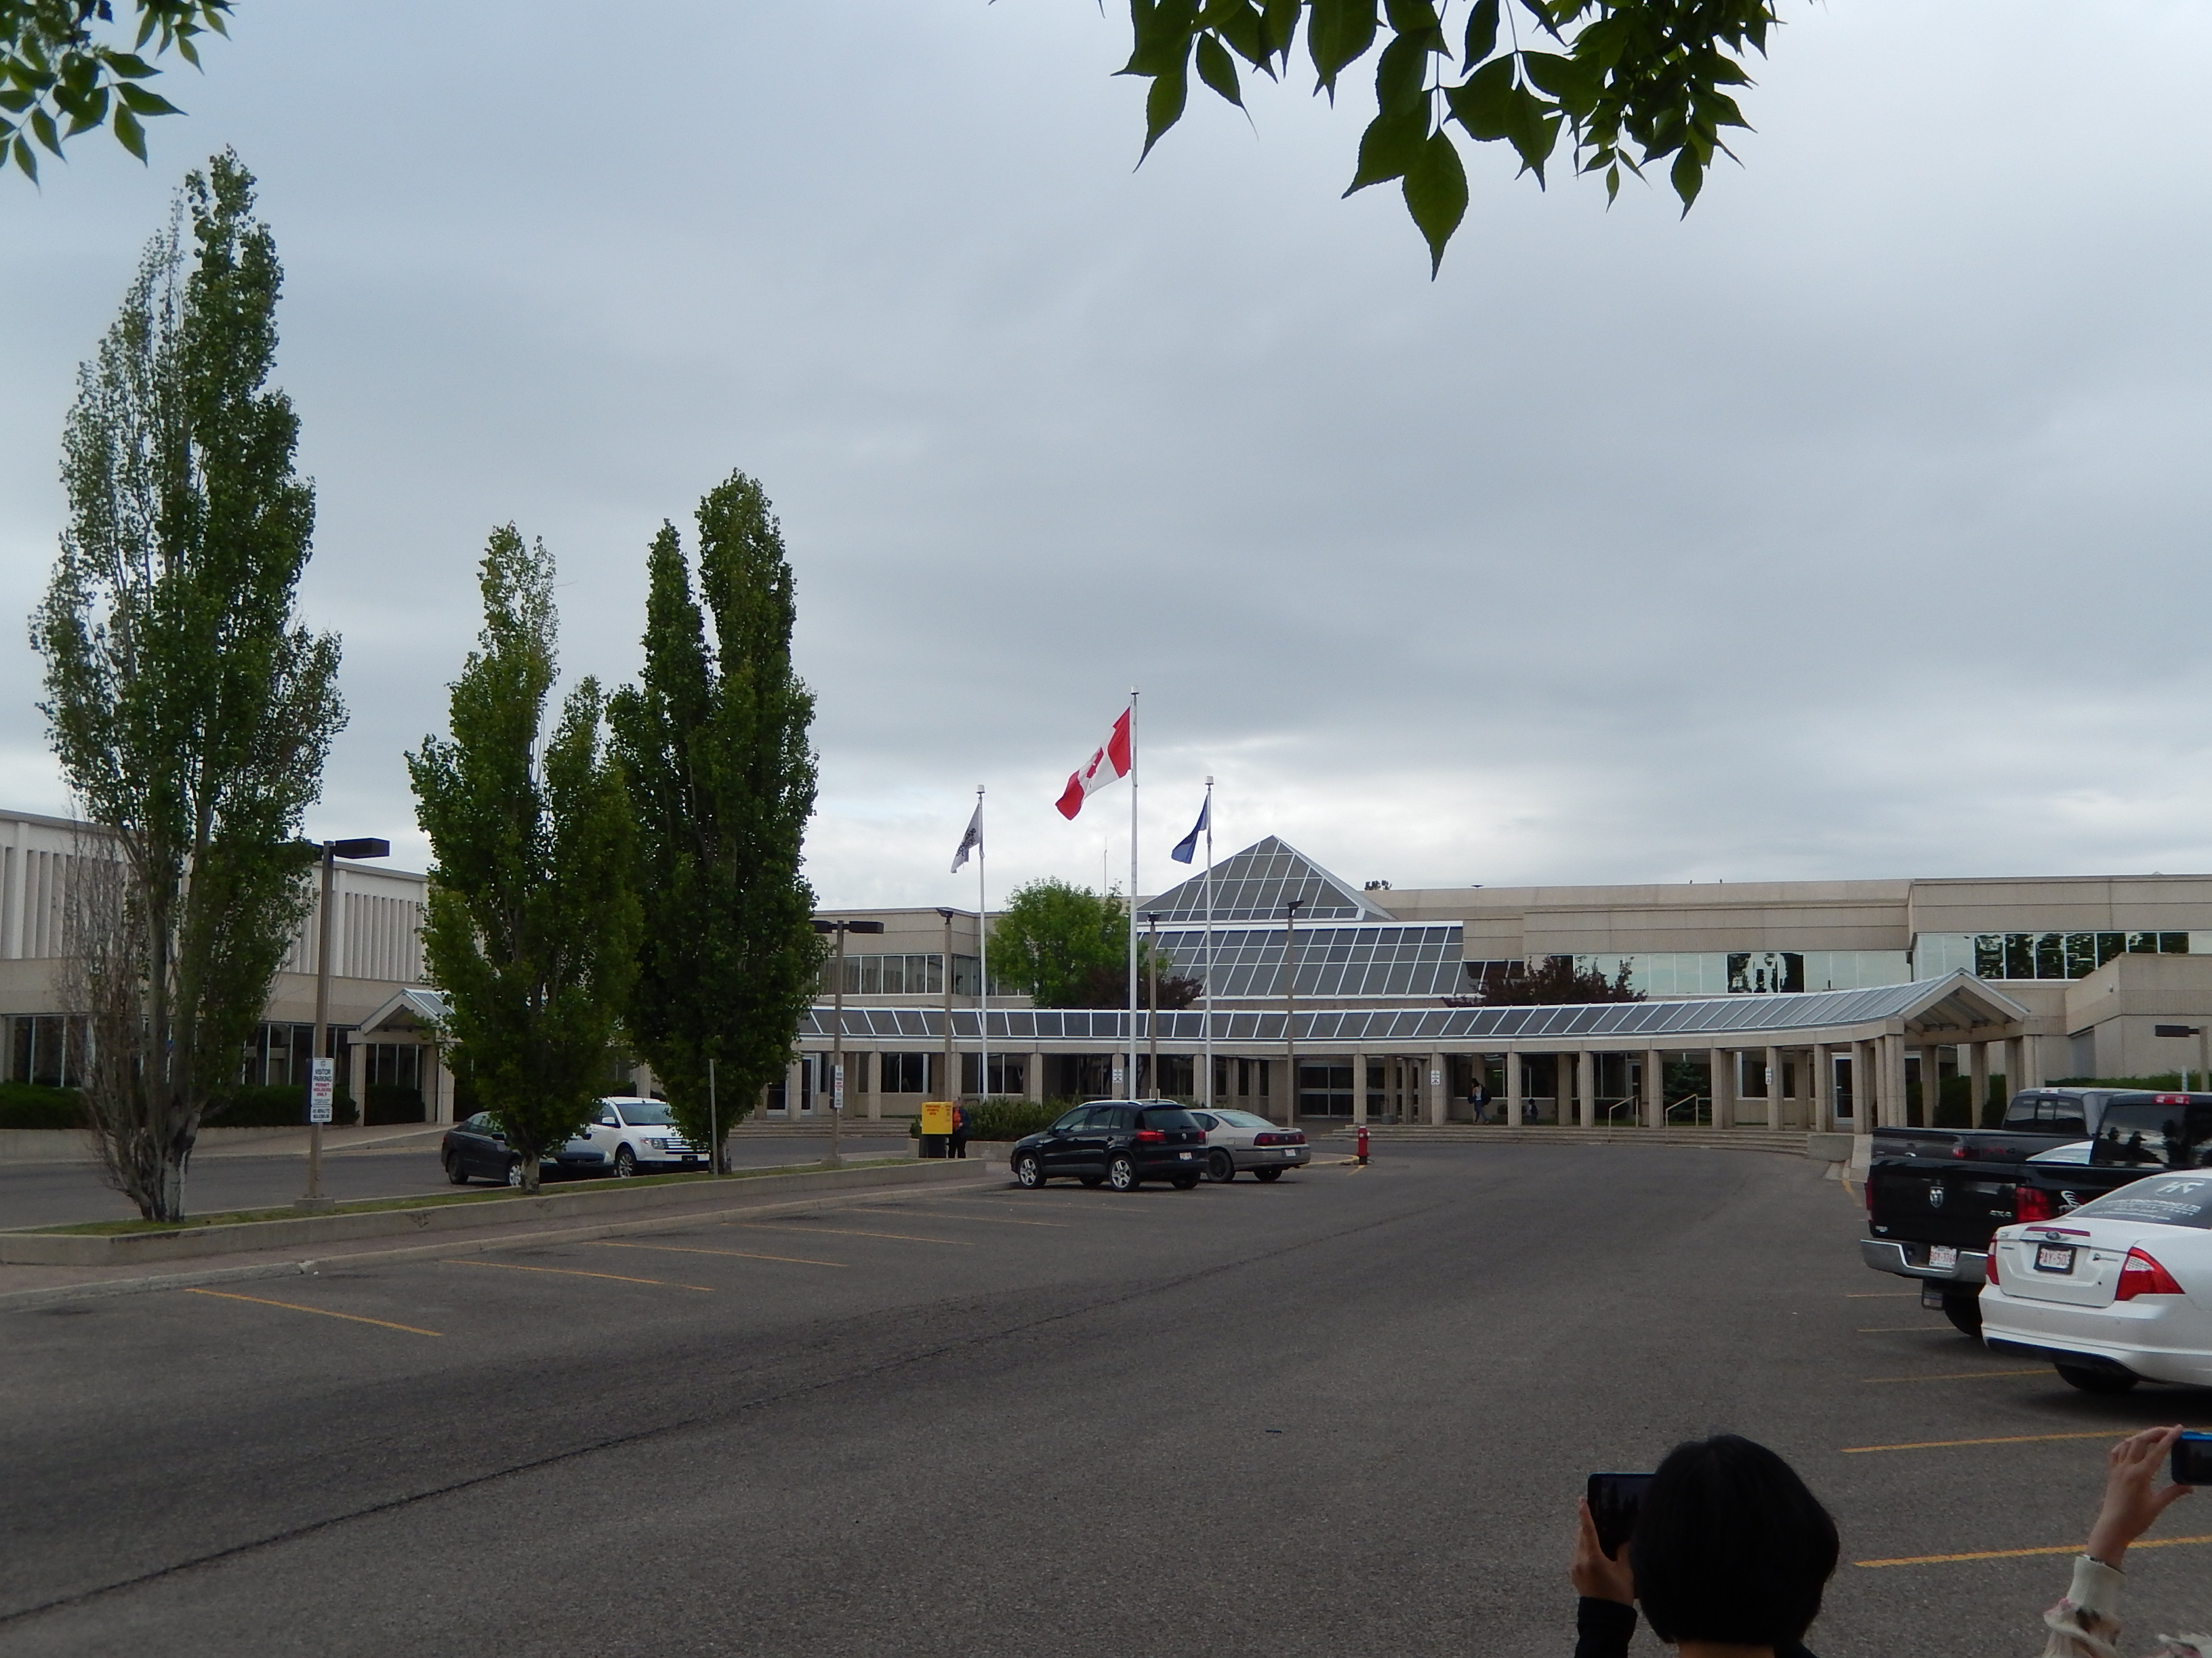
After graduation
An Alberta high school diploma is accepted in colleges and universities world-wide.
Lethbridge College:
offers many programs for international students: agriculture, automotives, criminal justice, criminal justice, early childhood education, fashion design, health care aide, interior design, massage therapy, multimedia production…
Offers transfer programs to the university in Nursing and Business Administration
Requires 100 high school credits, including English 30-2 for admission
Lethbridge College

Slide 10
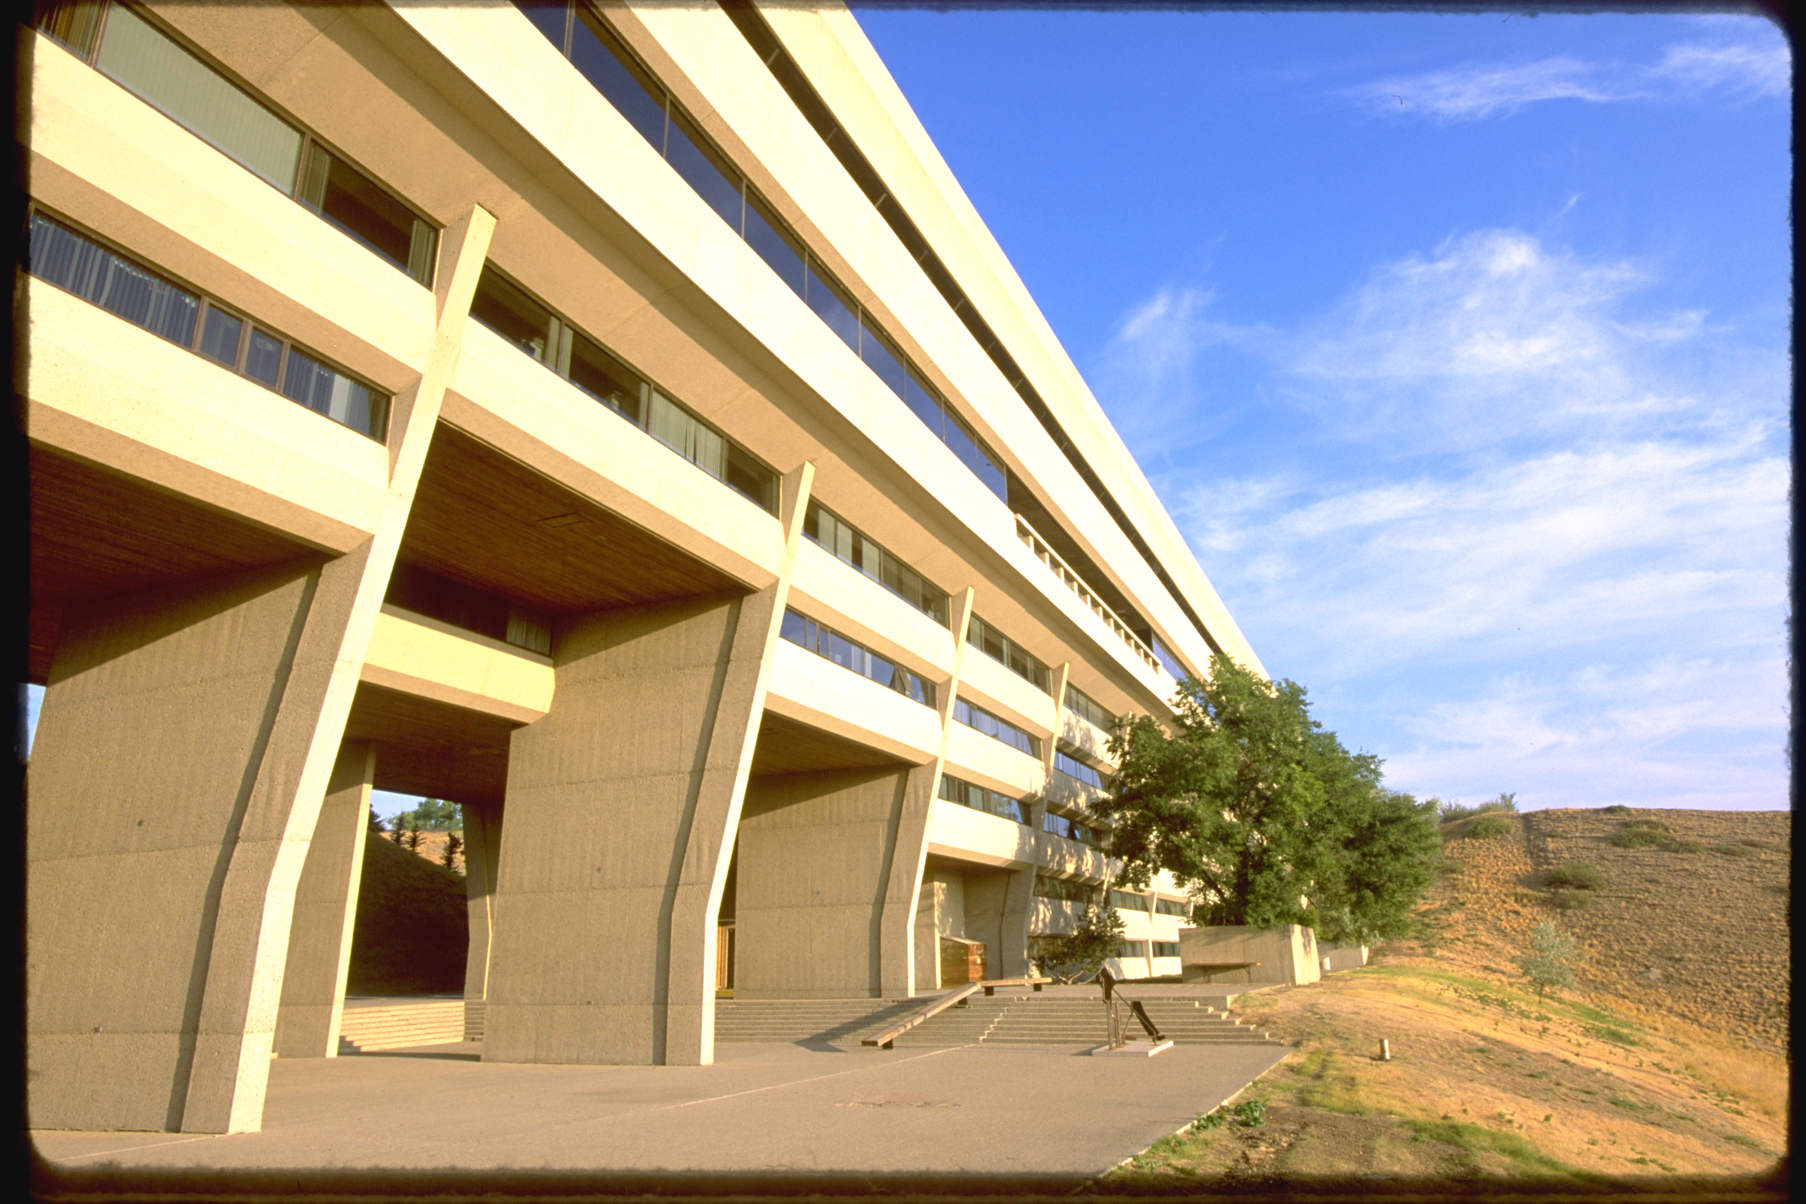
After graduation
The University of Lethbridge
Offers undergraduate degrees in Humanities, Sciences, Social Sciences, Education (teaching), Fine Arts, Health Sciences, and Management
Offers graduate (Masters) programs in Arts, Counselling, Education, Fine Arts, Music, Nursing, Science, and Management
Offers PhD programs in Sciences.
Offers preparation programs to transfer for medicine, pharmacy, dentistry, engineering
Requires 100 high school credits and English and Math 30-1 for admission.

Slide 11
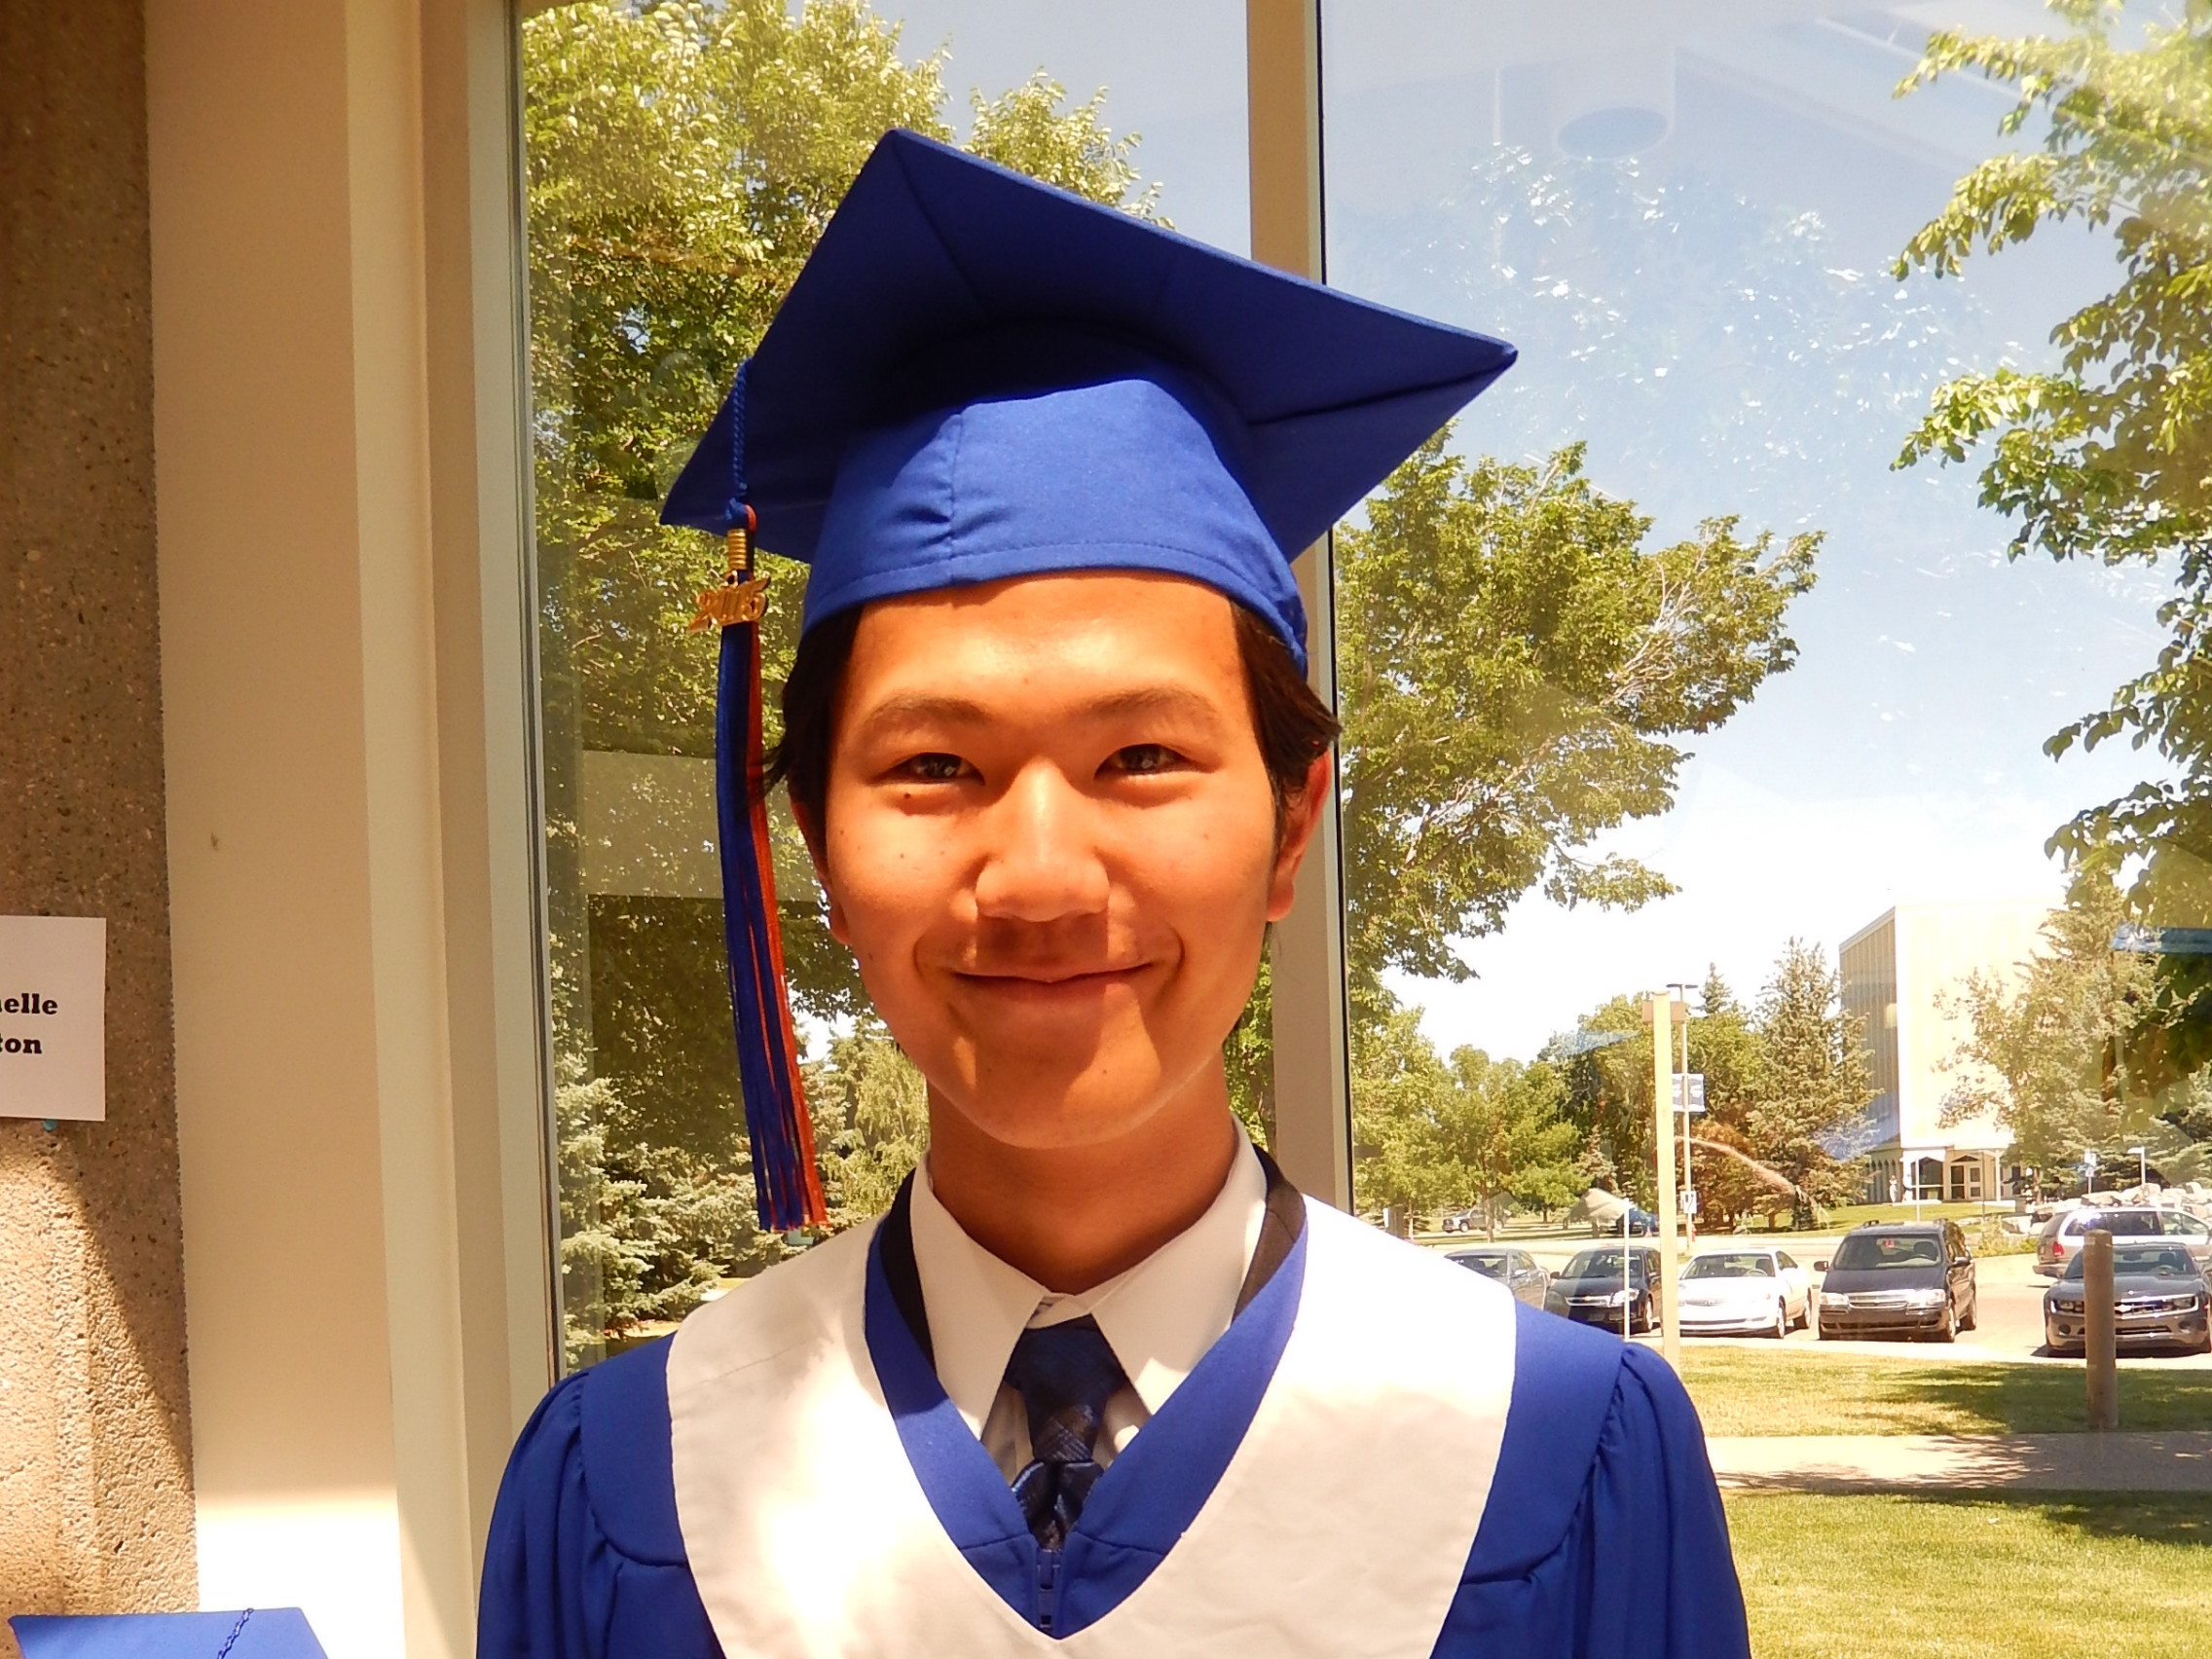
WHERE ARE OUR STUDENTS NOW?
In the past 3 years, every international student who has come to Lethbridge to study, with the intention to graduate, has successfully graduated with a high school diploma from Alberta. We have a 100% success rate which we attribute to excellent teaching, good support, and personal service.
Last year, we had five graduates. They are all currently enrolled in colleges or universities in Canada, the United States, or Japan.
Yohane was accepted into the Sophia University in Japan – the third best private university in Japan!

Slide 12
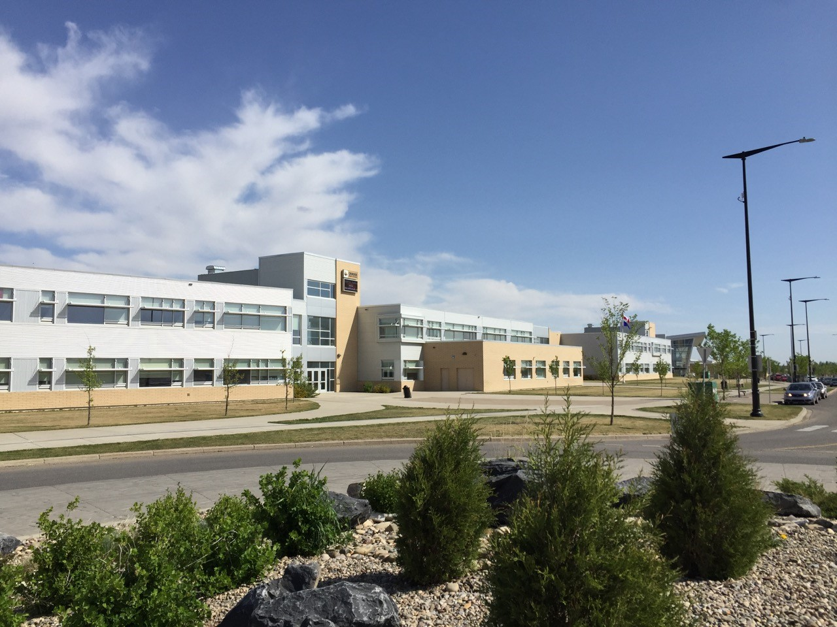
Chinook high school
Our newest high school
State of the art media centre for presentations and theatre productions
Many young staff members who love to travel and meet new people.
University preparation program

Slide 13
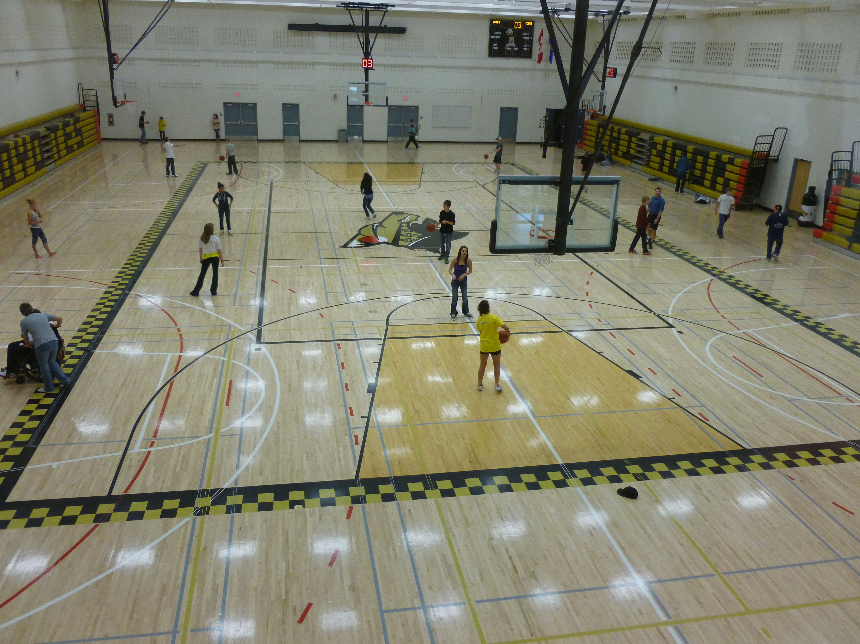
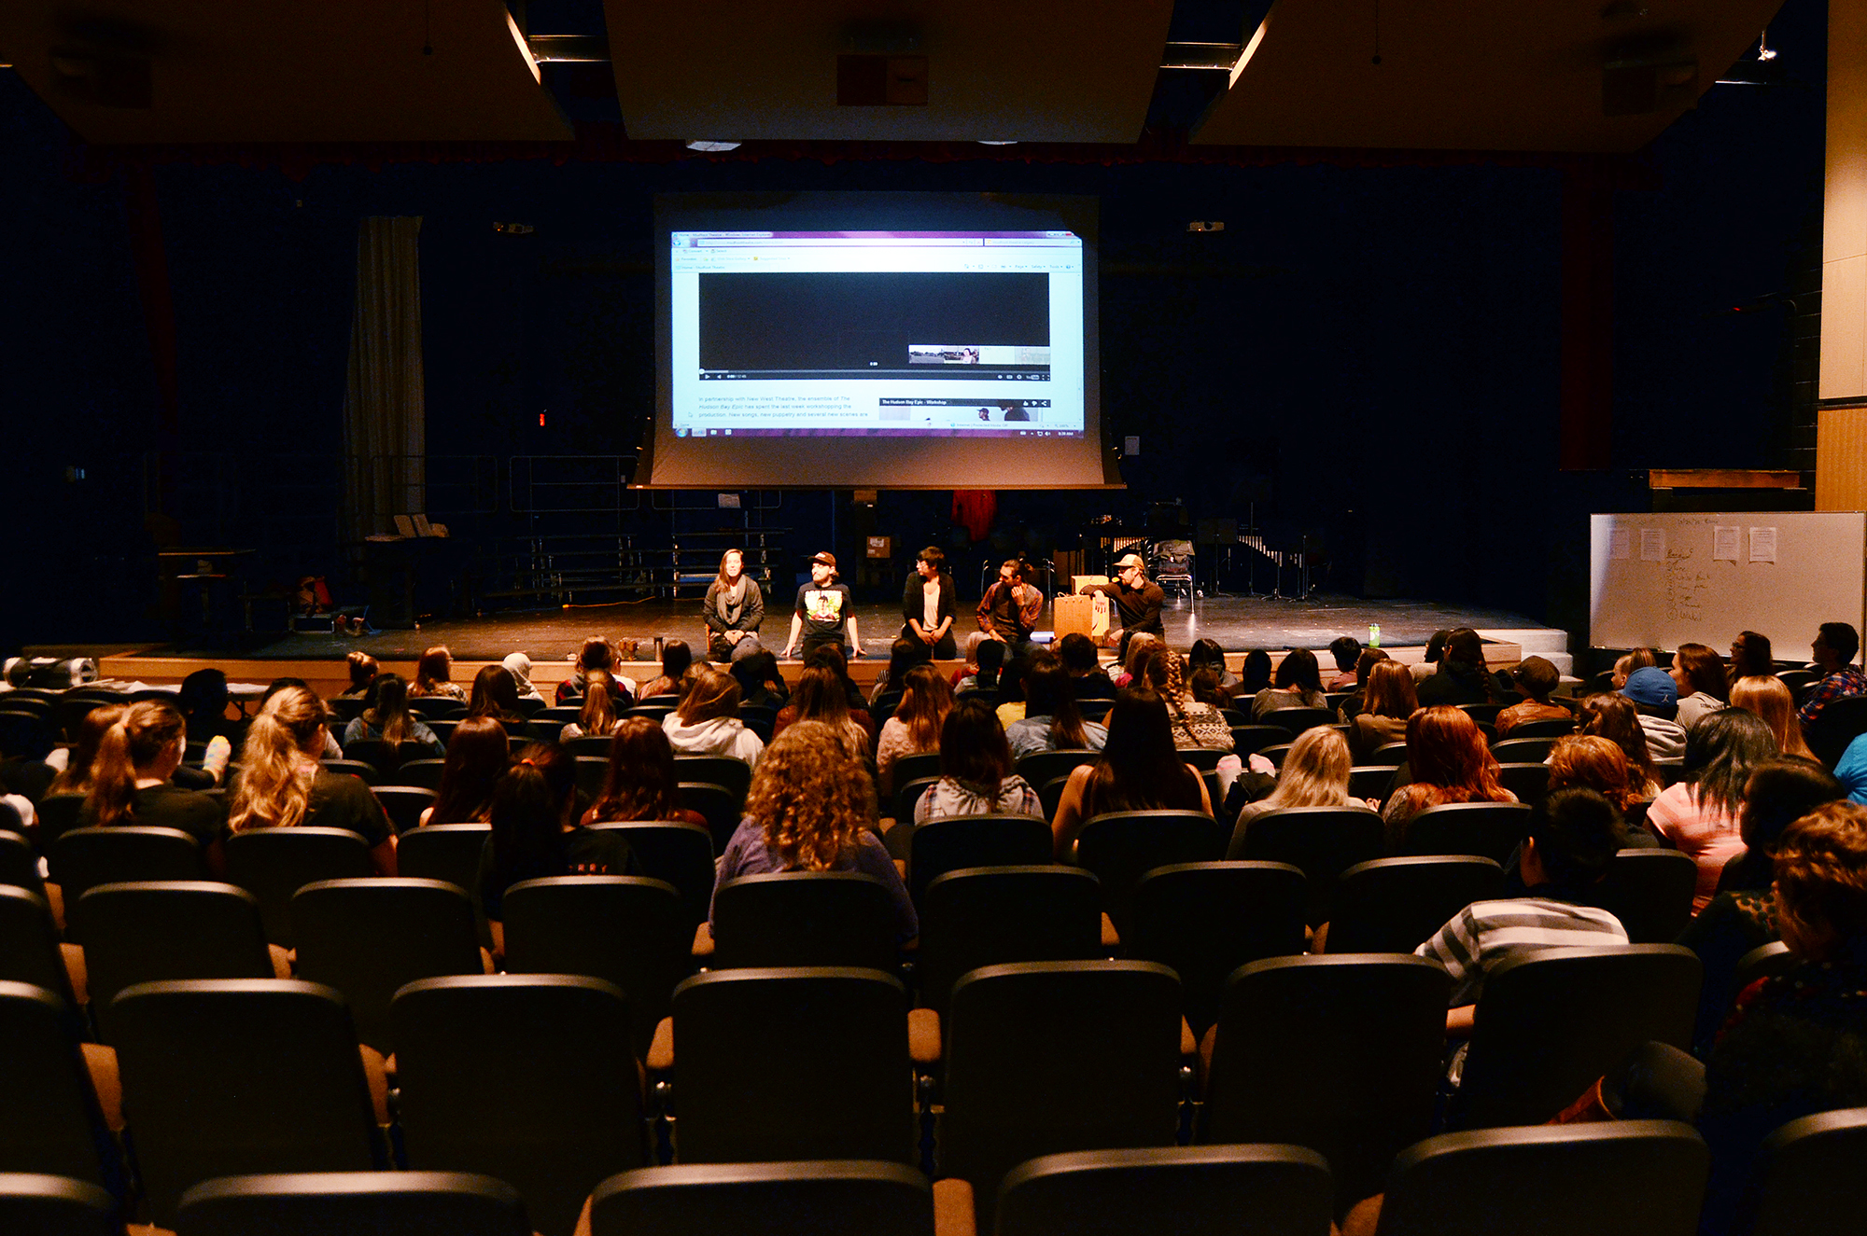

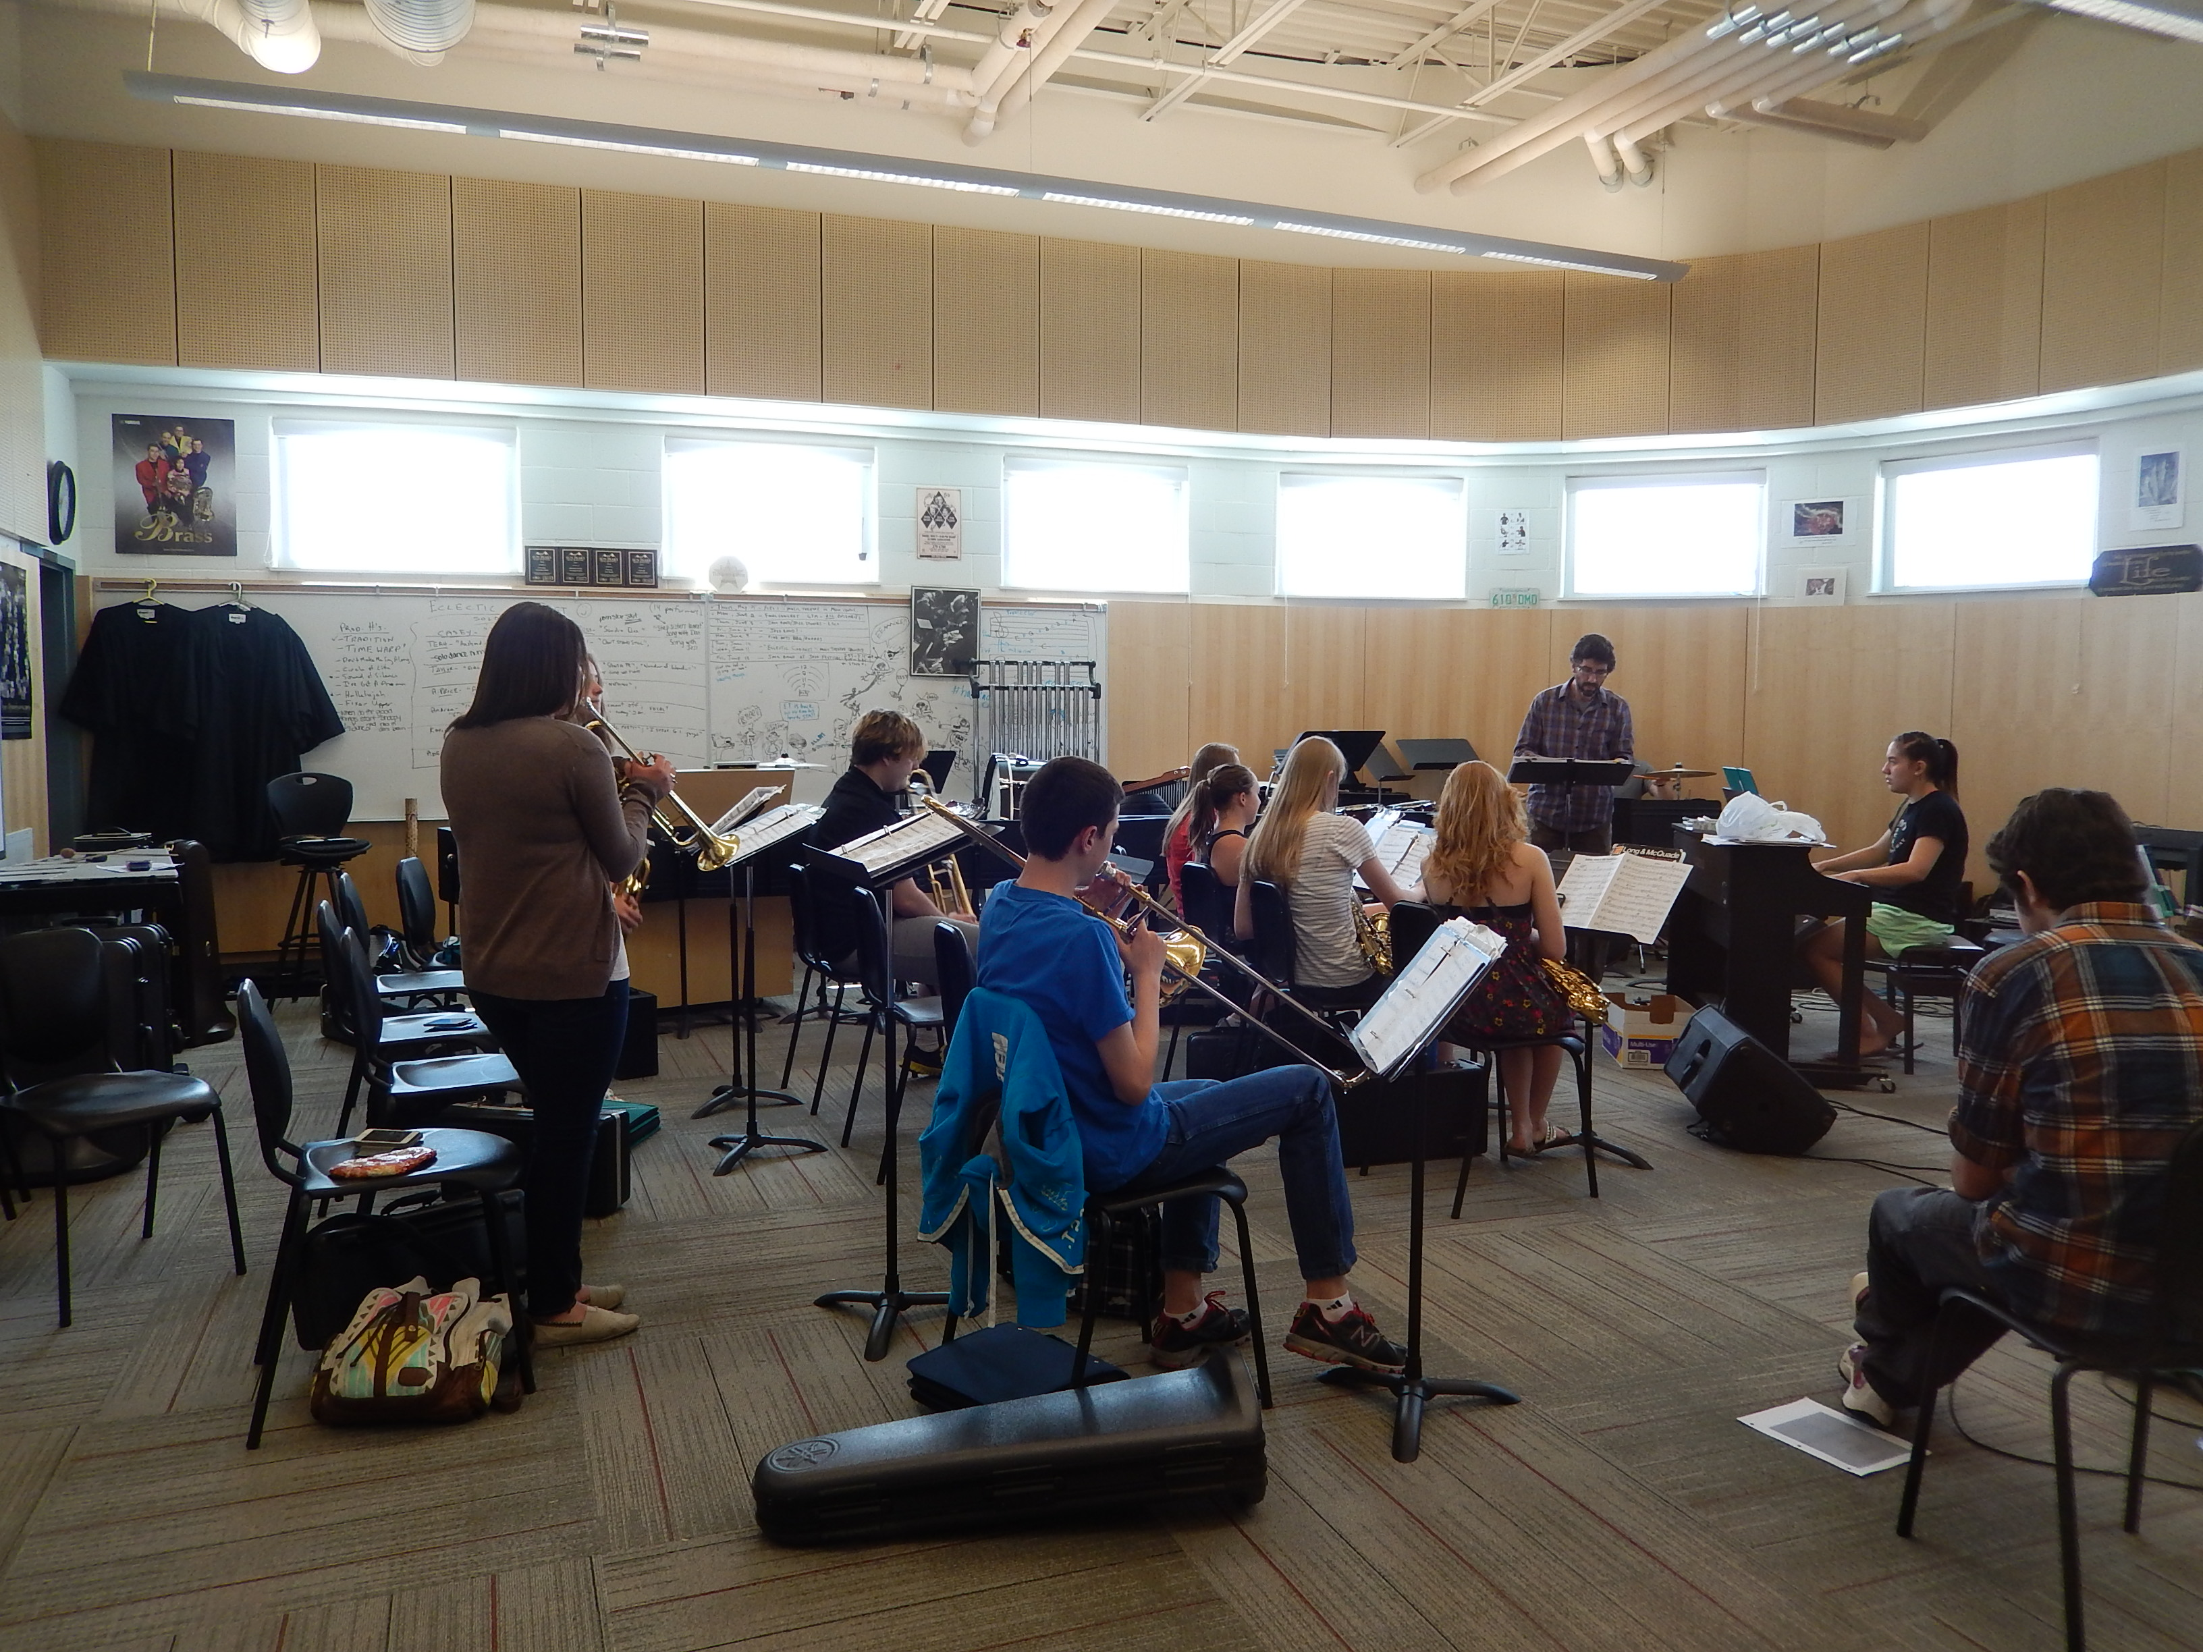
Chinook high school

Slide 14
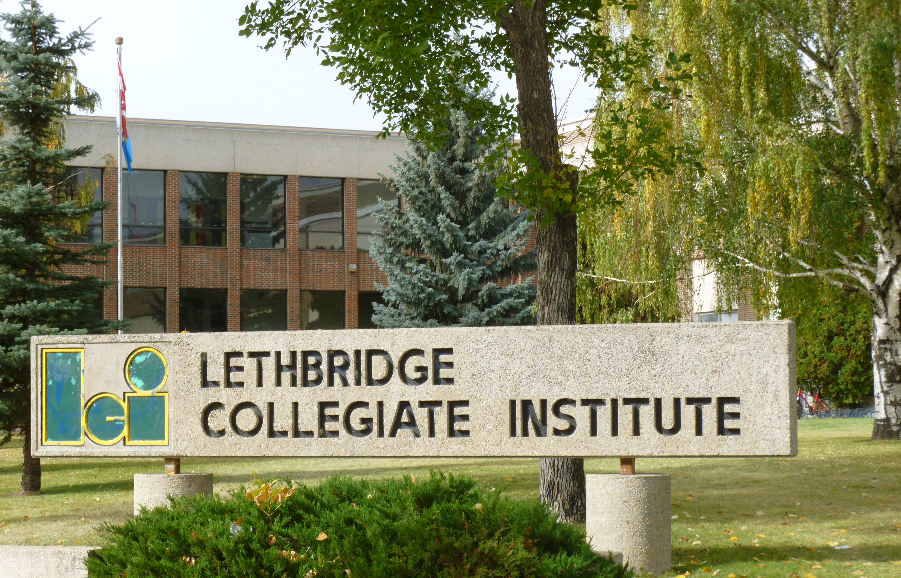
Lethbridge Collegiate institute
Our longest established high school – history of success
Two gymnasiums, state of the art computer labs
Strong language programs – ELL, German, Spanish, French Immersion, Japanese

Slide 15
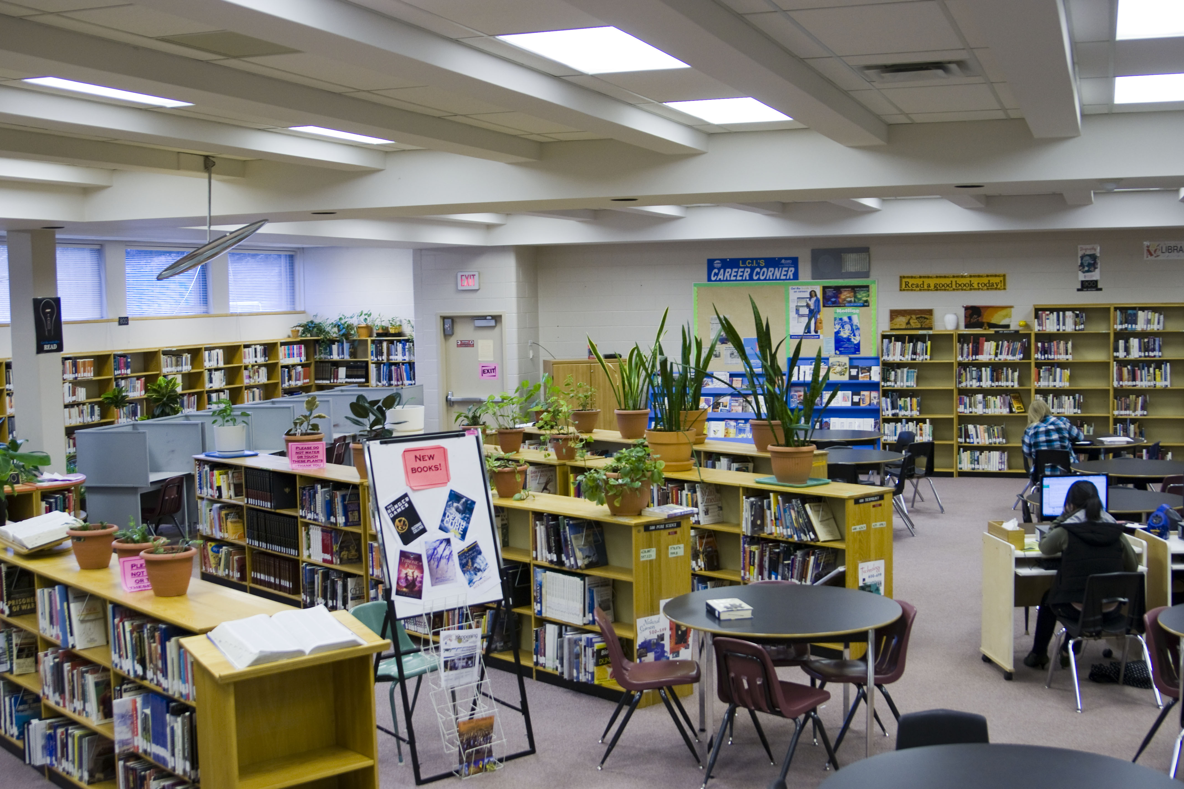
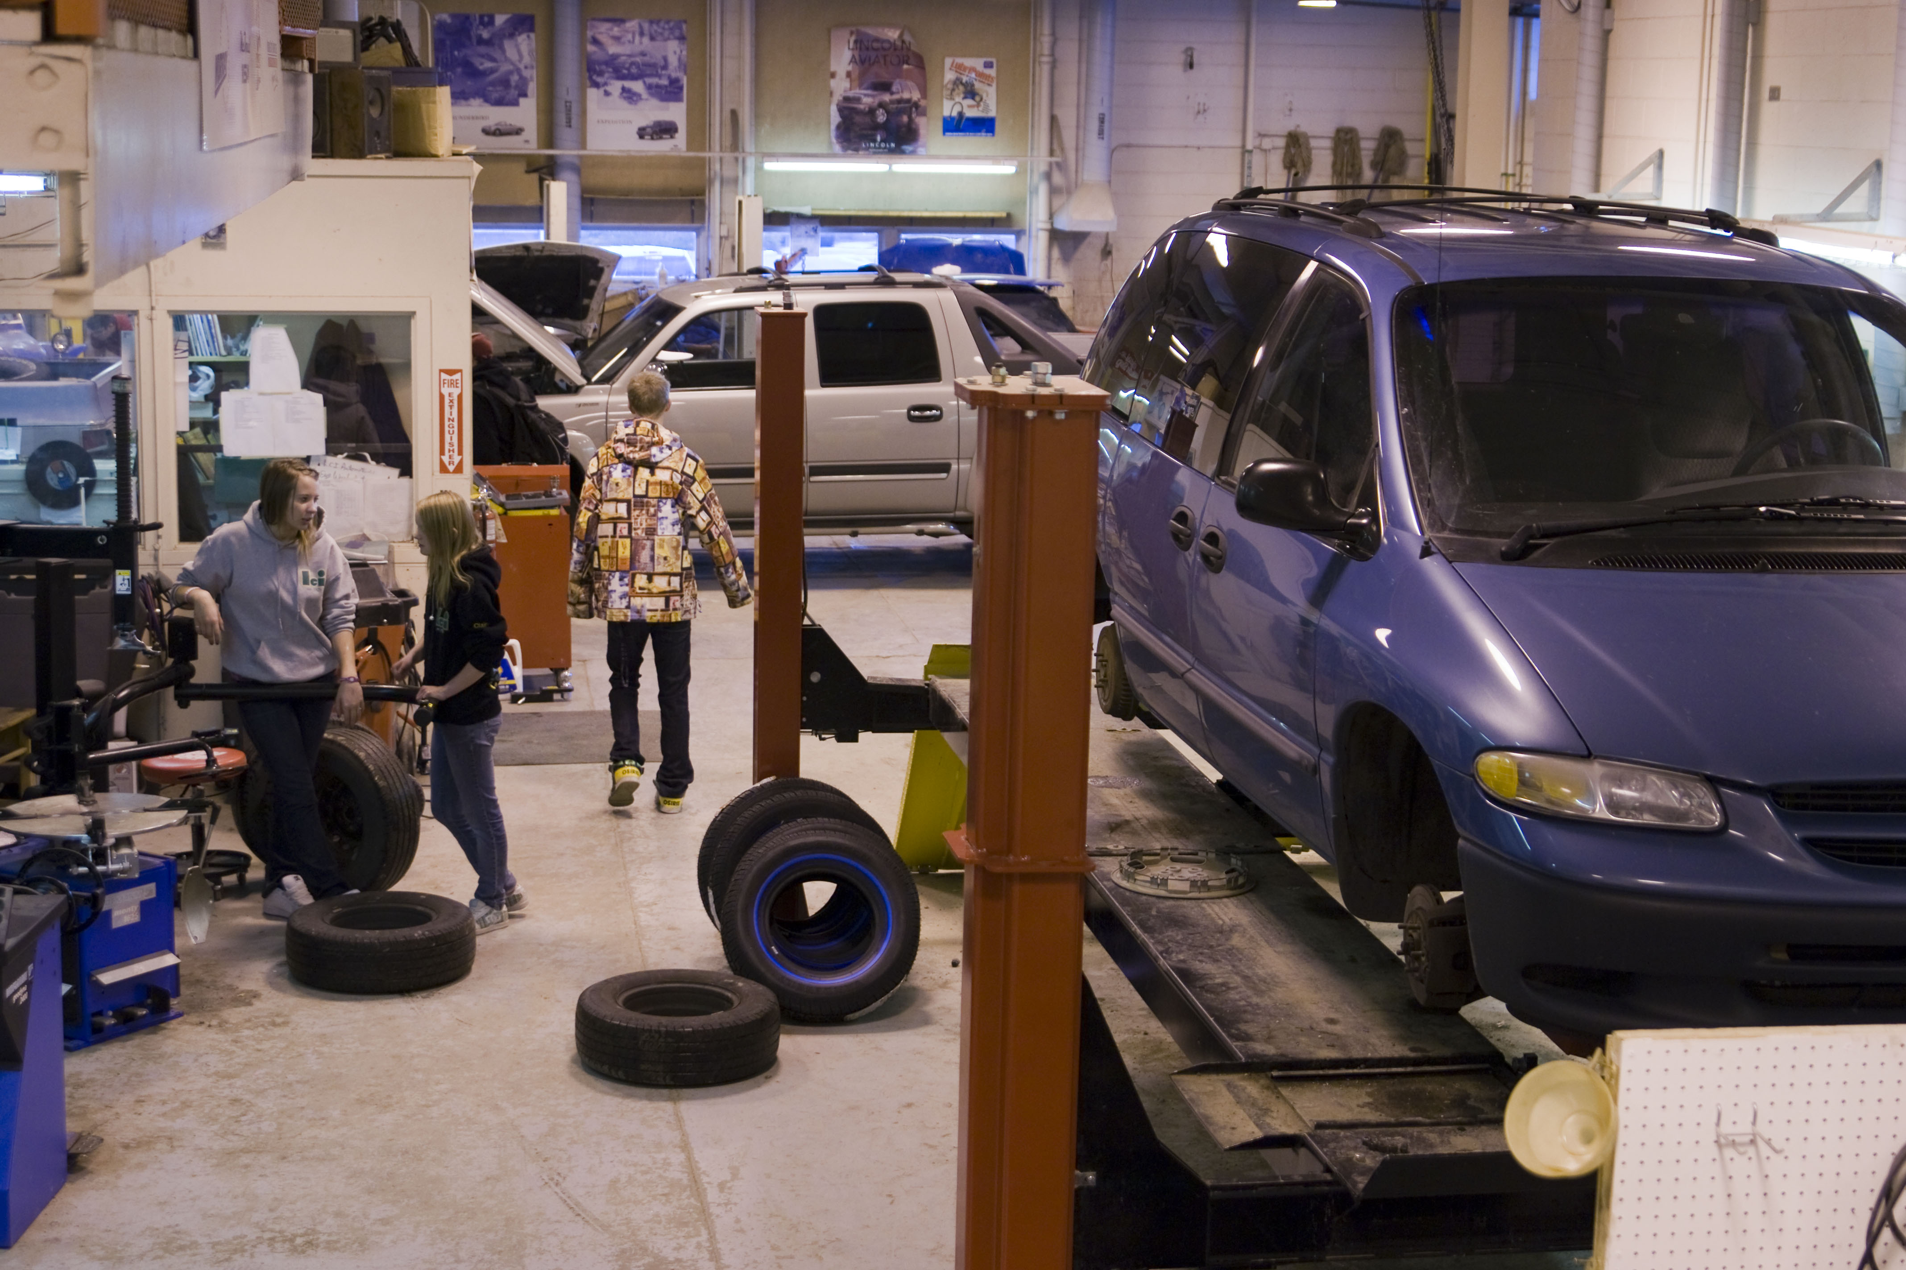
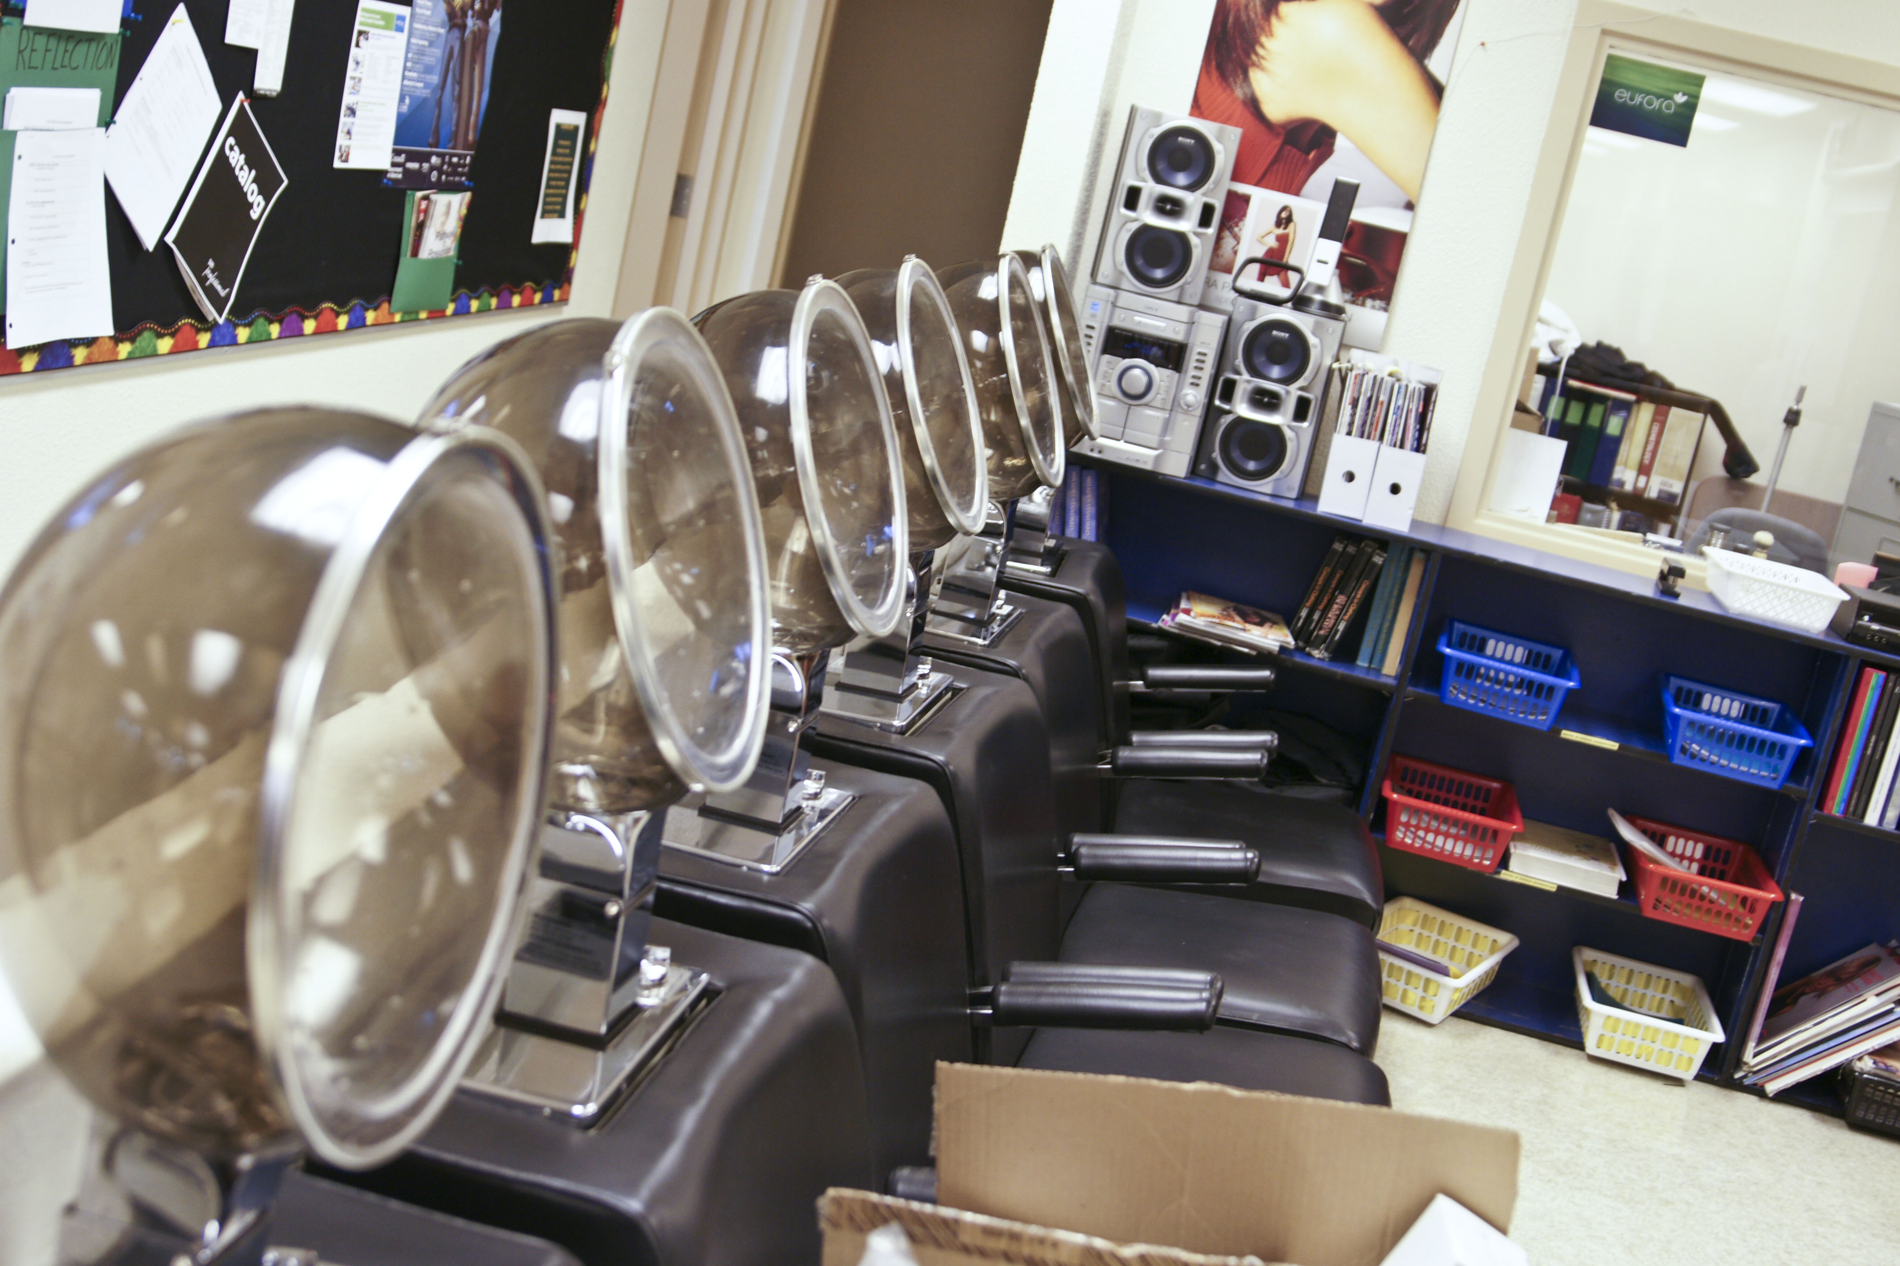
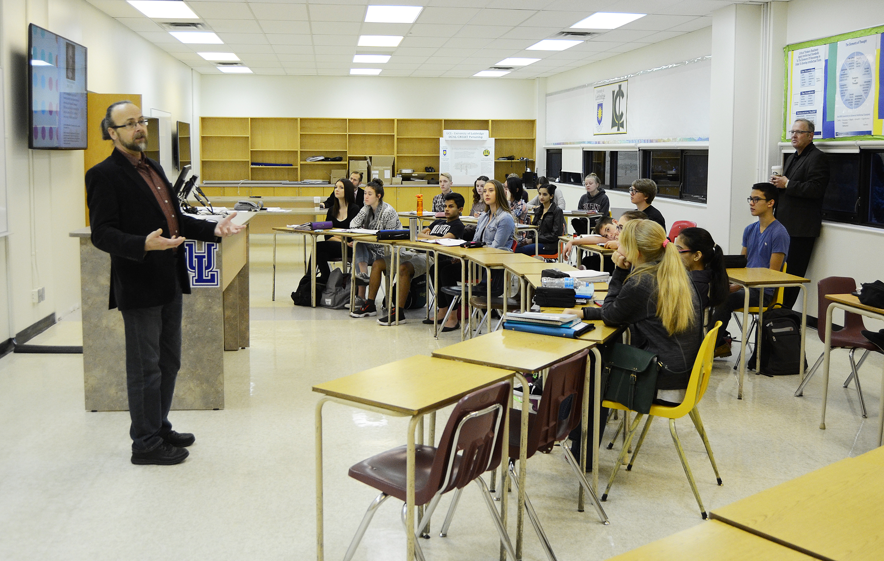
Lethbridge Collegiate institute

Slide 16
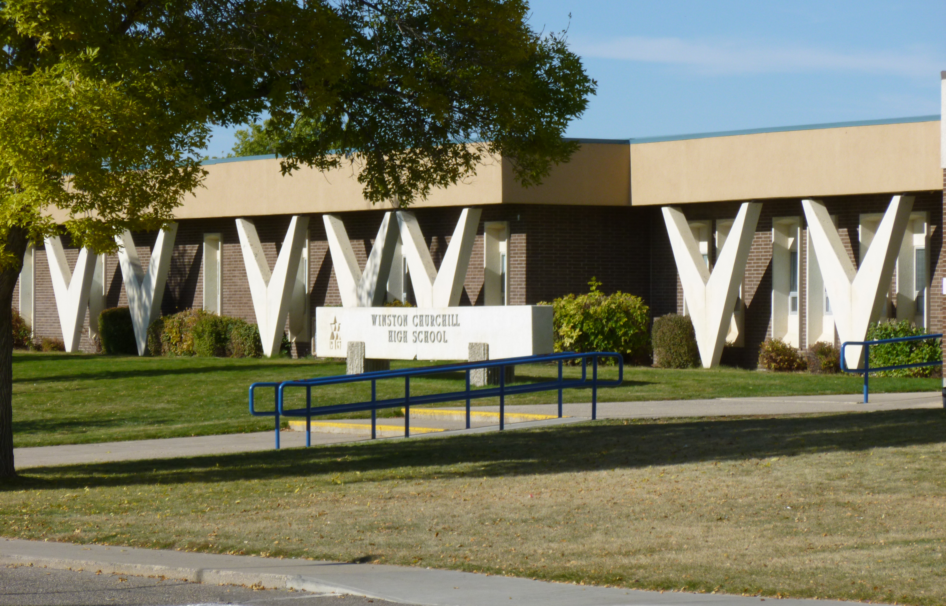
Winston Churchill high
Excellent academic and co-curricular programs – International Baccalaureate
Very diverse population of students from many cultures
Excel in sports programs and teams

Slide 17
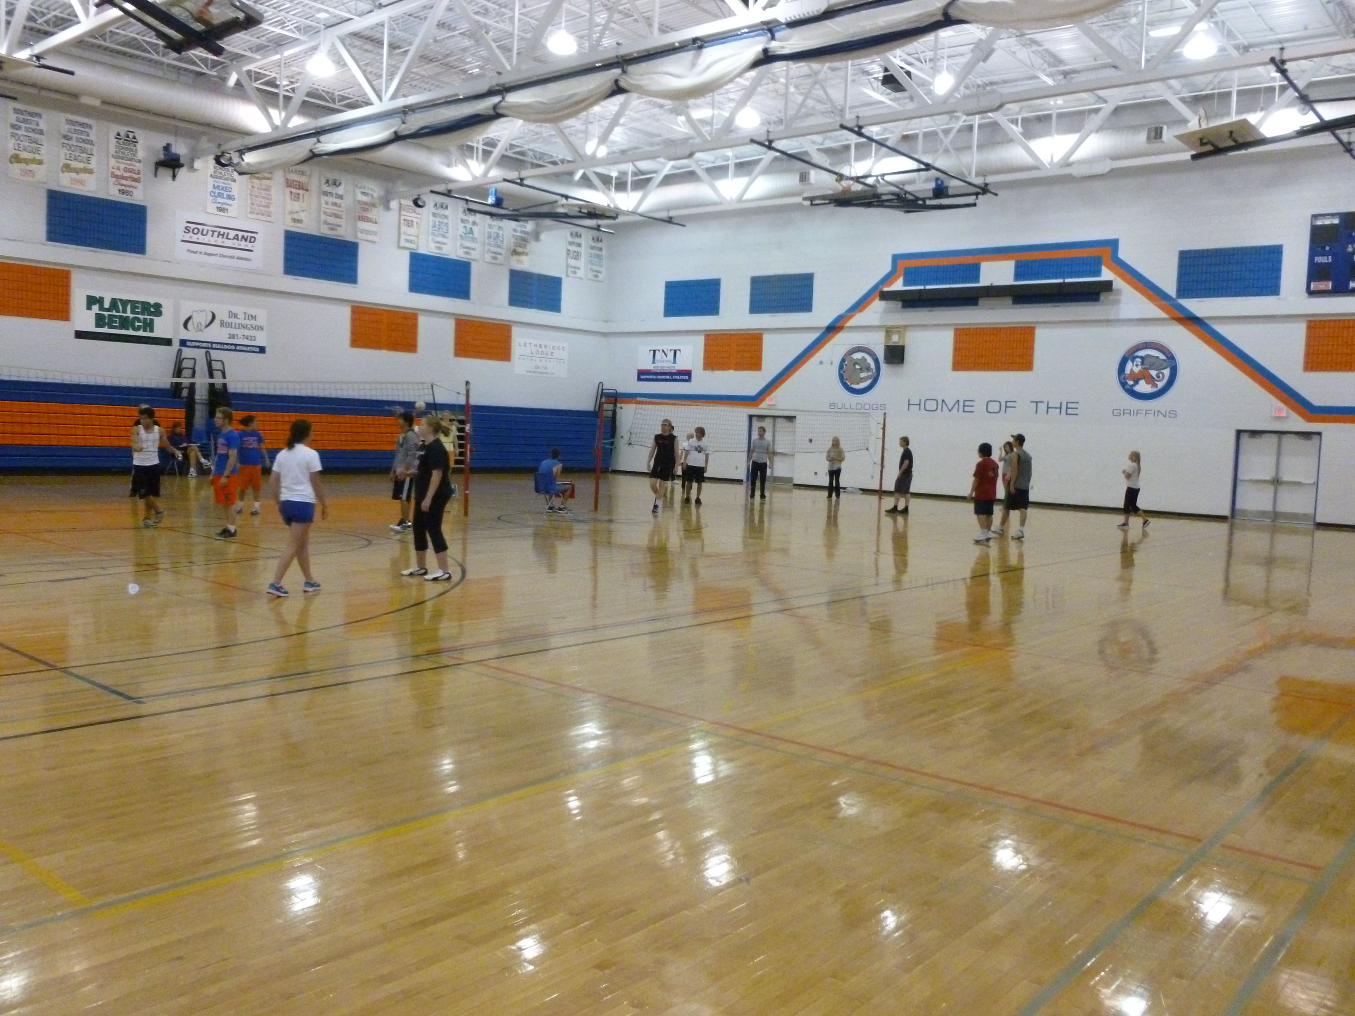
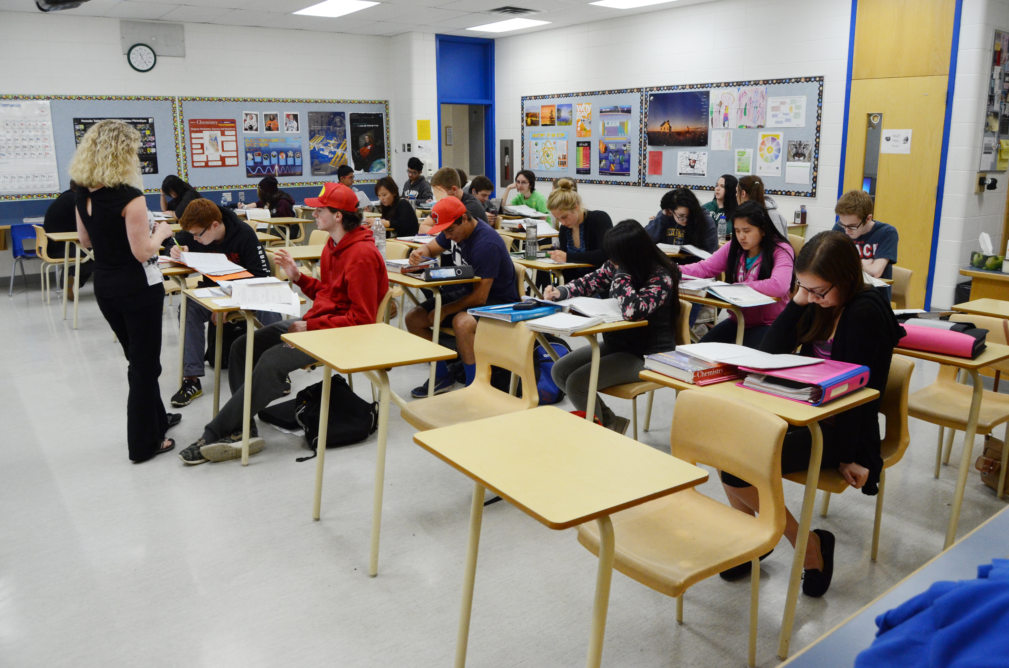

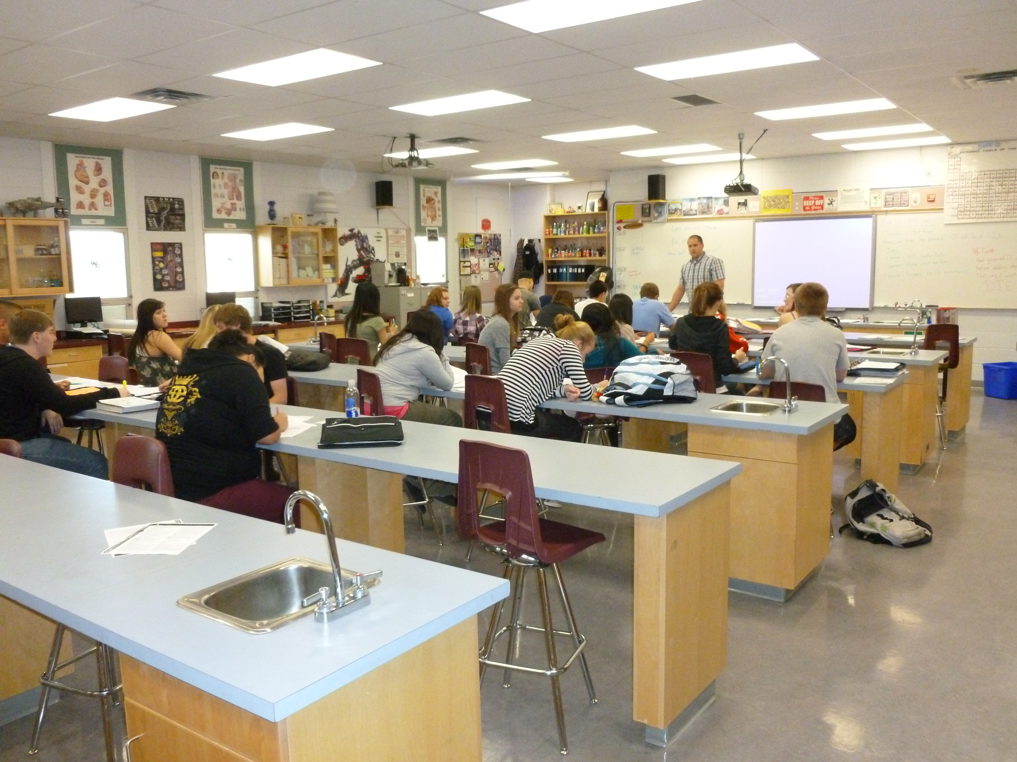
Winston Churchill high

Slide 18
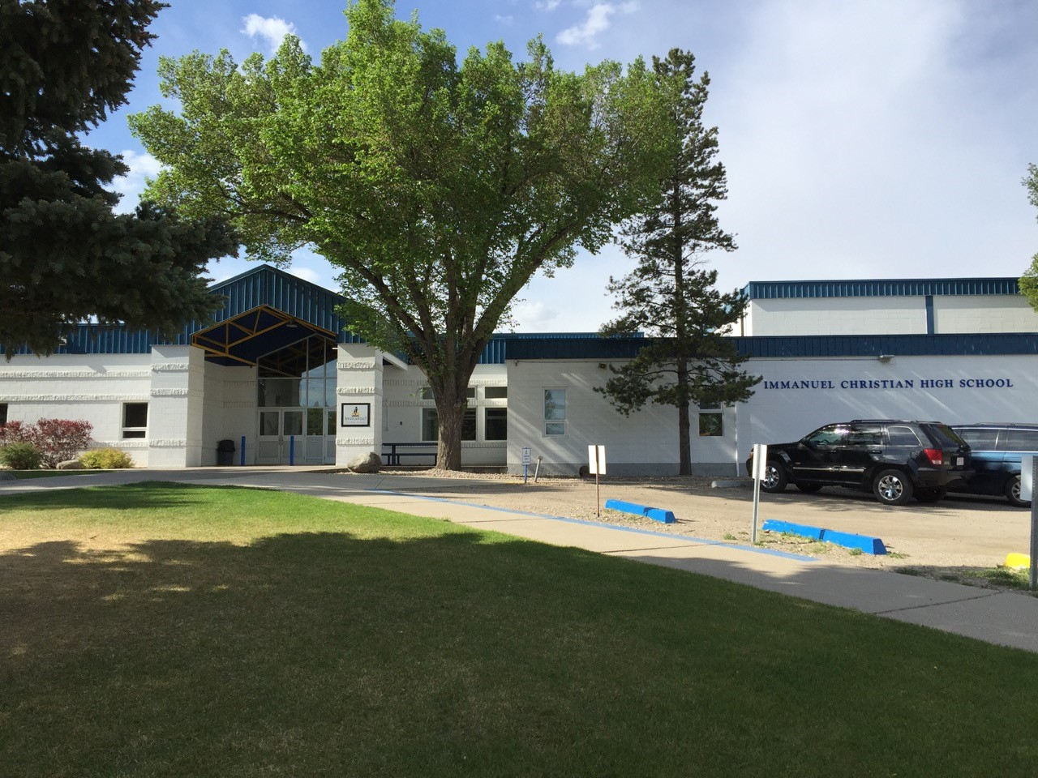
Immanuel Christian high
Excellent academic and co-curricular programs
Teach Alberta curriculum from the Christian perspective.
Small school population with a strong community spirit.

Slide 19
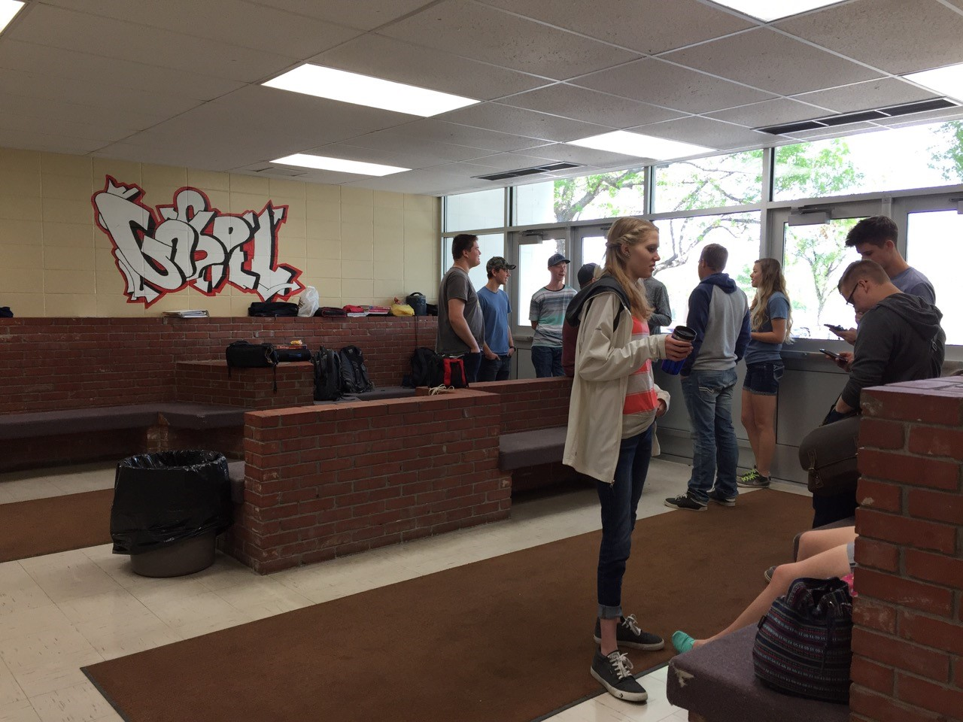
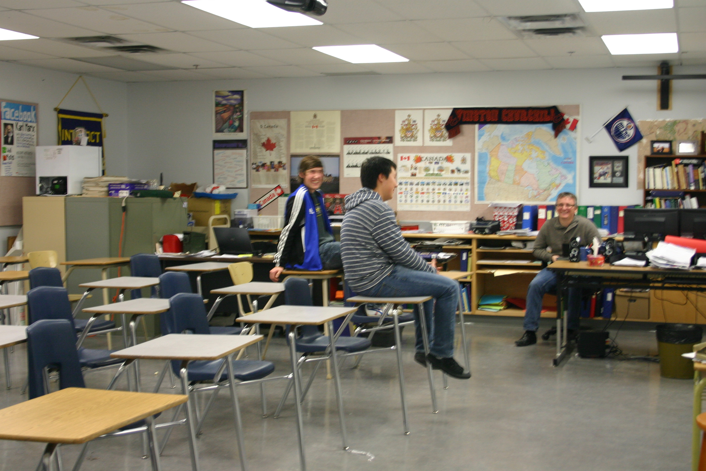
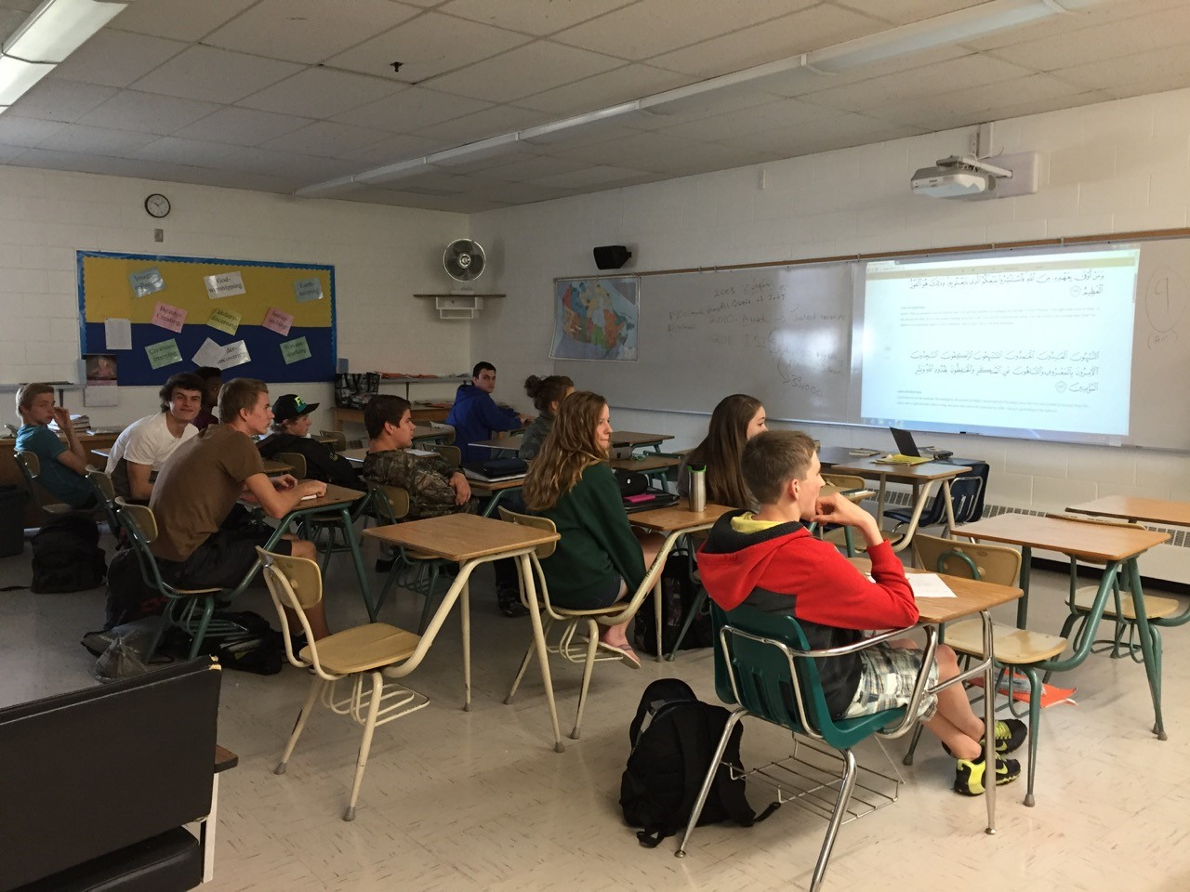
Immanuel Christian high

Slide 20


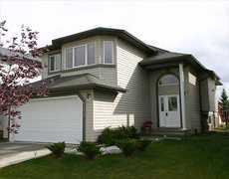
Where will my child live?
Carefully chosen homestay family – English-speaking family which enjoys teaching others about Canadian culture and enjoys learning about other cultures.
Within walking distance or bus ride to school.
a

Slide 21
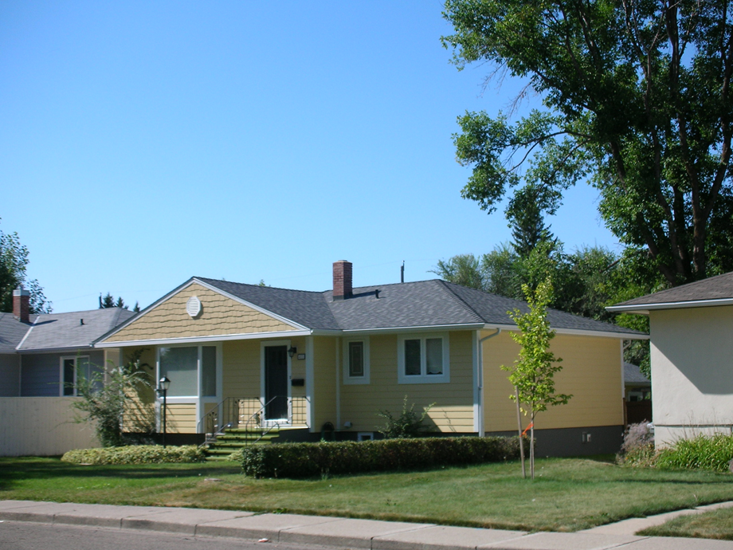
Where will my child live?
Single-family house with outdoor space.
Student will have his or her own bedroom and share the house with the family
Equipped with WIFI for email and Skype

Slide 22

WHAT SUPPORTS ARE THERE FOR STUDENTS IN HOMESTAY?
The Canada Homestay Network’s relationship manager also works in our International Services office
24/7 support through CHN
100% matching success rate to date (we’ve never needed to move anyone)

Slide 23
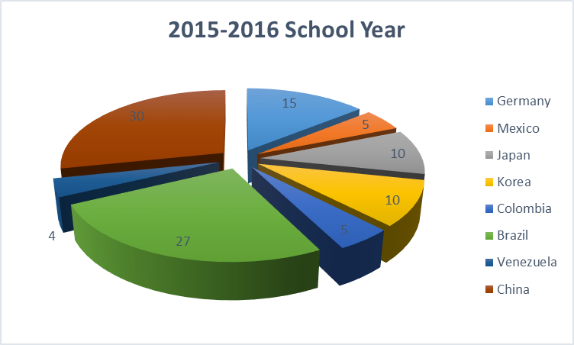
WHERE DO OUR STUDENTS COME FROM?
We have students from four different continents!
These statistics reflect full time equivalents of various nationalities.

Slide 24
Affordable quality education
For One School Year of Study in Lethbridge:
Compare with other Districts:
Calgary - $22 345
Vancouver - $24 800
Toronto - $27 025
Application Fee |  |  |  | $250.00
Homestay Placement/Custodian Fees |  |  |  | $950.00
Medical Insurance |  |  |  | $500.00
Tuition |  |  |  | $11 000.00
Homestay |  |  |  | $8 000.00
Airport transfers |  |  |  | $400.00
Total |  |  |  | $21 100.00

Slide 25
Alberta, Canada *

Slide 26
Study in Lethbridge
Succeed with us!

