Slide 1
The Registered Apprenticeship Program (RAP)

Slide 2
What is it?
The Registered Apprenticeship program is a modified apprenticeship program that permits a high school student to become an apprentice while attending high school. A RAP apprentice accumulates hours on-the-job training as credit towards his or her apprenticeship, and credit toward a high school diploma. A RAP student can earn up to 1000 hours of time credits toward an apprenticeship and simultaneously earn up to 40 credits toward senior high school diploma requirements.

Slide 3
Why RAP?
Skilled tradespeople are in short supply. A RAP apprentice begins learning a skilled trade as early as Grade 10
RAP gives employers an opportunity to find quality young employees, and to participate in their educational process
RAP offers an enriched high school education and provides an opportunity to learn skills industry needs
A RAP apprentice gets a realistic look at the work world and learns employability skills
Apprentices can combine trades with other post-secondary programs

Slide 4
What are the entrance requirements?
Grade 10 and age 15
HCS 3000, a one credit course. Most often students will complete this in Career and Life Management (CALM)
Strong recommendations: good academic standing in math, science and English and completion of Construction Safety Training System (CSTS)
Continue to take relevant CTS courses at school.
Demonstrate a genuine interest in RAP, have a good attendance record at school etc.

Slide 5
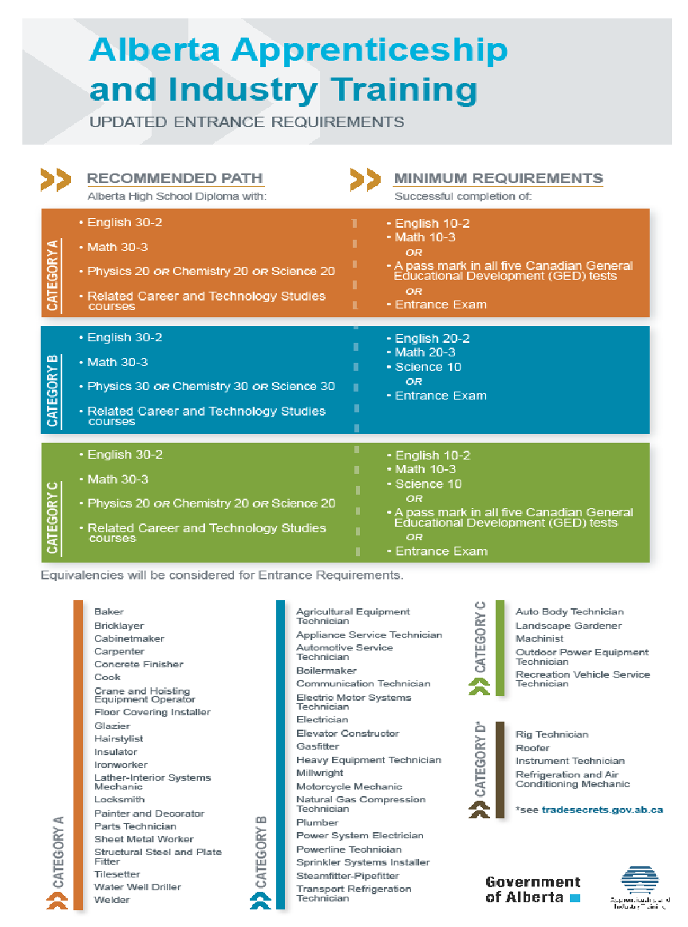

Slide 6
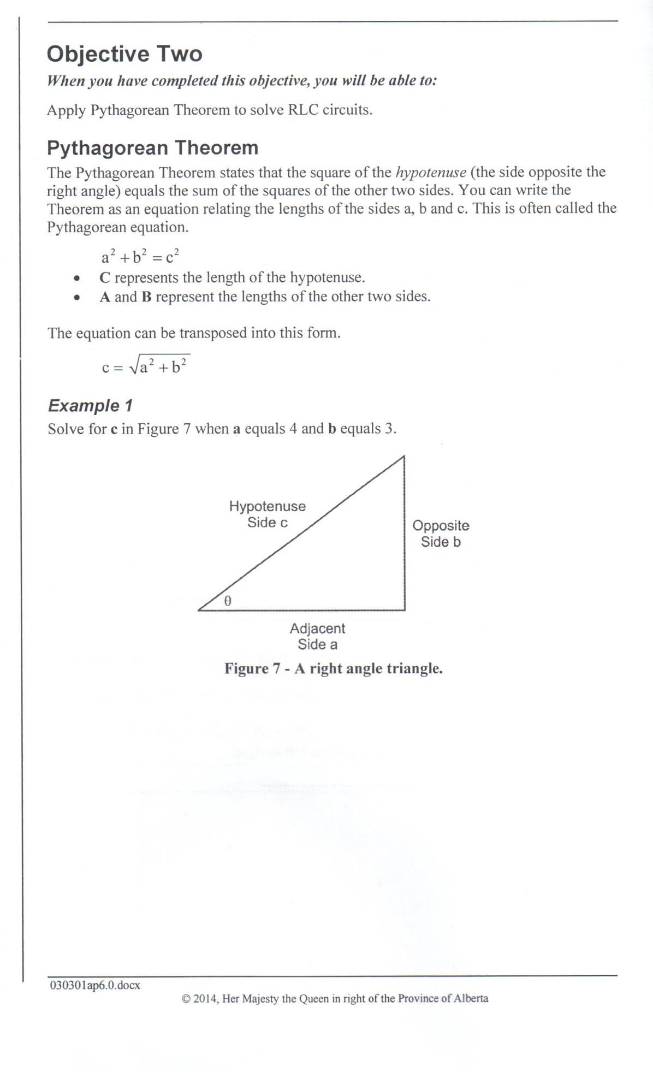

Slide 7
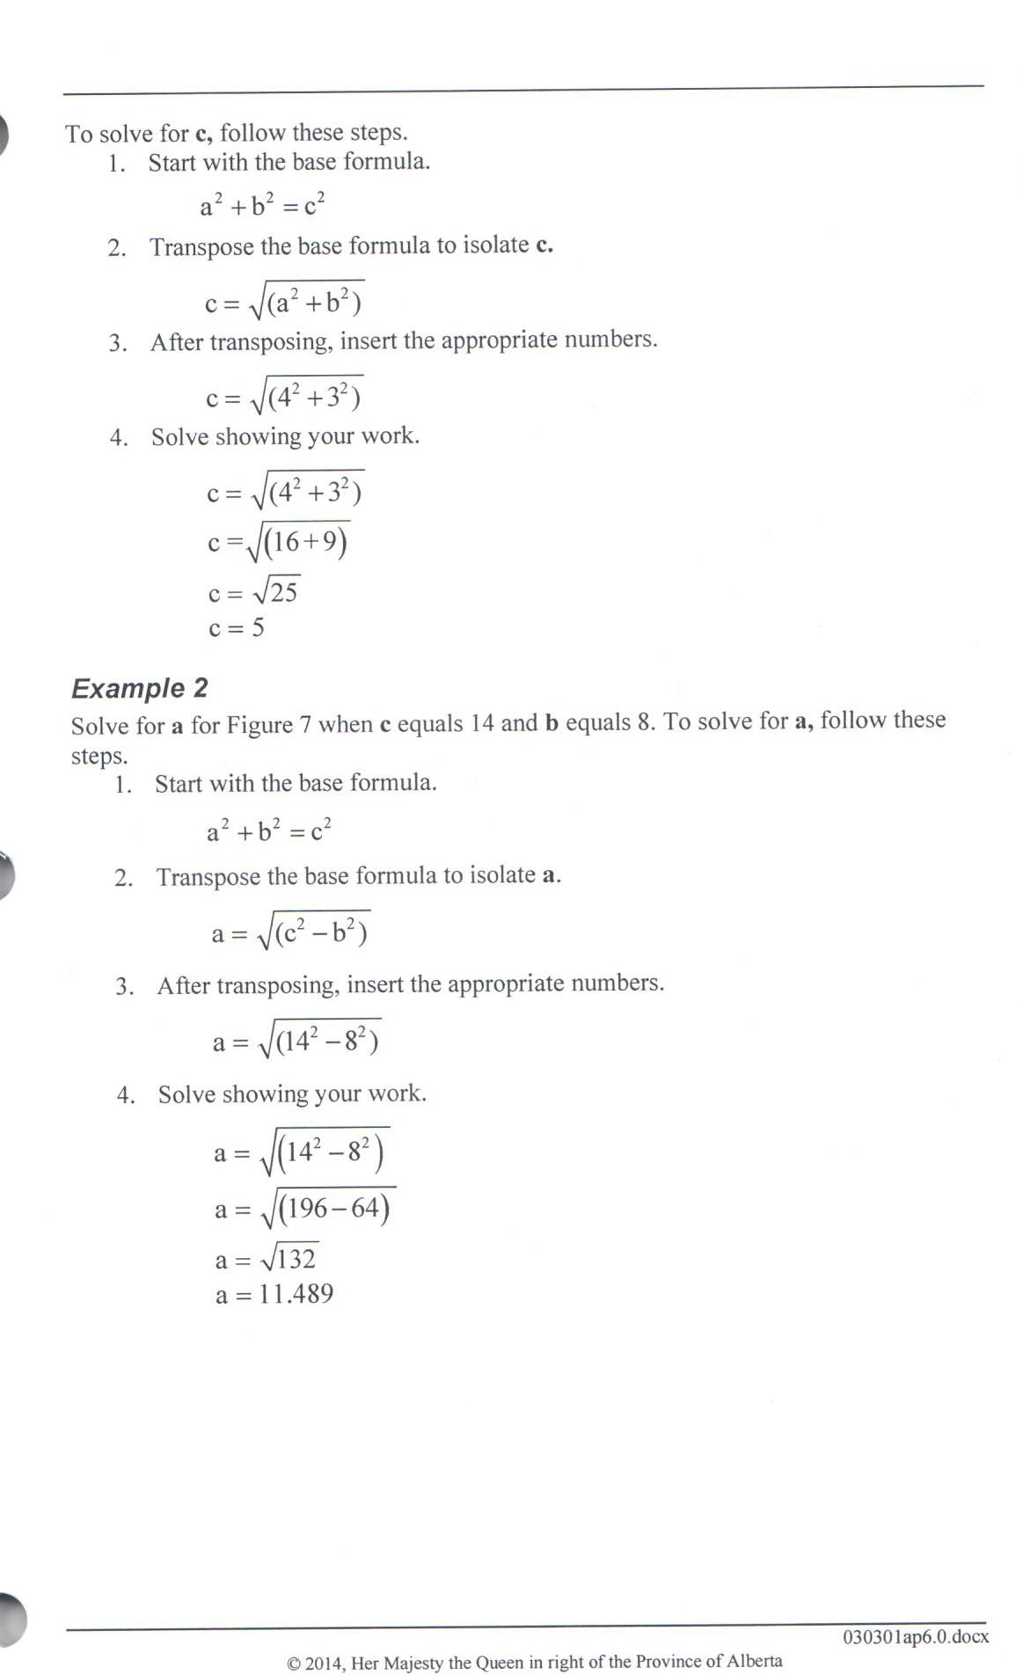

Slide 9
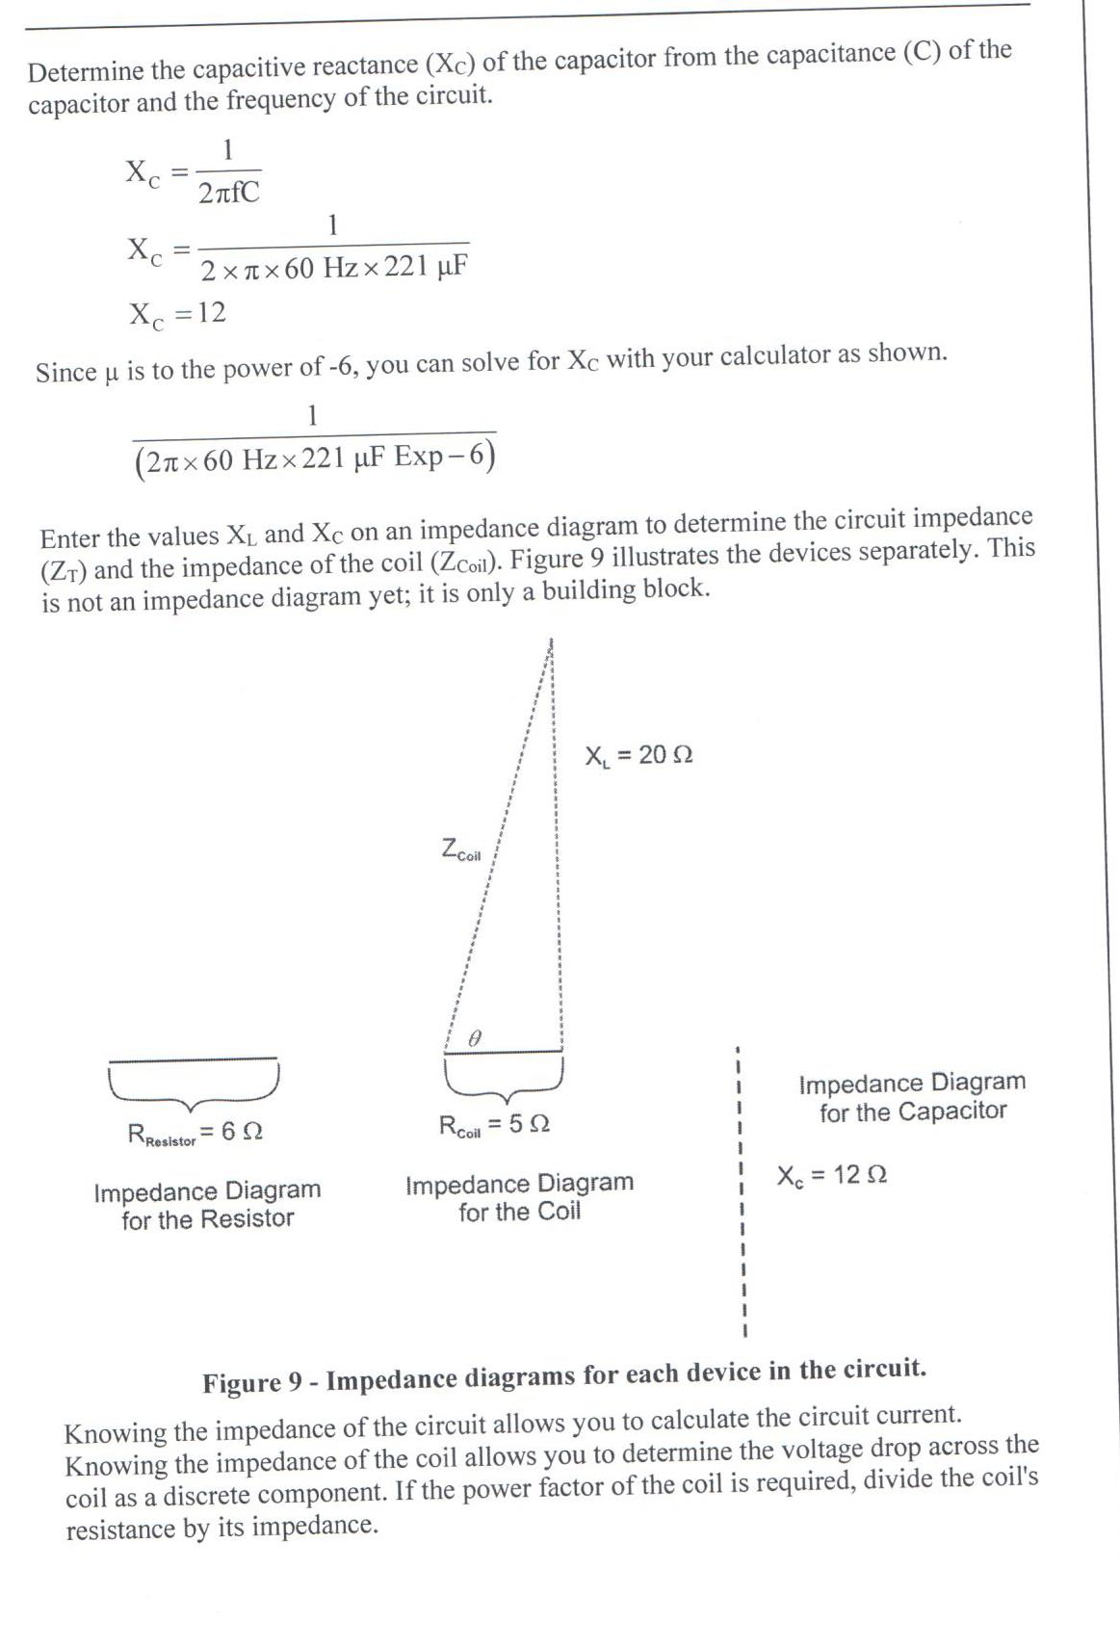

Slide 10
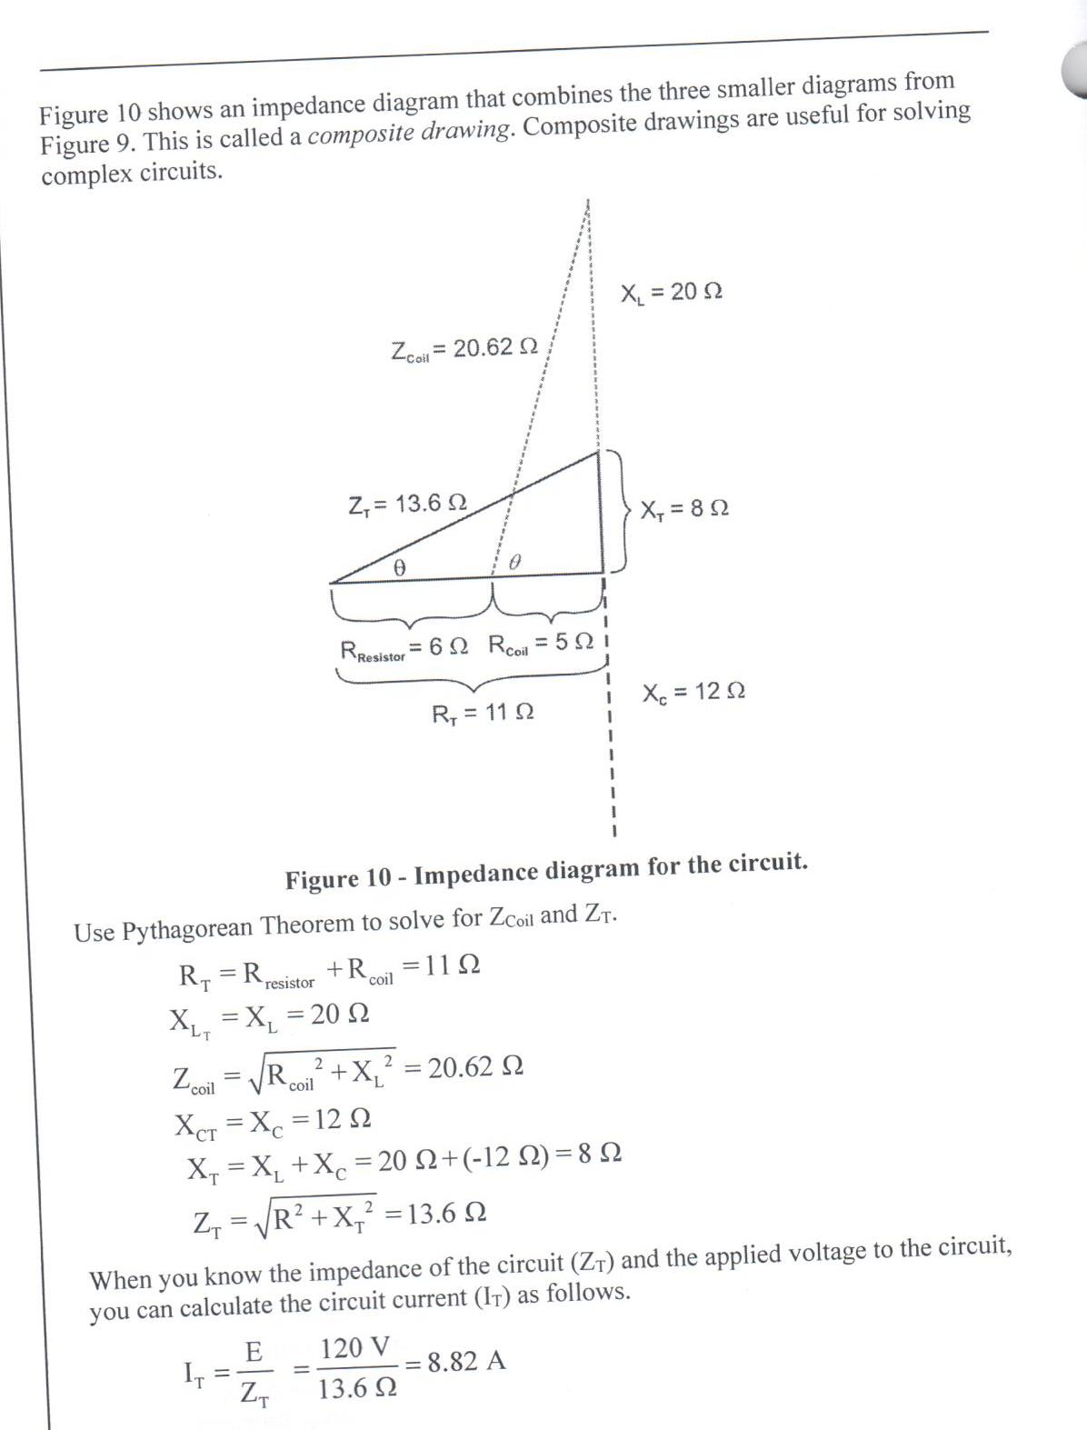

Slide 11
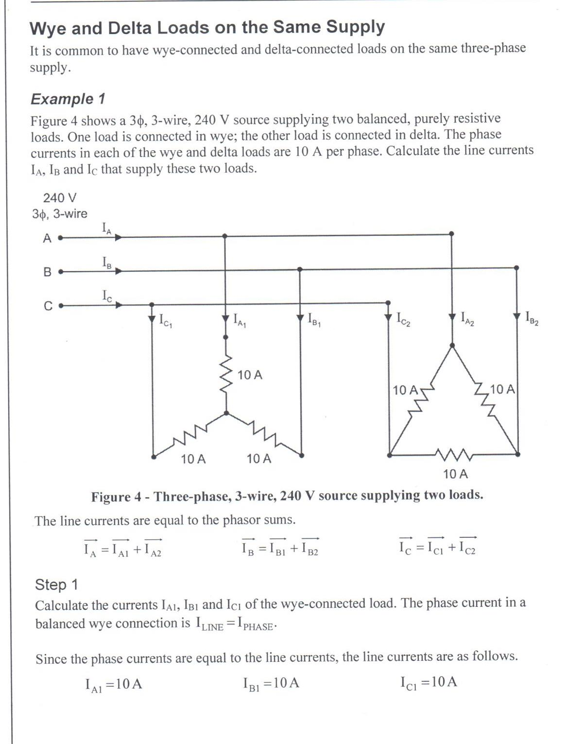

Slide 12
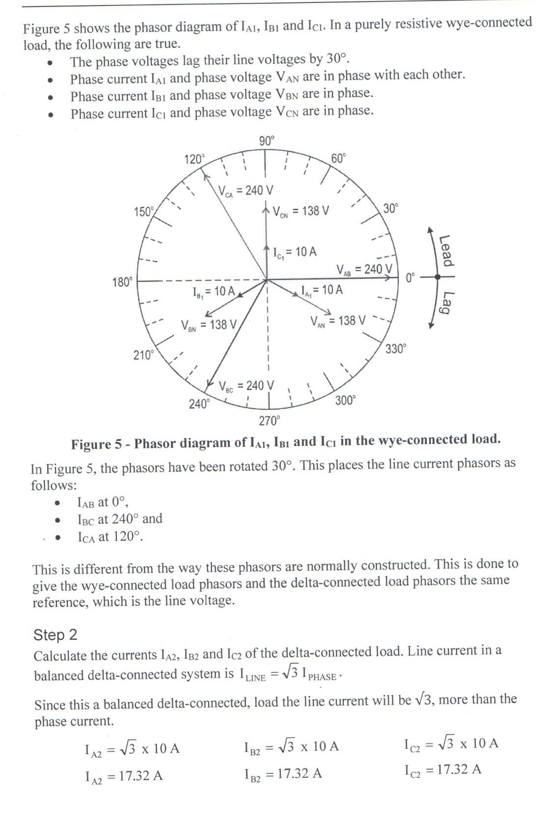

Slide 13
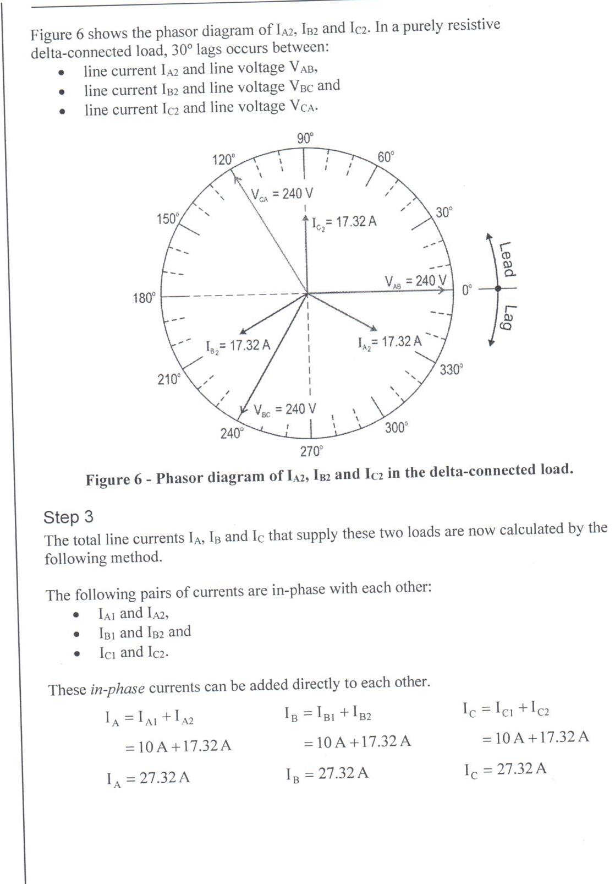

Slide 14
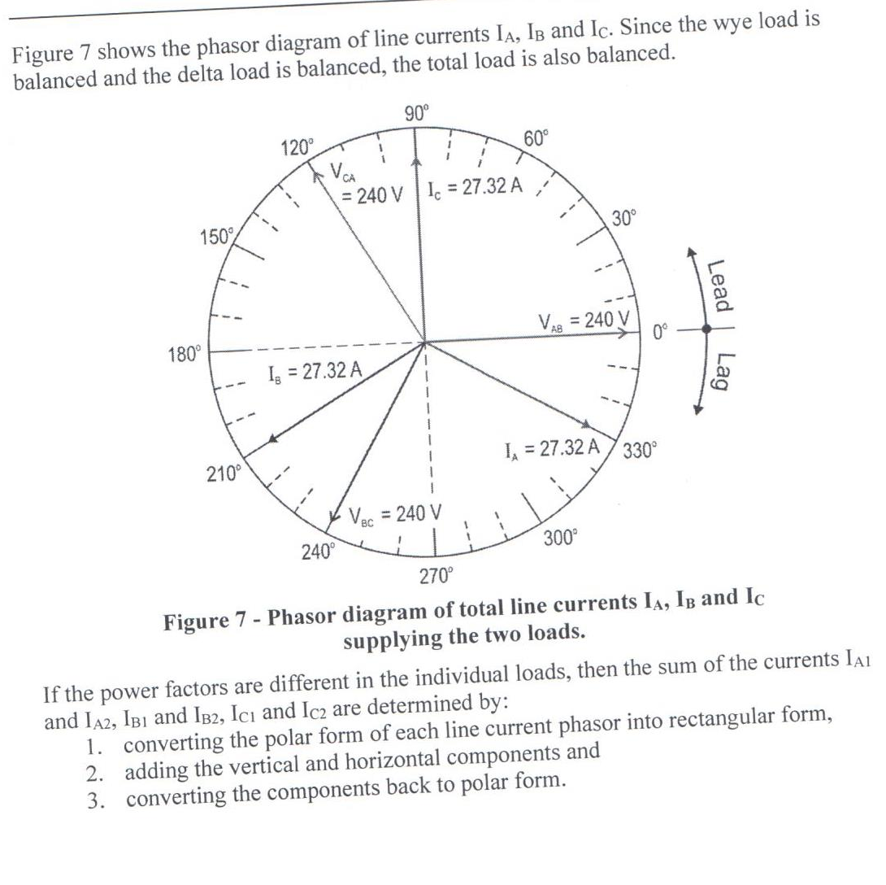

Slide 15
Work Experience
WE 15 25 35
3-10 credits each
75-250 hours
Process see Amy Court
Mondays and Fridays
amy.court@lethsd.ab.ca
Complete HCS 3000
Calm or in the ILC
Complete and return contract
Submit hours monthly

Slide 16
Advantages
Grad requirements up to 15 credits
Raise average for scholarships
Use as 5th course for college and university entrance requirements

Slide 17
LSD 51
Amy Court
amy.court@leth.ab.ca
(403) 894 0827
Andrew Krul
andrew.krul@lethsd.ab.ca
(403) 894 0375

Slide 18
Successes
1. Grade 10 LCI sheet metal worker.
2. Grade 11 WCHS heavy equipment technician.
3. Grade 12 Chinook electrical motor systems technician.
4.Grade 10 ICHS heavy equipment technician.
5. Grade 12 Victoria Park welder.

