Slide 1
Career Practitioners
Lethbridge school district #51

Slide 2
What is Career Development?
“Career Development is the lifelong process of managing learning, work, leisure, and transitions in order to move toward a personally determined and evolving preferred future.”
Source: Canadian Standards and Guidelines for Career Development Practitioners.

Slide 3
Career Practitioner
Role:
Support students by bringing awareness to the career planning process so they can make informed decisions about employment and post-secondary options

Slide 4
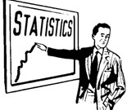
Statistics
(my favorite)

Slide 5
74.9% of students in Alberta graduate after three years of entering high school
of those graduates only 40% go on to post-secondary education
Estimates show that 70% of new positions in the labor market will require some level of post-secondary education
Notes:
Alberta High School Completion Strategic Framework https://ideas.education.alberta.ca/hsc/about/
Campus Alberta Planning Resource – A Learner Enabling System http://iae.alberta.ca/post-secondary/policy/capr/alearnerenablingsystem.aspx

Slide 6
Students are choosing post-secondary studies that leave them unemployed or underemployed
“…contributing factors to youth unemployment… a mismatch in skills and graduates having to work part-time jobs because their chosen industry is over-saturated.”
Notes:
http://business.financialpost.com/executive/careers/five-trends-that-will-shape-the-labour-market-landscape-in-canada-this-year

Slide 7
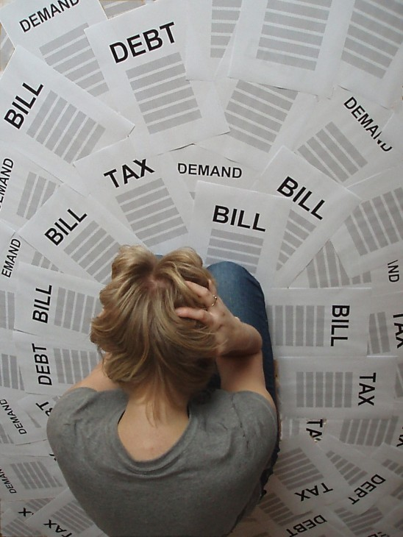
Post-Secondary-Financial Statistics
Average undergraduate tuition for full time students per year across Canada
$5,959
Average amount of student debt in Alberta after graduation
$28,000
The cost of a Bachelor’s Degree today is 20% higher than it was in the late 2000’s
http://www.statcan.gc.ca/tables-tableaux/sum-som/l01/cst01/educ50a-eng.htm
http://research.cibcwm.com/economic_public/download/if_2013-0826.pdf
Notes:
Stats Canada http://www.statcan.gc.ca/tables-tableaux/sum-som/l01/cst01/educ50a-eng.htm
BMO Canada http://www.huffingtonpost.ca/2013/08/14/alberta-student-debt-bmo-survey_n_3758535.html
CIBC study http://www.ctvnews.ca/business/canada-s-youth-at-risk-of-chronic-unemployment-cibc-study-1.1334197

Slide 8
Youth Unemployment Stats
Number of Canadian youth between the ages of 15-24 that are currently not working or enrolled in school?
1 in 10
http://www.ctvnews.ca/business/canada-s-youth-at-risk-of-chronic-unemployment-cibc-study-1.1334197
http://www.advisor.ca/news/industry-news/educated-youth-struggle-to-find-good-jobs-cibc-120881

Slide 9
One in five youth between the ages of 15-24 who are currently unemployed have never held a job
This number is 40% greater than the long term historical average
http://research.cibcwm.com/economic_public/download/if_2013-0620.pdf
Notes:
Dimensions of Youth Employment
in Canada
by Benjamin Tal

Slide 10
No experience
Can’t find a job
No experience
Can’t find a job

Slide 11
Don’t Let This Happen to You

Slide 12
Know Yourself
Choose a Direction
Make it Happen
Explore Possibilities
Guidelines to Career Planning

Slide 13
Know Yourself
Knowing yourself means knowing:
What you like and what you don’t
What is important to you
What are you good at

Slide 14
Explore Possibilities
Researching potential occupations

Slide 15
Choose a Direction
Find out what you need to pursue your occupation of choice
On the job training
Apprenticeship
Certificate
Diploma
Applied Degree
Bachelor Degree

Slide 16
Make it Happen
Identify your goals
Make plans
Put your plans into action

Slide 17
Sample activities the Career Practitioner and student may engage in are as follows:
Orientation to myBlueprint and Career Cruising
Completing Career and Interest Assessments
Assessing goals
Evaluation of high school courses and discussing future course selection
Scholarship Information
Resume Development
Post-Secondary Applications
Connecting students with related community services, school based events and off-site activities
Post-Secondary Research
Job Search Support

Slide 18
Have Questions?
Contact your school Career Practitioner today
Phone
Email
In person appointments

