Slide 1
2017
TOWN HALL
Lethbridge School District No. 51

Slide 2
Innovation
“What strategies can be implemented to develop innovative thinkers within schools as well as outside of schools in collaboration with parents, business, industry and community?”

Slide 3
LAST YEAR – LOOKED INTO FUTURE AND CAME UP WITH THE BIG IDEAS FOR A NEW VISION that would prepare our students for success into the future
Vision
Learners are innovative thinkers who are successful, confident, respectful, and caring.
Generated ideas during Town Hall – then refined with online feedback loop.

Slide 4
TONIGHT….
DEVELOP ACTIONABLE STRATEGIES TO FURTHER THE BOARD PRIORITY OF DEVELOPING INNOVATIVE THINKERS.
WITHIN SCHOOL
AS PARENTS – WITHIN THE HOME; IN PARTNERSHIP WITH THE SCHOOL
AS BUSINESS AND INDUSTRY
AS COMMUNITY (SERVICES TO CHILDREN AND FAMILIES, POST-SECONDARY, COMMUNITY MEMBERS WHO ENGAGE WITH YOUTH).

Slide 5
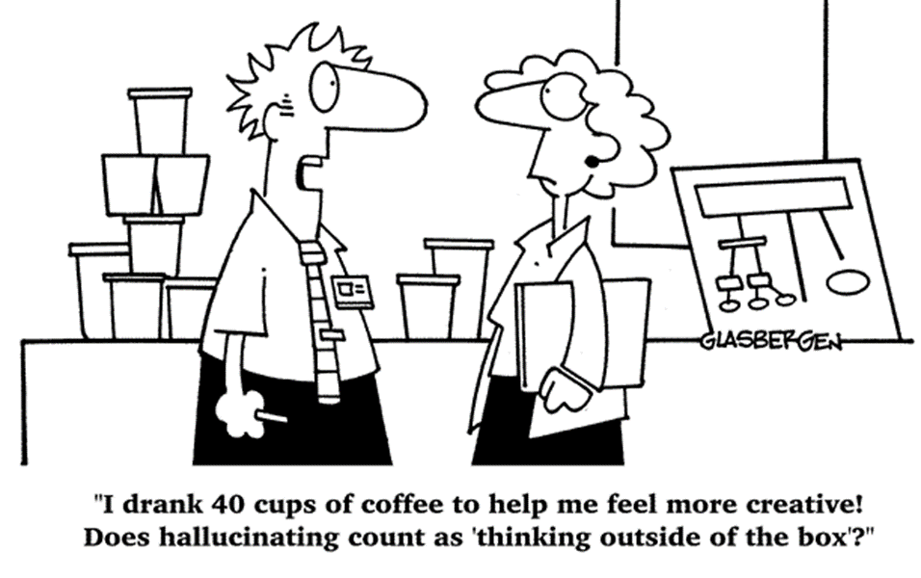
PROCESS
Generate ideas

Slide 6
PROCESS
Share Ideas – World Café (you will be at 3 different stations – see nametag numbers).
Narrow ideas (At third station)
Rank ideas

Slide 7
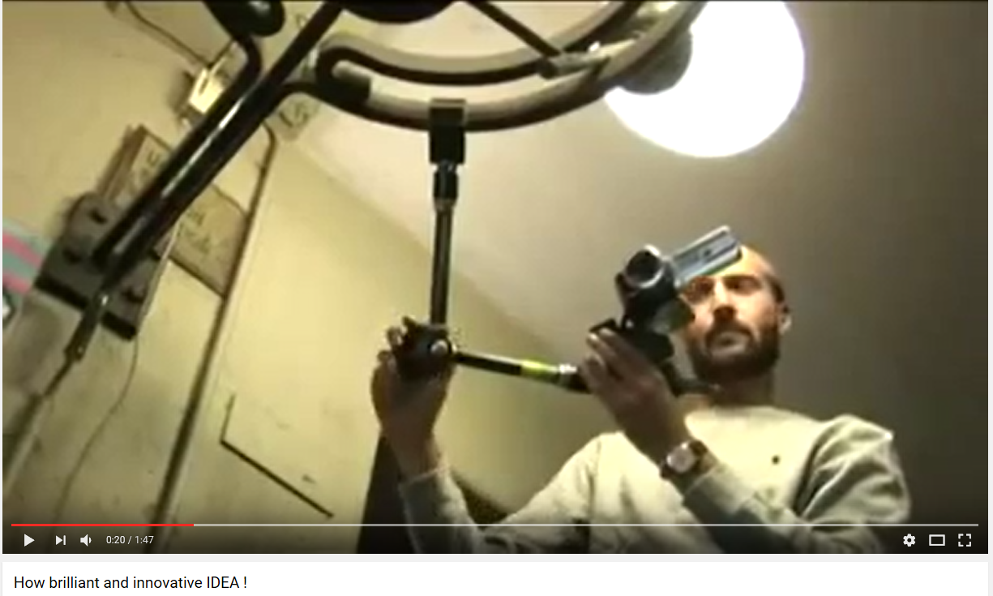
Example of a simple innovation

Slide 8
INNOVATIVE THINKERS CAN… WORD CLOUD

Slide 9
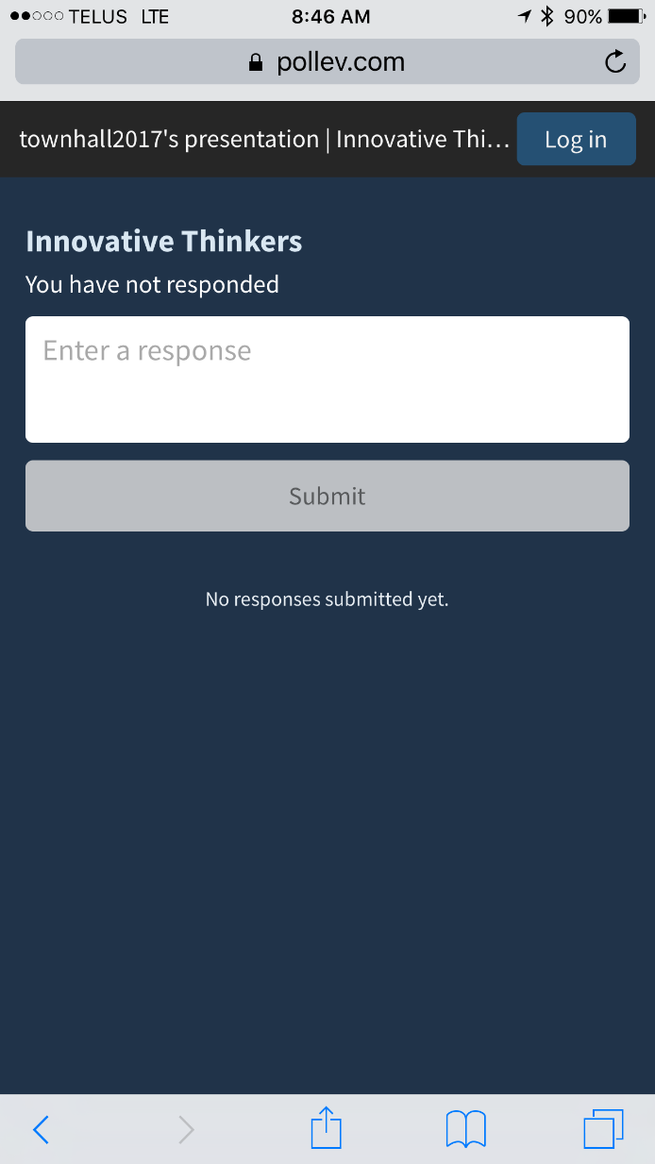
Respond at PollEv.com/townhall2017

Slide 10
INNOVATION
Broadly defined, innovation is any new idea or activities that can ultimately add value.
How value is defined depends on who is making the judgement of value (contribution of a product, process, social action). It answers a question (how can this be done better?), solves a problem or addresses an issue.

Slide 11
Innovative Thinking
Generally, innovative thinking is thought of as a blend of creativity and critical thinking.
Creativity generates ideas
Critical thinking is about exploring ideas—looking at information, synthesizing ideas, and making informed judgements, choices, or decisions.

Slide 12
ALL STUDENTS CAN BE INNOVATIVE THINKERS
PROVEN THAT INNOVATIVE THINKING IS MORE NURTURE THAN NATURE
EVERYONE IS CREATIVE
EVERYONE CAN BE A CRITICAL THINKER
SO…. EVERYONE CAN BE AN INNOVATIVE THINKER.
Some may be more fluent than others, but all it takes the right environment and practice opportunities to develop into an innovative thinker.

Slide 13
Process – World Cafe
Question broken into four:
What strategies can be implemented to develop innovative thinkers within schools?
What strategies can be implemented to develop innovative thinkers outside of schools in collaboration with parents?
What strategies can be implemented to develop innovative thinkers outside of schools in collaboration with business and industry?
What strategies can be implemented to develop innovative thinkers outside of schools in collaboration with community? (e.g. post-secondary, services for children, youth and families, youth groups, local government)

Slide 14
You will rotate to three groups.
For each group, generate ideas for “Actionable Strategies.”
What are actionable strategies?
If the objective is to develop innovative thinkers, actionable strategies are tangible “actions” that will contribute to this objective.
SHORT TERM OR SPECIFIC TIMELINE
ACTIONS THAT CAN BE IMPLEMENTED, MONITORED AND MEASURED – NOT BIG IDEAS
MAY NEED TO START WITH A BIG IDEA, BUT NARROW TO ACTIONS.

Slide 15
EXAMPLE
Goal: Productivity in the workplace.
Big Idea: Make the entire day as productive as possible.
Narrow Big Idea: Focus on increasing productivity during afternoon slump
Actionable Strategies:
Plan for a break during the slump (research says 8 -10 minutes every 52 minutes).
Drink Water as soon as you feel sleepy.
Move – walk around the halls or up and down stairs
Clean work space (mindless task but gets you moving and organized at the same time).

Slide 16
Process
Round One: Group has a key question.
Generate and record ideas (20 min.)
Round Two: You will be at a group with a different question.
Review what is already there; generate and record additional ideas or refine existing ideas (20 min.)
Round Three: You will be at a group with a different question.
Review, generate or refine ideas (15 minutes)
Rank top ideas on the sheets by voting with dots
Refine top two ideas into actionable strategy statements
Submit t be included in a ranking process by the whole group

Slide 17
ROUND ONE
20 MINUTES
Brainstorm; share ideas (does not matter if they are broad or narrow – get ideas going). Give everyone the chance to share their thoughts.
Facilitator – will record actionable strategies or ideas that can later be refined into actionable strategies.

Slide 18
ROUND TWO
20 MINUTES
Review ideas already recorded
Brainstorm; share ideas (does not matter if they are broad or narrow – get ideas going). Give everyone the chance to share their thoughts.
Facilitator – will record actionable strategies or ideas that can later be refined into actionable strategies.

Slide 19
ROUND THREE
15 MINUTES
Review ideas already recorded
Brainstorm; share ideas; refine, record
20 MINUTES
Take time to look at all of the ideas
Consider which ideas you believe can be actionable AND will have the highest impact
Place your dots on what you believe are “best” ideas (distribute however you like)
Choose top two and write actionable strategies – facilitator will submit the strategies

Slide 20
15 MINUTES

Slide 21
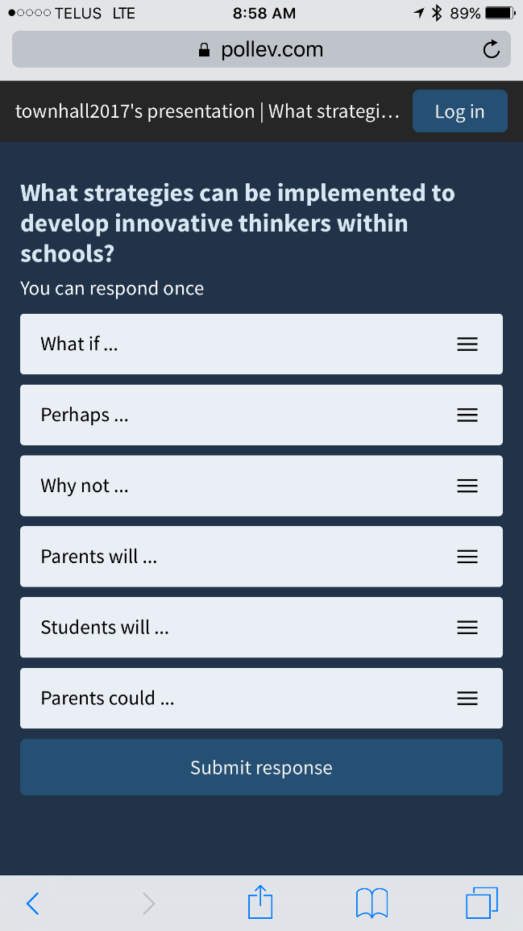
Respond at PollEv.com/townhall2017

Slide 22
Question One
What strategies can be implemented to develop innovative thinkers within schools?
Rank 1 to 6 by placing the strategies in order (what you believe to be the best at top, 2nd best next, and so on).

Slide 23
Question Two
What strategies can be implemented to develop innovative thinkers outside of schools in collaboration with parents?
Rank 1 to 6 by placing the strategies in order (what you believe to be the best at top, 2nd best next, and so on).

Slide 24
Question Three
What strategies can be implemented to develop innovative thinkers outside of schools in collaboration with business and industry?
Rank 1 to 6 by placing the strategies in order (what you believe to be the best at top, 2nd best next, and so on).

Slide 25
Question Four
What strategies can be implemented to develop innovative thinkers outside of schools in collaboration with community? (e.g. post-secondary, services for children, youth and families, youth groups, local government)
Rank 1 to 6 by placing the strategies in order (what you believe to be the best at top, 2nd best next, and so on).

Slide 26
NEXT STEPS
Results will be posted on website
Trustees will use the results to inform their strategic planning process in March.

Slide 27
Evaluation Form
You have the opportunity to provide feedback using Poll Everywhere or paper (available at stations).
If you are still in Poll Everywhere, you should see the question, "what went well?”
Once time has been provided for participants to respond to this question, we will close the question and the second question will be opened, “suggestions that would make future town hall meetings more successful.
THANK-YOU

