Slide 1
2016
TOWN HALL
Lethbridge School District No. 51

Slide 2
Contemporary World
The

Slide 3
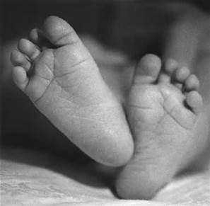
Did You Know?
More than 83 million people will be born this year?
They will be born into a data economy.

Slide 4
POPULATION GROWTH
TODAY THERE ARE 7.3 BILLION PEOPLE
BY 2050 THERE WILL BE 10 BILLION

Slide 5
DID YOU KNOW….
25% OF THE POPULATION IN CHINA WITH THE HIGHEST IQ’S
IS GREATER THAN THE ENTIRE POPULATION OF NORTH AMERICA?

Slide 6
IN INDIA IT IS THE TOP 28%
TRANSLATION:
THEY HAVE MORE HONOR KIDS THAN WE HAVE KIDS

Slide 7
DID YOU KNOW?
IT IS ESTIMATED THAT TODAY’S LEARNER WILL HAVE 10-14 JOBS
BY THE AGE OF 38

Slide 8
The top in-demand jobs that did not exist 10 years ago.
IOS AND ANDROID DEVELOPER
CLOUD SERVICES SPECIALIST
SOCIAL MEDIA INTERN
BIG DATA ARCHITECT
DIGITAL MARKETING MANAGER
DATA SCIENTIST
UI/UX DESIGNER

Slide 9
Jobs expected to experience growth over the next 10 years
HOME HEALTH CARE
MARKETING
ARTS AND CULTURE
LOGISTICS
TRADES
INFORMATION SPECIALISTS
GREEN JOBS
WELLNESS
INVENTORS
COMMUNICATION SPECIALISTS

Slide 10
WE ARE CURRENTLY PREPARING STUDENTS FOR JOBS THAT DON’T YET EXIST.

Slide 11
USING TECHNOLOGIES THAT HAVEN’T YET BEEN INVENTED

Slide 12
IN ORDER TO SOLVE PROBLEMS WE DON’T EVEN KNOW EXIST YET

Slide 13
DID YOU KNOW?
OVER 3 BILLION PEOPLE USE THE INTERNET NOW..
75 BILLION DEVICES WILL BE CONNECTED BY 2020…

Slide 14
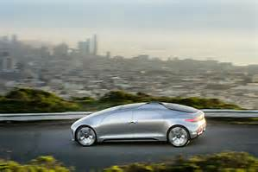
10 MILLION SELF-DRIVING CARS WILL BE ON THE ROAD BY 2020.

Slide 15
IN THE WORLD THERE ARE OVER 1.55 BILLION FACEBOOK USERS. 1.75 MILLION USERS CONNECTED EACH MOMENT 350 MILLION PHOTOS UPLOADED PER DAY

Slide 16
1 OUT OF 6 COUPLES MARRIED LAST YEAR MET ON LINE 1 IN 5 DIVORCES WERE BLAMED ON FACEBOOK -

Slide 17
E-REPUTATION
OUR YOUTH’S NEW WORST ENEMIES

Slide 18
THE RISE OF
SO
LO
MO
SOCIALL
LOCATION
MOBILEE

Slide 19
THE AGE OF IMAGES

Slide 20
DAILY
22 MILLION HOURS OF TV SHOWS AND MOVIES WATCHED
+ 54 MILLION HOURS OF MUSIC STREAMED
1 PETABYTE PLUS OF GAME CONTENT PROCESSED

Slide 21
8.000.000.000.000.000.000.000.000+ 8 ZETABYTES OF UNIQUE NEW DATA CREATED WORLD WIDE IN 2015
THE AGE OF BIG DATA

Slide 22
THAT IS MORE THAN THE PREVIOUS 5,000 YEARS

Slide 23
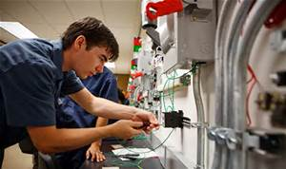
THE AMOUNT OF TECHNICAL INFORMATION IS DOUBLING EVERY TWO YEARS THIS MEANS THAT FOR STUDENTS STARTING A FOUR YEAR TECHNICAL DEGREE….

Slide 24
HALF OF WHAT THEY LEARN IN THEIR FIRST YEAR OF STUDY WILL BE OUTDATED BY THEIR 3RD YEAR OF STUDY.

Slide 25
PREDICTIONS ARE DIFFICULT IN OUR MODERN WORLD BUT…. IT IS PREDICTED THAT BY 2049 1,000 COMPUTERS WILL EXCEED THE COMPUTATION ABILITIES OF THE ENTIRE HUMAN RACE.

Slide 26
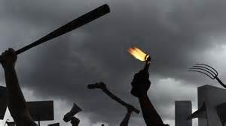
POLITICAL INSTABILITY
YOUTH OF TODAY WILL LIVE IN A WORLD CHARACTERIZED BY POLICIAL INSTABILITY AND INCREASING FOCUS ON SAFETY AT ALL LEVELS.
AS FUTURE LEADERS THEY WILL NEED TO NAVIGATE THIS INSTABILITY AND FIND SOLUTIONS

Slide 27
GLOBAL ECONOMICS
LINES WILL CONTINUE TO BLUR BETWEEN NATIONAL AND GLOBAL ECONOMICS.
MULTINATIONAL COMPANIES HAVE THE WORLD TO CHOOSE FROM FOR A LABOUR FORCE.
MEDICAL TECHNOLOGIES WILL BE A DRIVING FORCE

Slide 28
ECONOMICS: PREDICTED GLOBAL OPPORTUNITIES
GREEN INDUSTRY
ALTERNATE ENERGY
VOICE OVER INTERNET PROTOCOL SOCIAL CONSTRUCTION
BIO-TECHNOLOGIES
E-COMMERCE
SOCIAL NETWORK GAME DEVELOPMENT
HEALTH
EDUCATION

Slide 29
FUTURISTS: PREDICTIONS OF TOP 10 ESSENTIAL SKILLS FOR SUCCESS
THEY WILL NEED TO KNOW HOW TO CREATE NEW WORLDS
THEY WILL NEED TO THINK HOLISTICALLY
THEY WILL NEED TO RESPOND TO CHANGE MENTALLY AND PHYSICALLY

Slide 30
THEY WILL TURN INFORMATION INTO MATTER AND CREATE PROTOTYPES ON THE FLY
THEY WILL HAVE TO BE ABLE TO KNOW HOW TO WORK WITHOUT DIRECT LEADERSHIP IN TIGHT TEMPORARY ORGANIZATIONS
LONG-TERM SECURE EMPLOYMENT FOUND IN EMPLOYEE-OWNED COMPANIES.

Slide 31
Future skills will relate to mind-machine interfaces. They will all be data analysts. The ability to tell a good story will be valued over spreadsheets, graphs, and data points. SOUND COMMUNICATION AND SOCIAL SKILLS WILL BE A LOST ART AND THOSE WHO HAVE THEM WILL BE VALUED AS LEADERS.

Slide 32
STEWARDS OF THE ENVIRONMENT
INCREASING POPUALTION: ENVIRONMENTAL PRESSURE
SEVERE WEATHER;
THE UPCOMING GENERATION WILL NEED TO FIND SOLUTIONS
CULTURE OF CONSUMING EXAMINED; TECHNOLOGY AND INNOVATION USED TO FIND SOLUTIONS TO WASTE

Slide 33
GLOBAL MULTI-CULTURALISM
THERE WILL BE A TENSION BETWEEN INCREASING GLOBAL MULTI-CULTURALISM AND PROMOTION OF NATIONALISM GROUNDED IN FEAR OF SAFETY.

Slide 34
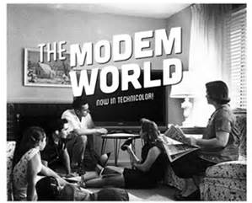
NOW YOU KNOW

Slide 35
Contemporary World
The

Slide 36
2016
TOWN HALL
Lethbridge School District No. 51

